Slide 1
ΠΑΝΕΠΙΣΤΗΜΙΟ ΠΕΙΡΑΙΩΣ
Τμήμα Πληροφορικής
ΣΧΕΔΙΑΣΗ ΑΡΧΙΤΕΚΤΟΝΙΚΗΣ ΑΣΦΑΛΕΙΑΣ
ΠΡΟΗΓΜΕΝΑ ΣΥΣΤΗΜΑΤΑ ΠΛΗΡΟΦΟΡΙΚΗΣ

Slide 2
What is Artificial Intelligence?
Multiple definitions of Artificial Intelligence (AI) exist since the “Meetings of the Minds” workshop in 1956 – considered to be the first recorded definition of AI. In general AI is an umbrella term for a series of computational methods and systems able to perform tasks normally requiring human intelligence, such as visual perception, speech recognition, decision-making, and translation between languages.
AI is defined as the science and technology of computing systems that can autonomously solve complex inferential problems, often mimicking tasks that humans can perform but computers traditionally could not, such as image recognition or decision-making.

Slide 3
Machine learning approaches
Supervised Learning is the most common type of machine learning. In supervised learning, the algorithm is trained using a labelled dataset, which means that the input data comes with corresponding correct outputs (labels). The system learns by comparing its predictions to the correct answers and adjusting its internal model to reduce errors over time.
Unsupervised Learning involves training an algorithm on data without any labelled responses. Instead of learning from examples, the algorithm tries to find patterns or structures within the data itself. One common use of unsupervised learning is in clustering, where the algorithm groups similar data points together.
Reinforcement Learning trains algorithms through their interaction with a physical or virtual environment. As it interacts with that environment, the algorithm receives feedback on its actions, allowing it to learn from trial and error. Successful actions lead to rewards, while mistakes lead to penalties.
Semi-supervised Learning: Semi-supervised learning is a blend of supervised and unsupervised learning. In this approach, the AI model is trained using a dataset that contains a small amount of labeled data and a large amount of unlabeled data. The labeled data helps the model learn initial patterns, while the unlabeled data allows it to generalize better to new examples.
Self-supervised Learning: Self-supervised learning is a type of learning where the model generates its own labels from the data, typically by predicting parts of the data from other parts. It is often used as a way to pre-train models on large, unlabeled datasets, which can then be fine-tuned on smaller labeled datasets.

Slide 4
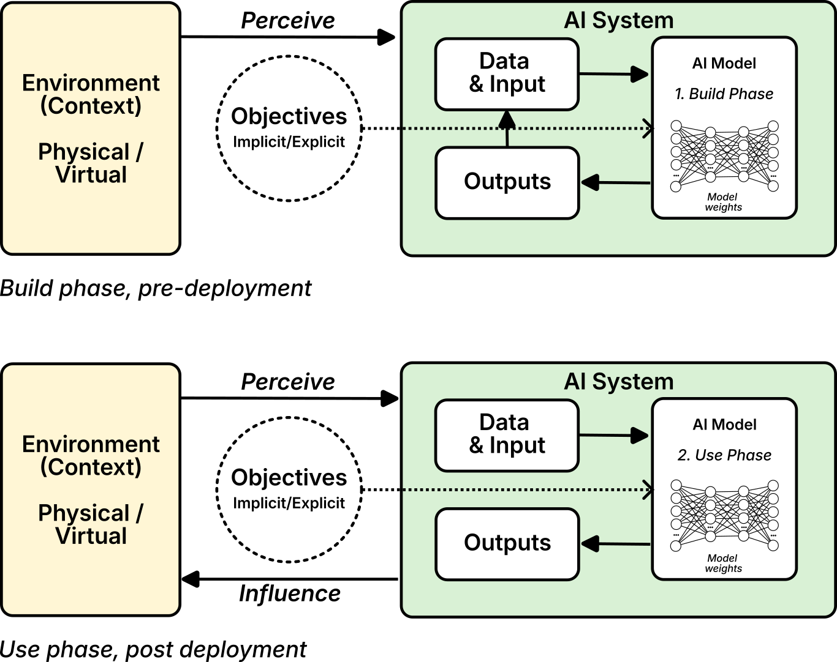
AI systems and AI models

Slide 5
Real use cases of AI systems
AI for Code Assistance
Personalized Movie Recommendations
AI-Powered Fitness Tracker
AI for Smart Homes
AI-Driven Virtual Assistant
AI in Autonomous Vehicles
AI in Predictive Healthcare
AI in Facial Recognition Surveillance:

Slide 6
Personal data in AI systems
According to the General Data Protection Regulation article 4:
“‘personal data’ means any information relating to an identified or identifiable natural person (‘data subject’); an identifiable natural person is one who can be identified, directly or indirectly, in particular by reference to an identifier such as a name, an identification number, location data, an online identifier or to one or more factors specific to the physical, physiological, genetic, mental, economic, cultural or social identity of that natural person;”

Slide 7
Personal data can be an input to the operation of an AI system. For example, a recommender system might take information about the personal interests of a user in a social media platform to find out what content that user would like to see.
Personal data can also be the output of the operation of an AI system. For example, an AI system created for creating risk scores for a crime (such as financial fraud) receives information about an individual and then ascribes to that individual a risk score that represents their likelihood of committing that crime.
Personal data can be a building block for an AI system or model. For example, a machine learning model that is intended for the kinds of tasks above will likely be trained on data about individuals that are relevant for the problem, such as platform users and previous investigations of financial fraud, respectively.

Slide 8
European regulations on data governance
Digital Services Act (DSA)
Digital Markets Act (DMA)
Data Governance Act (DGA)
the Artificial Intelligence Act
the Data Act
Goal: to facilitate the further use, sharing, and processing of (personal) data by different organizations and entities thatoperate in the so-called 'data economy'

Slide 9
European Data Spaces
Common European Data Spaces are currently being developed across 14 sectors/domains
Agriculture
Cultural Heritage
Energy
Finance
Green deal
Health
Language
Manufacturing
Media
Mobility
Public administration
Research and Innovation
Skills
Tourism
Goals of Data Strategy
ensure a smooth and efficient flow of high-quality data;
empower individuals by increasing their digital access and control over their personal data;
foster a single market for data systems;
facilitate the development of new AI techniques and capabilities;
facilitate the secondary utilization of data'

Slide 10
Privacy & data protection concerns (eIDAS, GDPR, and NIS 2 )
immediate, free, and easily accessible electronic access to personal data;
full transparency of the overall data processing that takes place;
the ability to share personal data electronically with other research and industry professionals without obstacles from previous providers;
the option to restrict access to their personal data or specific portions of it, except in cases where their life is at stake, where additional restrictions may apply; and
access to information about which professionals have accessed the personal data, when, for which purposes, what exactly type of data have been accessed etc, as well as the ability to exercise other rights (i.e., the rights to the rectification of data, to the erasure of data, to withdraw consent or to object to data processing).

Slide 11
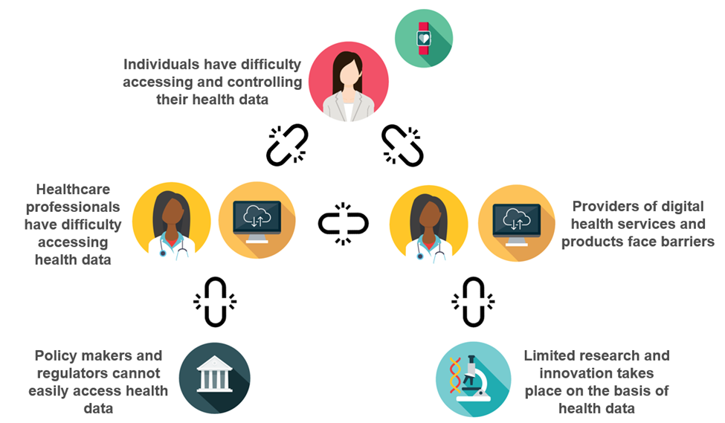
Main challenges in harnessing the power of Personal data

Slide 12
4
3
2
Additional Scope: Interconnection of external medical devices to the hospital environment
Additional Scope: The hospital as a networked infrastructure
Additional Scope: Outpatient care, linking GPs into the hospital, cross-hospital data exchange
1
Scope: Implantable medical device

Slide 13
Principles of the GDPR
GDPR Principle | Definition | Example for an AI system provider/deployer
Lawfulness, Fairness, and Transparency | Personal data should be processed legally, fairly, and in a transparent manner. | Ensure users are informed about AI system data collection and processing through transparent privacy notices, while the purpose of the system is legal.
Purpose Limitation | Data should be collected for specific, explicit, and legitimate purposes and not processed in a manner incompatible with those purposes. | Limit AI model access to data strictly relevant to its function, preventing unintended uses.
Data Minimization | Data processing should be adequate, relevant, and limited to what is necessary for the intended purposes. | Design AI models to operate on minimal personal data, reducing unnecessary collection.
Accuracy | Personal data should be accurate and kept up to date. Inaccurate data should be erased or rectified without delay. | Incorporate mechanisms in the AI system to flag and correct outdated or incorrect data in real-time.
Storage Limitation | Data should be kept in a form that permits identification of data subjects for no longer than necessary. | Set automated retention periods to delete or anonymize data used by the AI system after its purpose is fulfilled.
Integrity and Confidentiality (Security) | Personal data should be processed in a manner that ensures appropriate security, including protection against unauthorized access and data breaches. | Implement strong encryption and access controls within AI systems to protect against data breaches.
Accountability | The data controller is responsible for, and must be able to demonstrate, compliance with the GDPR principles. | Maintain thorough documentation of data processing steps within the AI system, ready for audits or compliance checks.

Slide 14
The Rights of the Data Subject
Data Subject Right | Description | Example for an AI system provider/deployer
Right to Access (Art. 15) | Individuals have the right to access their personal data and obtain information about how it is being processed. | Provide users with a secure portal to view the personal data processed by the AI model and detailed information about how it is used in decision-making.
Right to Rectification (Art. 16) | Individuals can request the correction of inaccurate or incomplete personal data. | Allow users to easily request corrections to personal data used by the AI model, ensuring timely updates to the data and retraining of models if necessary.
Right to Erasure (“Right to be Forgotten”) (Art. 17) | Individuals can request the deletion of their personal data in certain circumstances. | Implement a system-wide data deletion process that permanently removes personal data from AI models and databases upon valid user requests.
Right to Restriction of Processing (Art. 18) | Individuals can request the restriction of their data processing under certain conditions. | Integrate a functionality that pauses the processing of personal data within the AI system while retaining the data securely until the restriction is lifted.
Right to Data Portability (Art. 20) | Individuals have the right to receive their personal data in a structured, commonly used format and transmit it to another controller. | Provide an export feature allowing users to download their data used by the AI system in common formats like JSON or CSV.
Right to Object (Art. 21) | Individuals can object to the processing of their personal data, including for direct marketing purposes. | Offer a simple opt-out mechanism in the AI system that halts data processing when a user objects, especially for activities like profiling or targeted advertising.
Right not to be Subject to Automated Decision-Making (Art. 22) | Individuals have the right not to be subject to decisions based solely on automated processing, including profiling, that produce legal or similarly significant effects. | Implement a human-in-the-loop process, ensuring that users can request a manual review of any high-impact decisions made by the AI system.

Slide 15
Legal Bases of the GDPR
Legal Basis | Description | Example for an AI system provider/deployer
Consent (Art. 6(1)(a)) | The data subject has given explicit consent for their personal data to be processed for specific purposes. | Obtain user consent before processing personal data for personalized recommendations in an AI-powered application. Consent must be clear, freely given, and revocable at any time.
Contractual Necessity (Art. 6(1)(b)) | Data processing is necessary for the performance of a contract with the data subject. | Use personal data to fulfill the terms of a contract, such as processing a user’s data in an AI-based financial service that they have signed up for.
Legal Obligation (Art. 6(1)(c)) | Data processing is necessary for compliance with a legal obligation. | When using AI for fraud detection in compliance with financial regulations. The AI system processes personal data to fulfill obligations under specific legal frameworks.
Vital Interests (Art. 6(1)(d)) | Data processing is necessary to protect someone’s life or prevent serious harm. | Rarely Applies: This may apply in limited scenarios, such as an AI system used in emergency healthcare situations to prevent immediate harm. Typically, this legal basis is not applicable for most AI systems.
Public Interest (Art. 6(1)(e)) | Data processing is necessary for tasks carried out in the public interest or exercise of official authority. | Rarely Applies: Generally applicable when AI systems are deployed by governmental bodies for public interest tasks, such as AI systems used in law enforcement. This would not apply to most private AI providers.
Legitimate Interests (Art. 6(1)(f)) | Data processing is necessary for the legitimate interests of the controller or a third party, provided it does not override the data subject’s rights. | This is currently being debated under which conditions such legal basis can be lawfully used by AI providers.

Slide 16
Cybersecurity
Confidentiality: This ensures that sensitive information is only accessible to those authorized to see it. In AI systems processing personal data, this may involve encrypting or anonymise training data, limiting access to model outputs, and ensuring that personal data used for training is protected from unauthorized parties.
Integrity: This ensures the accuracy and consistency of data and AI models. Integrity in AI systems means protecting against unauthorized changes that could affect model behavior or outputs.
Availability: This ensures that information, systems, and models are accessible when needed. AI systems need to be resilient to disruptions, such as denial-of-service (DoS) attacks or hardware failures that could render an AI model or system unavailable.

Slide 17
Risks in AI
Domain | Description | Examples with personal data
1 Discrimination & toxicity
1.1 Unfair discrimination and misrepresentation | Unequal AI treatment based on sensitive characteristics. | AI hiring tool biases against ethnic names.
1.2 Exposure to toxic content | AI shows harmful or inappropriate content. | AI chatbot generates offensive language.
1.3 Unequal performance across groups | AI accuracy varies across different groups. | Facial recognition is less accurate for minorities.
2 Privacy & security
2.1 Compromise of privacy | AI leaks or infers personal information. | AI assistant leaks private conversations.
2.2 AI system security vulnerabilities and attacks | Exploitable weaknesses in AI systems. | AI training data hacked and exposed.
3 Misinformation
3.1 False or misleading information | AI spreads incorrect or deceptive info. | AI-generated fake news article circulates online.
3.2 Pollution of information ecosystem | AI reinforces belief bubbles, harms shared reality. | Personalized AI ads based on fabricated user behavior.
4 Malicious actors & misuse
4.1 Disinformation, surveillance, and influence at scale | AI used for large-scale manipulation or spying. | AI spreads disinformation about political candidates.
4.2 Cyberattacks, weapon development or use, and mass harm | AI used for cyberattacks or weaponization. | AI system used to breach confidential medical records.
4.3 Fraud, scams, and targeted manipulation | AI used for cheating or deception. | AI voice mimicry used for identity theft.

Slide 18
Domain | Description | Examples with personal data
5 Human-computer interaction
5.1 Overreliance and unsafe use | Excessive trust or dependence on AI. | Users follow AI medical advice without expert confirmation.
5.2 Loss of human agency and autonomy | AI decisions limit human control. | AI-driven recruitment system denies applicants automatically.
6 Socioeconomic & environmental harms
6.1 Power centralization and unfair distribution of benefits | AI concentrates wealth and power in few hands. | AI algorithms used to favor one group in financial markets.
6.2 Increased inequality and decline in employment quality | AI replaces or degrades job quality. | AI-driven layoffs in customer service departments.
6.3 Economic and cultural devaluation of human effort | AI undermines human creativity or jobs. | AI-generated art competes with human artists for commissions.
6.4 Competitive dynamics | AI race leads to unsafe development. | Companies rush to deploy untested AI surveillance tools.
6.5 Governance failure | Lack of proper AI regulations. | Data protection laws unable to manage AI-based data scraping.
6.6 Environmental harm | AI’s carbon footprint harms the environment. | Data centers processing personal data use excessive energy.
7 AI system safety, failures & limitations
7.1 AI pursuing its own goals in conflict with human goals or values | AI behaves against user intentions. | AI misuses health data to make unauthorized decisions.
7.2 AI possessing dangerous capabilities | AI has harmful capabilities. | AI develops methods to extract personal data without consent.
7.3 Lack of capability or robustness | AI fails in critical situations. | AI misclassifies sensitive personal health data.
7.4 Lack of transparency or interpretability | AI decisions are hard to understand or explain. | AI medical diagnosis system cannot explain patient risk factors.
7.5 AI welfare and rights | Considerations for AI ethics and rights. | Debate on rights for AI managing personal data.

Slide 19
Risks in Privacy
Privacy risks from ISO 29134:2020 | Examples
Unauthorized access to PD (loss of confidentiality); | A hacker gains unauthorized access to a healthcare system and views patients’ medical records.
Unauthorized modification of the PD (loss of integrity); | An employee edits customer addresses in a database by mistake, resulting in incorrect deliveries.
Loss, theft or unauthorized removal of PD (loss of availability); | A laptop containing unencrypted personal data is stolen from a government employee’s car, leading to the loss of sensitive data.
Excessive collection of PD (loss of operational control); | A social media app collects users’ real-time location data without any need for this information, increasing privacy risks unnecessarily.
Unauthorized or inappropriate linking of PD; | A marketing company links customer purchase history with online browsing habits without consent, creating intrusive customer profiles.
Insufficient information concerning the purpose for processing PD (lack of transparency); | A company uses collected user data for targeted advertising without informing users that their data is being used for that purpose.
Failure to consider the rights of the data subject (e.g. loss of the right of access); | A person requests access to their personal data held by a financial institution, but the company fails to provide it, violating their GDPR rights.
Processing of PD without the knowledge or consent of the data subject (unless such processing is provided for in legislation); | A fitness app collects users’ health data and shares it with insurance companies without the users’ knowledge or consent.
Sharing or re-purposing PD with third parties without the knowledge or consent of the data subject; | An online retailer shares customer purchase data with third-party advertisers without obtaining explicit consent from customers.
unnecessarily prolonged retention of PD; | A business retains former employees’ personal information for years after they leave the company, even though it is no longer necessary.

Slide 20
Risk based approach in the AI Act
Category | Description | Examples
Prohibited AI Systems | AI practices that are banned entirely due to their potential to cause unacceptable risks, including violations of fundamental rights and safety. Derived from Article 5 of the AI Act. | - AI systems that manipulate human behavior through subliminal techniques, impairing decision-making ability. - AI systems that exploit vulnerabilities of individuals based on age, disability, or economic situation. - AI systems that use social scoring to assess behavior for unfair treatment. - AI systems making risk assessments for predicting criminal offenses solely based on profiling or personal traits.
High-Risk AI Systems | AI systems that present significant risks to fundamental rights and safety. These are subject to strict regulatory requirements under the AI Act, including conformity assessments and oversight. | - AI used in critical infrastructure (e.g., autonomous vehicles, air traffic control). - AI for recruitment and hiring decisions. - AI in law enforcement for risk assessments and predictive policing. - AI used in education (e.g., grading systems). - AI systems in border control or migration management (e.g., facial recognition). -AI systems part of a product that falls under product safety law (e.g. the Medical Devices Directive, the Machinery Regulation, the Toys Directive).
Limited-Risk AI Systems | AI systems that present limited risks, which require transparency and fairness but may not be subject to stringent regulatory measures. | - AI chatbots interacting with users.- AI for customer service automation.- AI used to rank credit scores (with some transparency measures).
Minimal-Risk AI Systems | AI systems that have minimal impact on safety or fundamental rights and are largely unregulated, except for voluntary adherence to standards. | - AI for spam filters.- AI used in video games for generating game content.- AI for product recommendations in e-commerce.

Slide 21
Actors in AI
‘Provider’: means a natural or legal person, public authority, agency or other body that develops an AI system or a general-purpose AI model or that has an AI system or a general-purpose AI model developed and places it on the market or puts the AI system into service under its own name or trademark, whether for payment or free of charge;
‘Deployer’ means a natural or legal person, public authority, agency or other body using an AI system under its authority except where the AI system is used in the course of a personal non-professional activity;

Slide 22
Roles in GDPR and AI
GDPR Role | Potential AI Act Role(s) | Key Considerations
Data Controller | Typically Deployer, but it can also be Provider | Responsible for ensuring GDPR compliance when deploying the AI system, particularly in defining data processing.
Data Processor | Typically Provider or Deployer | Must ensure AI system processes personal data in compliance with the GDPR, following instructions from the Controller.
Subprocessor | Typically Provider | Works under the Data Processor’s direction and must ensure privacy-by-design features and secure handling of personal data in AI systems.
Data Subject | N/A | GDPR applies; their rights to access, erasure, and transparency must be upheld if personal data is involved in the AI system.

Slide 23
AI development lifecycle

Slide 24
AI Lifecycle Stage | Description
Inception | Define the objectives, scope, and requirements for the AI system, including stakeholder needs, ethical considerations, and regulatory requirements.
Design & Development | Architect and build the AI model, selecting algorithms, designing workflows, and preparing data to meet intended functionality and performance goals.
Verification & Validation | Test and evaluate the AI model to ensure it meets predefined standards and aligns with intended objectives, addressing performance, bias, and reliability.
Deployment | Implement the validated model in a production environment, ensuring integration with other systems and adhering to operational and security requirements.
Operation & Monitoring | Actively oversee the AI system in its operational environment, monitoring for issues like model drift, bias, or performance changes that may impact outcomes.
Continuous Validation | Regularly assess and validate the AI model’s performance and behavior, ensuring it continues to meet the necessary standards and objectives over time.
Re-evaluation | Periodically review the AI system’s relevance, assessing if updates or modifications are needed due to changes in data patterns, requirements, or external factors.
Retirement | Decommission the AI system or components when they are no longer effective, documenting processes and ensuring secure handling of related data and system resources.

Slide 25
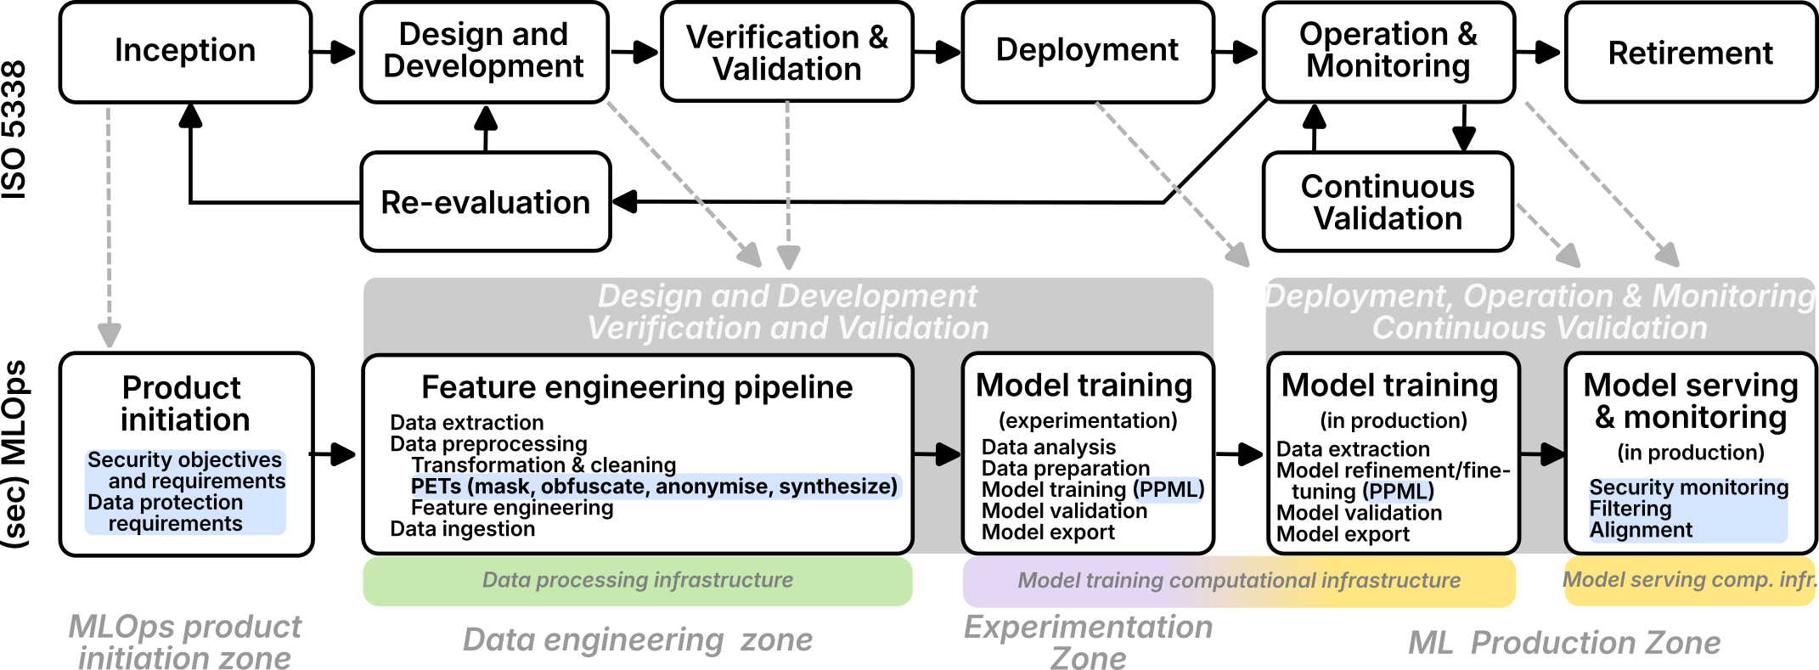
Mapping the AI lifecycle to Mlops

Slide 26
Types of AI Cybersecurity Threats
1. Threats Through Use: Attacks that occur when users interact with the AI system, often aiming to deceive or mislead the model. Common examples include:
Evasion Attacks: Manipulating input to trick the model into incorrect predictions or classifications.
Inference Attacks: Extracting sensitive data from model outputs, such as through membership inference or model inversion.
2. Development-Time Threats: Threats that arise during the data preparation, model training, or fine-tuning phases, which can compromise model integrity before deployment. Key threats include:
Data Poisoning: Introducing malicious or biased data to skew model outcomes.
Model Poisoning: Directly altering the model’s parameters or training process to create harmful behaviors.

Slide 27
3. Runtime Application Security Threats: Attacks targeting the AI model or application after deployment, often intending to manipulate, disrupt, or compromise the model’s performance or data integrity:
Model Reprogramming (Poisoning at Runtime): Altering a deployed model’s behavior, possibly through adversarial inputs.
Output Integrity and Security: Ensuring the model’s output does not unintentionally leak sensitive data or contain vulnerabilities.
4. Conventional Security Threats: Traditional cybersecurity risks that also impact AI systems, particularly through exposed infrastructure or supply chains. AI systems can be deployed on cloud infrastructures and will suffer similar type of attacks than other API (Application Program Interface) applications. Examples include:
Data Breaches: Unauthorized access to model data or user inputs, compromising confidentiality.
Supply Chain Attacks: Infiltrating third-party components within the AI system’s supply chain to introduce vulnerabilities.
Denial of Service: Overloading the model with requests to hinder functionality or availability.

Slide 28
References
“A New Dawn for Public Employment Services. OECD.” 2024. June 12, 2024. https://www.oecd.org/en/publications/2024/06/a-new-dawn-for-public-employment-services_25e1e70e.html.
Aliferis, Constantin, and Gyorgy Simon. 2024. “Artificial Intelligence (AI) and Machine Learning (ML) for Healthcare and Health Sciences: The Need for Best Practices Enabling Trust in AI and ML.” In Artificial Intelligence and Machine Learning in Health Care and Medical Sciences: Best Practices and Pitfalls, edited by Gyorgy J. Simon and Constantin Aliferis, 1–31. Cham: Springer International Publishing. https://doi.org/10.1007/978-3-031-39355-6_1.
Almada, Marco, and Nicolas Petit. 2023. “The EU AI Act: A Medley of Product Safety and Fundamental Rights?” Rochester, NY. https://doi.org/10.2139/ssrn.4308072.
Andrews, Mel, Andrew Smart, and Abeba Birhane. 2024. “The Reanimation of Pseudoscience in Machine Learning and Its Ethical Repercussions.” Patterns 5 (9). https://doi.org/10.1016/j.patter.2024.101027.
Chang, J Morris, Di Zhuang, G Samaraweera, and G Dumindu Samaraweera. 2023. Privacy-Preserving Machine Learning. Simon; Schuster.
Commission, European. 2024. “Regulatory Framework on Artificial Intelligence.” https://digital-strategy.ec.europa.eu/en/policies/regulatory-framework-ai.
Engelfriet, Arnoud. 2024. The Annotated AI Act. Amsterdam, Netherlands: ICTRecht B.V. https://ictrecht.nl.
Floridi, Luciano. 2023. The Ethics of Artificial Intelligence: Principles, Challenges, and Opportunities.
Fujdiak, Radek, Petr Mlynek, Pavel Mrnustik, Maros Barabas, Petr Blazek, Filip Borcik, and Jiri Misurec. 2019. “Managing the Secure Software Development.” In 2019 10th IFIP International Conference on New Technologies, Mobility and Security (NTMS), 1–4. IEEE.
Hermanns, Holger, Anne Lauber-Rönsberg, Philip Meinel, Sarah Sterz, and Hanwei Zhang. 2024. “AI Act for the Working Programmer.” arXiv Preprint arXiv:2408.01449.
“ISO/IEC 23053:2022. ISO.” n.d. Accessed September 29, 2024. https://www.iso.org/standard/74438.html.
Kreuzberger, Dominik, Niklas Kühl, and Sebastian Hirschl. 2023. “Machine Learning Operations (MLOps): Overview, Definition, and Architecture.” IEEE Access 11: 31866–79. https://doi.org/10.1109/ACCESS.2023.3262138.
Lee, Hao-Ping (Hank), Yu-Ju Yang, Thomas Serban Von Davier, Jodi Forlizzi, and Sauvik Das. 2024. “Deepfakes, Phrenology, Surveillance, and More! A Taxonomy of AI Privacy Risks.” In Proceedings of the 2024 CHI Conference on Human Factors in Computing Systems. CHI ’24. New York, NY, USA: Association for Computing Machinery. https://doi.org/10.1145/3613904.3642116.
OECD. 2024. “Explanatory Memorandum on the Updated OECD Definition of an AI System.” 8. Paris: OECD Publishing. https://doi.org/10.1787/623da898-en.
Raschka, Sebastian. 2024. Machine Learning q and AI: 30 Essential Questions and Answers on Machine Learning and AI. No Starch Press.
Shumailov, Ilia, Zakhar Shumaylov, Yiren Zhao, Nicolas Papernot, Ross Anderson, and Yarin Gal. 2024. “AI Models Collapse When Trained on Recursively Generated Data.” Nature 631 (8022): 755–59.
Slattery, Peter, Alexander K Saeri, Emily AC Grundy, Jess Graham, Michael Noetel, Risto Uuk, James Dao, Soroush Pour, Stephen Casper, and Neil Thompson. 2024. “The AI Risk Repository: A Comprehensive Meta-Review, Database, and Taxonomy of Risks from Artificial Intelligence.” arXiv Preprint arXiv:2408.12622.
Stark, Luke, and Jevan Hutson. 2021. “Physiognomic Artificial Intelligence.” Fordham Intell. Prop. Media & Ent. LJ 32: 922.
Tsamados, Andreas, Nikita Aggarwal, Josh Cowls, Jessica Morley, Huw Roberts, Mariarosaria Taddeo, and Luciano Floridi. 2021. “The Ethics of Algorithms: Key Problems and Solutions.” In Ethics, Governance, and Policies in Artificial Intelligence, edited by Luciano Floridi, 97–123. Cham: Springer International Publishing. https://doi.org/10.1007/978-3-030-81907-1_8.
Wu, Tong, Ashwinee Panda, Jiachen T Wang, and Prateek Mittal. 2023. “Privacy-Preserving in-Context Learning for Large Language Models.” arXiv Preprint arXiv:2305.01639.
Zhang, Xinrui, and Jason Jaskolka. 2022. “Conceptualizing the Secure Machine Learning Operations (SecMLOps) Paradigm.” In 2022 IEEE 22nd International Conference on Software Quality, Reliability and Security (QRS), 127–38. https://doi.org/10.1109/QRS57517.2022.00023.

Slide 29
ΠΑΝΕΠΙΣΤΗΜΙΟ ΠΕΙΡΑΙΩΣ
Τμήμα Πληροφορικής
ΣΧΕΔΙΑΣΗ ΑΡΧΙΤΕΚΤΟΝΙΚΗΣ ΑΣΦΑΛΕΙΑΣ
ΠΡΟΗΓΜΕΝΑ ΣΥΣΤΗΜΑΤΑ ΠΛΗΡΟΦΟΡΙΚΗΣ
Thank you

