Slide 1
System Architecture
Thanos Karantjias

Slide 2
CyberSANE Components
Deep Web Data
Acquisition
Data
Manipulation
& Analysis
Incident
Analysis
Threat
Intelligence
Threat Intelligence
Detection
DarkNet
LiveNet
Anomaly
Detection
Security
Monitoring
CyberSANE
Core
HybridNet
Privacy Policy Enforcement
Event & Incident
Analysis
PrivacyNet
Homomorphic
Cryptography
ShareNet
Attack & Behaviour Simulation Environment
Anonymization & Encryption
Data Usage
Control
Data Sharing
Agreement Mgmt
Secure
Storage (DPOS)

Slide 3
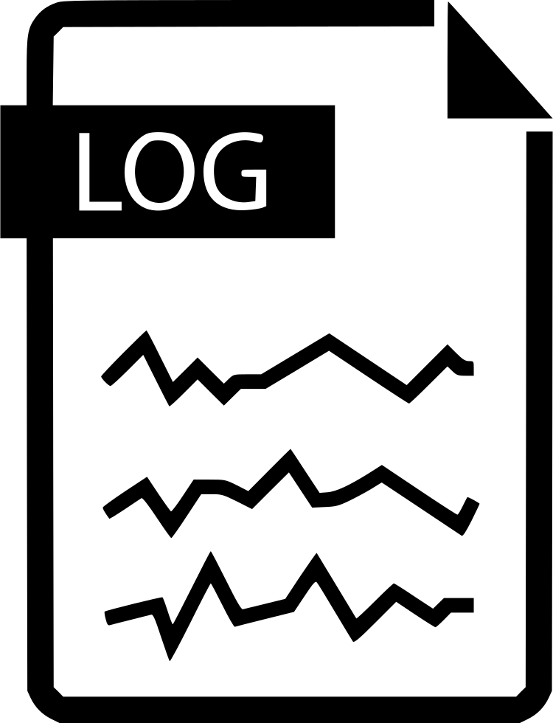
CyberSANE System Architecture
LiveNet
DarkNet
HybridNet
ShareNet
PrivacyNet
CyberSANE
Apps
Core CyberSANE System Building Blocks
CyberSANE
Ecosystem
Built-in Dashboards
Identity Mgmt
Message Queuing
Data Storage
API Mgmt (Adapter)
C3ISP
Customer
CARMEN
CERTCOOP
VPN
Gateway
CHIMERA
CyberSANE
Admin
Main Dashboard
Application Gateway
CyberSANE Services
EventRegistry
Orchestration & API
Buisinnes Application
Policy Enforcment
GLORIA
Vendor /
Supplier
L-ADS
3rd Party Apps
MEDUSA
Infrastructure & SUPPORT Services
Analytics Monitoring
OLISTIC
Logging
Auditing
Caching
Monitoring
Analytics
SiVi Tool
XL-SIEM
-- Virtual Network --
-- Private DNS --
-- Contatiner Registry --
-- Application Server --
Notes:
Application Server
API Management

Slide 4
7
Policy
Enforcement
Caching
Customer
DB
adapter
2
4
1
5
CyberSANE
Admin
Main
Dashboard
3
Identity
Mgmt
Orchestration
& API
DB
adapter
Vendor /
Supplier
Business
Services
Data
Repository
6
8
Service
Registry
9
App
Gateway

Slide 5
Tool 1
4
REST
API
1
REST
API
2
LiveNet
Adapter
Policy
Enforcement
Caching
REST
API
DB
adapter
Msg Brokering
& Queuing
DarkNet
Adapter
7
REST
API
5
HybridNet
Adapter
Main
Dashboard
Identity
Mgmt
6
Orchestration
& API
DB
adapter
REST
API
CyberSANE
Business
Services
Data
Repository
ShareNet
Adapter
Service
Registry
8
REST
API
REST
API
Tool 2
3
3
PrivacyNet
Adapter
9
App
Gateway
CyberSANE
Adapter

