Slide 1
Image Analysis Laboratory
Dionysios Sotiropoulos (PhD)

Slide 2
Contents (1/2)
Basic Image Processing Operations
Overview
Point Operations
Basic Point Operations
Histogram Normalization
Histogram Equalization
Thresholding
Morphing (transforming a circle to an eclipse)
Group Operations
Template Convolution
Averaging Operator
Gaussian Averaging Operator

Slide 3
Contents (2/2)
Low – Level Feature Extraction
First – Order Edge Detection
Basic Operators
Analysis of the basic operators
Roberts edge detection operator
Prewitt edge detection operator
Sobel edge detection operator
Kirsch edge detection
Second – Order Edge Detection
Motivation
Basic operators: the Laplacian
Laplacian of a Gaussian - Marr–Hildreth operator

Slide 4
Overview (1/2)
Main Topic | Sub topics | Main points
Image Description | Portray variation in image brightness as graph/histogram. | Histograms, image contrast.
Point Operations | Calculate new image points as a function of the point at the same place in the original image. The functions can be mathematical, or can be computed from the image itself and will change the image’s histogram. Finally, thresholding turns an image from grey to level to a binary representation. | Histogram manipulation; intensity mapping: inversion, scaling. Intensity normalization; histogram equalization. Thresholding and optimal thresholding.
Group Operations | Calculate new image points as a function of neighborhood of the point at the same place in the original image. The functions can be statistical such as the mean (average). | Template convolution: direct averaging

Slide 5
Overview (2/2)
Main Topic | Sub topics | Main points
First – order Edge detection | What is an edge and how we detect it. The equivalence of operators to first – order differentiation and the insight this brings. | Histograms, image contrast.
Second – order edge detection | Relationship between first- and second – order differencing operations. The basis of a second – order operator. | Second – order differencing; Laplacian, Zero – crossing detection; Laws energy & texture measures.

Slide 6
Histograms (1/3)
Intensity histogram shows how individual brightness levels are occupied in an image;
Image contrast is measured by the range of brightness levels.
Histogram plots the number of pixels with a particular brightness level against the brightness level.
For 8-bit pixels, the brightness ranges from zero (black) to 255 (white).

Slide 7
Histograms (2/3)
MatLab code for histogram construction (Histogram.m):
%Histogram Generation Script.
clear all
% Load an image.
Io = imread('Io.jpg');
figure('Name','Original Image');
imshow(Io);
Io = double(Io);
[width,height,colors] = size(Io);
% Get constituent color matrices corresponding to colors Red, Green and
% Blue.
IoR = Io(:,:,1);
IoG = Io(:,:,2);
IoB = Io(:,:,3);
% Trasform each color matrix to a corresponding vector so that the
% intensity hisograms for each color component may be computed.
IoR = reshape(IoR,1,width*height);
IoG = reshape(IoG,1,width*height);
IoB = reshape(IoB,1,width*height);
% Compute intensity histograms for each color component.
HoR = hist(IoR,[0:1:255]);
HoG = hist(IoG,[0:1:255]);
HoB = hist(IoB,[0:1:255]);
% Plot intensity histograms for each color component.
figure('Name','Original Image Color Histograms')
subplot(3,1,1)
bar(HoR,'r');
xlabel('Red Color Intensity Levels');
ylabel('Number of pixels');
subplot(3,1,2)
bar(HoG,'g');
xlabel('Green Color Intensity Levels');
ylabel('Number of pixels');
subplot(3,1,3)
bar(HoB,'b');
xlabel('Blue Color Intensity Levels');
ylabel('Number of pixels');

Slide 8
Histograms (3/3)
Histogram as a MatLab function (display_histogram.m):
function display_histogram(I,figure_name)
% This function displays the color histogram for each color constituent
% corresponding to the image I.
% The parameter figure_name corresponds to the name of the displayed image.
I = double(I);
[width,height,colors] = size(I);
% Get constituent color matrices corresponding to colors Red, Green and
% Blue.
IR = I(:,:,1);
IG = I(:,:,2);
IB = I(:,:,3);
% Trasform each color matrix to a corresponding vector so that the
% intensity hisograms for each color component may be computed.
IR = reshape(IR,1,width*height);
IG = reshape(IG,1,width*height);
IB = reshape(IB,1,width*height);
% Compute intensity histograms for each color component.
HR = hist(IR,[0:1:255]);
HG = hist(IG,[0:1:255]);
HB = hist(IB,[0:1:255]);
% Plot intensity histograms for each color component.
figure('Name',figure_name)
subplot(3,1,1)
bar(HR,'r');
xlabel('Red Color Intensity Levels');
ylabel('Number of pixels');
subplot(3,1,2)
bar(HG,'g');
xlabel('Green Color Intensity Levels');
ylabel('Number of pixels');
subplot(3,1,3)
bar(HB,'b');
xlabel('Blue Color Intensity Levels');
ylabel('Number of pixels');
end

Slide 9
Point Operations (1/ 25) Basic Point Operations
The most basic operations in image processing where each pixel value is replaced with a new value obtained from the old one.
If we want to increase the brightness to stretch the contrast we can simply multiply all pixel values by a scalar, say by 2 to double the range.
Conversely, to reduce the contrast (though this is not usual) we can divide all point values by a scalar.

Slide 10
Point Operations (2/ 25) Basic Point Operations
If the overall brightness is controlled by a level, l (e.g. the brightness of global light), and the range is controlled by a gain, k, the brightness of the points in a new picture, N, can be related to the brightness in old picture, O, by:
This is a point operator that replaces the brightness at points in the picture according to a linear brightness relation.

Slide 11
Point Operations (3/ 25) Basic Point Operations
The level controls overall brightness and is the minimum value of the output picture.
The gain controls the contrast, or range, and if the gain is greater than unity, the output range will be increased or otherwise decreased.
Image Whitening:
Image Darkening:
Image Inversion:

Slide 12
Point Operations (4/ 25) Basic Point Operations
MatLab code for Image Whitening (ImageWhitening.m):
% Image Whitening Script.
clear all
% Load an image.
Io = imread('Io.jpg');
figure('Name','Original Image');
imshow(Io);
Io = double(Io);
[width,height,colors] = size(Io);
% Brightening the original image.
Iw = double(Io)/255;
% Initialize the gain and level parameters for the whitening operation.
k = 1.06;
l = 0.05;
Iw = k * Iw + l;
% Pixel values mapped to normalized intensity levels grater than 1 will be
% mapped to 1.
over_indices = find(Iw > 1);
Iw(over_indices) = 1;
Iw = uint8(Iw * 255);
figure('Name','Whitened Image');
imshow(Iw);
display_histogram(Io,'Origina Image');
display_histogram(Iw,'Whitened Image');

Slide 13
Point Operations (5/ 25) Basic Point Operations
MatLab code for Image Darkening (ImageDarkening.m):
% Image Darkening Script.
clear all
% Load an image.
Io = imread('Io.jpg');
figure('Name','Original Image');
imshow(Io);
Io = double(Io);
[width,height,colors] = size(Io);
% Brightening the original image.
Id = double(Io)/255;
% Initialize the gain and level parameters for the whitening operation.
k = 0.75;
l = 0.00;
Id = k * Id + l;
% Pixel values mapped to normalized intensity levels grater than 1 will be
% mapped to 1.
% However, this code segment is not necessary for the darkening operation.
over_indices = find(Id > 1);
Id(over_indices) = 1;
Id = uint8(Id * 255);
figure('Name','Whitened Image');
imshow(Id);
display_histogram(Io,'Origina Image');
display_histogram(Id,'Darkened Image');

Slide 14
Point Operations (6/ 25) Basic Point Operations
MatLab code for Image Inversion (ImageInverting.m):
% Image Inverting Script.
clear all
% Load an image.
Io = imread('Io.jpg');
figure('Name','Original Image');
imshow(Io);
Io = double(Io);
[width,height,colors] = size(Io);
% Initialize the gain and level parameters for the whitening operation.
k = -1.00;
l = 1.00;
% Inverting the original image.
Iinv = double(Io) / 255;
Iinv = k * Iinv + l;
Iinv = uint8(Iinv * 255);
figure('Name','Inverted Image');
imshow(Iinv);
display_histogram(Io,'Origina Image');
display_histogram(Iinv,'Inverted Image');

Slide 15
Point Operations (7/ 25) Histogram Normalization
Popular technique to stretch or shrink the range of intensities include histogram (intensity) normalization.
If the original histogram of old picture O starts at Omin and extends up to Omax brightness levels, then we can scale up the image so that the pixels in the new picture N lie between a minimum output level Nmin and a maximum level Nmax, simply by scaling up the input intensity levels according to:

Slide 16
Point Operations (8/ 25) Histogram Normalization
MatLab code for Histogram Normalization (HistogramNormalization.m):
% Histogram Normalization Script.
clear all
% Load an image.
Io = imread('Io.jpg');
figure('Name','Original Image');
imshow(Io);
Io = double(Io);
[width,height,colors] = size(Io);
%Minimum intensity values for the original image per color.
Iomin = min(min(Io));
%Maximum intensity values for the original image per color.
Iomax = max(max(Io));
% Mind that the matrices Iomin and Iomax are 1x1x3 matrices containing the
% minimimum and maximum intensity value respectively for each color
% component.
%Minimum intensity value for each color for the normalized image.
Qmin = 100;
%Maximum intensity value for each color for the normalized image.
Qmax = 150;
% Consturct the normalized image for eacgh color component.
InormR = Io(:,:,1) - Iomin(1);
InormR = ((Qmax - Qmin) / (Iomax(1) - Iomin(1))) * InormR;
InormR = InormR + Qmin;
InormG = Io(:,:,2) - Iomin(2);
InormG = ((Qmax - Qmin) / (Iomax(2) - Iomin(2))) * InormG;
InormG = InormG + Qmin;
InormB = Io(:,:,3) - Iomin(3);
InormB = ((Qmax - Qmin) / (Iomax(3) - Iomin(3))) * InormB;
InormB = InormB + Qmin;
% Combine each color matrix into a sigle image matrix.
Inorm(:,:,1) = InormR;
Inorm(:,:,2) = InormG;
Inorm(:,:,3) = InormB;
Inorm = uint8(Inorm);
figure('Name','Normalized Image');
imshow(Inorm);
display_histogram(Io,'Original Image');
display_histogram(Inorm,'Normalized Image');

Slide 17
Point Operations (9/ 25) Histogram Equalization
A non-linear process aimed to highlight image brightness in a way particularly suited to human visual analysis.
Aims to change a picture in such a way as to produce a picture with a flatter histogram.
Increases the global contrast of many images, especially when the usable data of the image is represented by close contrast values.
Through this adjustment, the intensities can be better distributed on the histogram.
This allows for areas of lower local contrast to gain a higher contrast.
Histogram equalization accomplishes this by effectively spreading out the most frequent intensity values.

Slide 18
Point Operations (10/ 25) Histogram Equalization
Let be a discrete random variable such that .
Let be the probability distribution function (pdf) for the discrete variable X such that
where .
Let be the cumulative distribution function such that .

Slide 19
Point Operations (11/ 25) Histogram Equalization
Histogram equalization provides a mapping f: X → Y to a new random variable such that and .
Let be the pdf for the discrete random variable Y such that .
Let be the cdf for Y such that
Histogram equalization aims at providing a mapping f such that where K is a constant.

Slide 20
Point Operations (12/ 25) Histogram Equalization
This mapping is given by the formula:
Since the function provides values in the [0,1] interval the values of Y must be rescaled in the original range for the X variable such as:

Slide 21
Point Operations (13/ 25) Histogram Equalization
MatLab code demonstrating Histogram Equalization (I).
% The purpose of this script file is to demonstrate the % operation of histogram equalization procedure.
clc
clear all
N = 100000;
X = round(125 + 15.*randn(1,N));
Xmin = min(X);
Xmax = max(X);
Range = Xmax - Xmin;
Hx = hist(X,[Xmin:1:Xmax]);
Hx = Hx / N;
% Compute the cumulative histogram corresponding to Hx.
Cx = cumsum(Hx);

Slide 22
Point Operations (14/ 25) Histogram Equalization
MatLab code demonstrating Histogram Equalization (II).
% We need to construct a mapping objects which relates each integer in the X
% array with the corresponding cumulative frequency value.
% The basic problem which is addressed here through the utilization of the
% MatLab's map objects is the following:
% X: [1..N] ---> [0..n] denotes a given many-to-one mapping.
% Cx: [1..n+1] --> [0..N] denotes the corresponding one-to-many mapping
% providing the cumulative histogram for each element in the [0..n]
% interval.
% Y: [1..N] --> [0..n] denotes am one-to-many mapping given by the
% following function type: for each i in [N], Y[i] = Cx[X[i]].
% Therefore the basic problem is the execution of the following illegal
% code segment Y = Cx(X) since the number of elements in X is greater than
% the number of elements in Cx.
% Therefore, it is necessary to define a mapping between the elements of
% the sets [0..n] and [0..N].
Ckeys = num2cell([Xmin:1:Xmax]);
Cvalues = num2cell(Cx);
FrequencyMap = containers.Map(Ckeys,Cvalues);
CX = num2cell(X);
FCX = values(FrequencyMap,CX);

Slide 23
Point Operations (15/ 25) Histogram Equalization
MatLab code demonstrating Histogram Equalization (III).
Y = Xmin + Range * Y;
Y = round(Y);
Ymin = min(Y);
Ymax = max(Y);
Hy = hist(Y,[Ymin:1:Ymax]);
Hy = Hy / N;
Cy = cumsum(Hy);
% Set X and Y Labels string values.
Xstr = strcat('X Values',' ',' Xmin = ',num2str(Xmin),' Xmax = ',num2str(Xmax));
Ystr = strcat('Y Values',' ',' Ymin = ',num2str(Ymin),' Ymax = ',num2str(Ymax));
figure('Name','Histogram Plots');
subplot(2,2,1)
bar([Xmin:1:Xmax],Hx);
xlabel(Xstr);
ylabel('Relative Frequecies');
grid on
subplot(2,2,2)
bar(Cx,'r');
ylabel('Cumulative Frequecies');
grid on
subplot(2,2,3)
bar([Ymin:1:Ymax],Hy)
xlabel(Ystr);
ylabel('Relative Frequecies');
grid on
subplot(2,2,4)
bar(Cy,'r')
ylabel('Cumulative Frequecies');
grid on

Slide 24
Point Operations (16/ 25) Histogram Equalization
MatLab function histogram_equalized_image.m
function [Ie] = histogram_equalized_image(Io)
% This function return the image Ie with the equalized histogram version of
% the original image Io.
% The original image valued must be converted to double as usual.
Io = double(Io);
% Get the size of the original image.
[width,height,colours] = size(Io);
% Get the constituent color components in separate matrices.
IoR = Io(:,:,1);
IoG = Io(:,:,2);
IoB = Io(:,:,3);
% Reshape colour constituent matrices into vectors so that they are
% appropriately fed into the hist function.
IoR = reshape(IoR,1,width*height);
IoG = reshape(IoG,1,width*height);
IoB = reshape(IoB,1,width*height);
% Get the unique intensity valiues for each colour component.
IoRunique = unique(IoR);
IoGunique = unique(IoG);
IoBunique = unique(IoB);
% Get the histogram vectors for each colour component.
HoR = hist(IoR,IoRunique);
HoG = hist(IoG,IoGunique);
HoB = hist(IoB,IoBunique);
% Get the cumulative probability distribution function for the intensity
% levels of each colour component.
CoR = cumsum(HoR);
CoG = cumsum(HoG);
CoB = cumsum(HoB);

Slide 25
Point Operations (17/ 25) Histogram Equalization
MatLab function histogram_equalized_image.m
% Scale the values of the obtained cumulative histogram in the [0..255]
% range of the new equalized histogram for each colour component.
RangeR = 255;
CoRmin = min(CoR);
CoRmax = max(CoR);
CoR = round((RangeR/(CoRmax-CoRmin))*(CoR-CoRmin));
RangeG = 255;
CoGmin = min(CoG);
CoGmax = max(CoG);
CoG = round((RangeG/(CoGmax-CoGmin))*(CoG-CoGmin));
RangeB = 255;
CoBmin = min(CoB);
CoBmax = max(CoB);
CoB = round((RangeB/(CoBmax-CoBmin))*(CoB-CoBmin));
% Define the mapping f for the red colour intensity values.
CRKeys = num2cell(IoRunique);
CRValues = num2cell(CoR);
RFrequencyMap = containers.Map(CRKeys,CRValues);
% Define the mapping f for the green colour intensity values.
CGKeys = num2cell(IoGunique);
CGValues = num2cell(CoG);
GFrequencyMap = containers.Map(CGKeys,CGValues);
% Define the mapping f for the blue colour intensity values.
CBKeys = num2cell(IoBunique);
CBValues = num2cell(CoB);
BFrequencyMap = containers.Map(CBKeys,CBValues);

Slide 26
Point Operations (18/ 25) Histogram Equalization
MatLab function histogram_equalized_image.m
% Get the corresponding vector for the cumulative frequency values for each
% pixel in the image plane for each colour component.
FIoR = cell2mat(FIoRcell);
FIoG = cell2mat(FIoGcell);
FIoB = cell2mat(FIoBcell);
% Reshape the vector for each colour component to their original dimensions
% in order to obtained the matrix for the equalized image.
IeR = reshape(FIoR,width,height);
IeG = reshape(FIoG,width,height);
IeB = reshape(FIoB,width,height);
% Get the matrix for the new image.
Ie(:,:,1) = IeR;
Ie(:,:,2) = IeG;
Ie(:,:,3) = IeB;
Ie = uint8(Ie);

Slide 27
Point Operations (19/ 25) Thresholding
This operator selects pixels which have a particular value, or are within a specified range.
It can be used to find objects within a picture if their brightness level (or range) is known. This implies that the object’s brightness must be known as well.
Uniform thresholding clearly requires knowledge of the grey level, or the target features might not be selected in the thresholding process.
Uniform Thresholding:

Slide 28
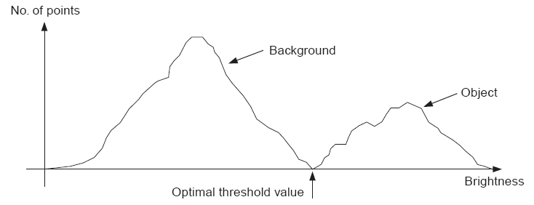
Point Operations (20/ 25) Thresholding
Optimal Thresholding: seeks to select a value for the threshold that separates an object in the foreground from its background.
This suggests that there can be identified two regions of pixels corresponding to the foreground and background areas of the image.
The object must have a different range of intensities to the background, in order that an appropriate threshold can be chosen.

Slide 29
Point Operations (21/ 25) Thresholding
Thresholding is difficult since these ranges usually overlap.
Minimize the error of classifying a background pixel as a foreground one or vice versa.
To do this, try to minimize the area under the histogram for one region that lies on the other region’s side of the threshold.
The problem is that we don’t have the histograms for each region, only the histogram for the combined regions.

Slide 30
Point Operations (22/ 25) Thresholding
Try to make each region / cluster as tight as possible, thus (hopefully!) minimizing their overlap.
Obviously, distributions cannot be changed but the separating threshold can be adjusted
As the threshold is adjusted one way, the spread of one region is increased while the spread of the other is decreased.
The goal then is to select the threshold that minimizes the combined spread given by the following equation:

Slide 31
Point Operations (23/ 25) Thresholding
MatLab code for Optimal Thresholding:
% This script demonstrates the optimal thresholding process.
clc
clear all
Io = imread('I4.jpg');
Io = rgb2gray(Io);
figure('Name','Original Image');
imshow(Io);
Io = double(Io);
display_histogram(Io,'Original Image');
[width,height] = size(Io);
Tmin = 0;
Tmax = 255;
for T = 0:1:255
BackgroundIndices = find(Io<T);
Ibackground = Io(BackgroundIndices);
ForegroundIndices = find(Io>=T);
Iforeground = Io(ForegroundIndices);
Pbackground = hist(Ibackground,[Tmin:1:T-1]);
Pforeground = hist(Iforeground,[T:1:Tmax]);
Nbackground = sum(Pbackground);
Nforeground = sum(Pforeground);
Sbackground = var(Ibackground);
Sforeground = var(Iforeground);
Swithin(T+1) = Nbackground * Sbackground + Nforeground * Sforeground;
end;
[Smin,Tmin] = min(Swithin);
Io = reshape(Io,width,height);
Io = hardlim(-(Io-Tmin));
Io = uint8(255*Io);
figure('Name','Thresholded Image');
imshow(Io);

Slide 32
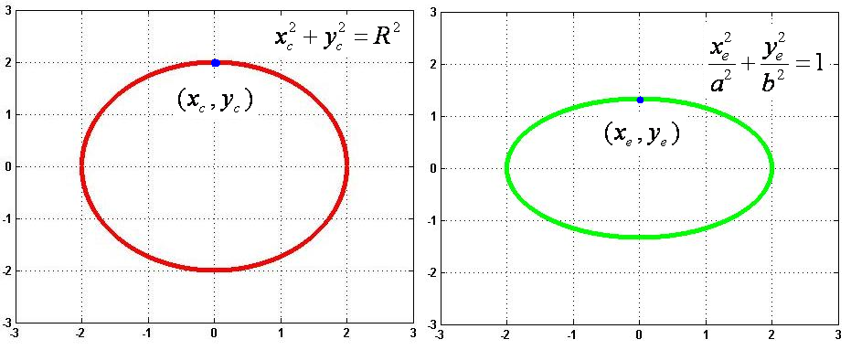
Point Operations (24/ 25) Morphing
Transforming a circle to an eclipse:
for each circle point holds:
for each elipse point holds:
each circle point (Xc,Yc) is mapped to a corresponding eclipse point (Xe,Ye) such that:

Slide 33
Point Operations (25/ 25) Morphing
MatLab code for morphing a circle to an eclipse:
% Set circle radious.
R = 2;
% Set the x step.
dx = 0.0001;
% Set the X interval.
X = [-R:dx:R];
% Set the positive Y interval.
Ypos = sqrt(R^2 - X.^2);
% Set the negative Y interval.
Yneg = -Ypos;
% Set the x-cordinates matrix for the circle.
Xc = [X,X];
% Set the y-coordinates matrix for the circle.
Yc = [Ypos,Yneg];
% Plot the circle.
figure('Name','Circle')
plot(Xc,Yc,'.r','LineWidth',1.3);
axis([-(R+1) (R+1) -(R+1) (R+1)]);
grid on
% Define the ellipse parameters a and b.
a = 2;
b = 3;
% Scale the x and y circle coordinates.
Xe = (R/a)*Xc;
Ye = (R/b)*Yc;
% Plot the ellipse.
figure('Name','Ellipse')
plot(Xe,Ye,'.g','LineWidth',1.3);
axis([-(R+1) (R+1) -(R+1) (R+1)]);
grid on
% Set the translation vector for the x-coordinates of the circle.
DX = Xe - Xc;
% Set the translation vector for the y-coordinates of the circle.
DY = Ye - Yc;
% Set the number of intermediate steps to be ploted.
steps = 25;
% Set the step translation for the x-coordinates of the circle.
dX = DX / steps;
% Set the step translation for the y-coordinates of the circle.
dY = DY / steps;
% Initialize the current x and y circle cooridinates.
Xt = Xc;
Yt = Yc;
figure('Name','Circle to Ellipse')
% Capture the movie of tranlation from circle to ellipse.
for s = 1:1:steps
Xt = Xt + dX;
Yt = Yt + dY;
plot(Xt,Yt,'.k','LineWidth',1.3);
axis([-(R+1) (R+1) -(R+1) (R+1)]);
grid on
F(s) = getframe;
end;
% Play the movie.
movie(F);

Slide 34
Group Operations (1/8) Template Convolution
Group operations calculate new pixel values from pixels’ neighborhoods by using a ‘grouping’ process.
The group operation is usually expressed in terms of template convolution where the template is a set of weighting coefficients.
The template is usually square, and its size is usually odd to ensure that it can be positioned appropriately.
A template of size n is usually described through a kernel matrix.

Slide 35
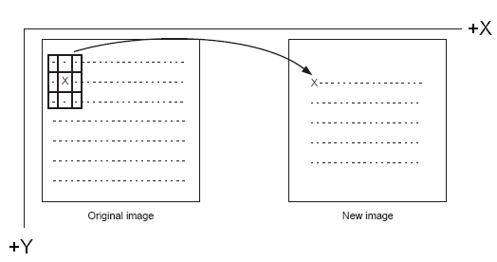
Group Operations (2/8) Template Convolution
New pixel values are calculated by placing the template at the point of interest.
Pixel values are multiplied by the corresponding weighting coefficient and added to an overall sum.
The sum (usually) evaluates a new value for the centre pixel (where the template is centered) and this becomes the pixel in a new output image.
If the template’s position has not yet reached the end of a line, the template is then moved horizontally by one pixel and the process repeats.
For n=3 the new pixel value for an NxN original image is computed as illustrated:

Slide 36
Group Operations (3/8) Template Convolution
Convolution Process:
CONVOLUTION

Slide 37
Group Operations (4/8) Template Convolution
Note that we cannot ascribe values to the picture’s borders.
This is because when we place the template at the border, parts of the template fall outside the image and we have no information from which to calculate the new pixel value.
To calculate values for the border pixels, we now have three choices:
set the border to black (or deliver a smaller picture);
assume (as in Fourier) that the image replicates to infinity along both dimensions and calculate new values by cyclic shift from the far border; or
calculate the pixel value from a smaller area.

Slide 38
Group Operations (5/8) Averaging Operator
An averaging operator corresponds to a kernel matrix of the form:
The averaged image is obtained as follows:
information loss?
inversion?

Slide 39
Group Operations (6/8) Averaging Operator
MatLab code for the averaging operator
% This script demonstrates the image averaging process through the
% utilization of template convolution.
clc
clear all
Io = imread('Io.jpg');
figure('Name','Original Image');
imshow(Io);
display_histogram(Io,'Original Image');
Io = double(Io)/255;
[Rows,Columns,Colours] = size(Io);
IoR = Io(:,:,1);
IoG = Io(:,:,2);
IoB = Io(:,:,3);
n = 10;
n_max = floor((min(Rows,Columns)-1)/2);
if (n <= n_max)
K = ones(2*n+1,2*n+1);
K = K / numel(K);
IavgR = conv2(IoR,K,'same');
IavgG = conv2(IoG,K,'same');
IavgB = conv2(IoB,K,'same');
Iavg(:,:,1) = IavgR;
Iavg(:,:,2) = IavgG;
Iavg(:,:,3) = IavgB;
Iavg = uint8(255*Iavg);
figure('Name','Averaged Image');
imshow(Iavg);
display_histogram(Iavg,'Averaged Image');
else
error('Illegal kernel dimension');
end;

Slide 40
Group Operations (7/8) Gaussian Averaging Operator
The Gaussian averaging operator has been considered to be optimal for image smoothing.
The template for the Gaussian operator has values set by the Gaussian relationship.
The Gaussian kernel K at co-ordinates x, y is controlled by the variance σ² according to:

Slide 41
Group Operations (8/8) Gaussian Averaging Operator
MatLab code for the Gaussian Averaging Operator
% This script demonstrates the image Gaussian averaging process through
% the utilization of template convolution.
clc
clear all
Io = imread('Io.jpg');
figure('Name','Original Image');
imshow(Io);
display_histogram(Io,'Original Image');
Io = double(Io)/255;
[Rows,Columns,Colours] = size(Io);
IoR = Io(:,:,1);
IoG = Io(:,:,2);
IoB = Io(:,:,3);
% Set the kernel size.
n = 1;
% Set the variance parameter for the Gaussian kernel.
sigma = sqrt(1.6);
% Estimate the maximum size for the Kernel.
n_max = floor((min(Rows,Columns)-1)/2);
if (n <= n_max)
% Set the Gaussiam Kernel.
I = [1:1:2*n+1]'*ones(1,2*n+1);
J = I';
K = exp(-(I.^2+J.^2)/(2*sigma*sigma));
IavgR = conv2(IoR,K,'same');
IavgG = conv2(IoG,K,'same');
IavgB = conv2(IoB,K,'same');
Iavg(:,:,1) = IavgR;
Iavg(:,:,2) = IavgG;
Iavg(:,:,3) = IavgB;
Iavg = uint8(255*Iavg);
figure('Name','Averaged Image');
imshow(Iavg);
display_histogram(Iavg,'Averaged Image');
else
error('Illegal kernel dimension');
end;

Slide 42
Low Level Feature Extraction (1/2)
Low – level features may be defined as those basic features that can be extracted automatically from an image without any shape information (information about spatial relationships).
Thresholding is actually a form of low-level feature extraction performed as a point operation.
Naturally, all of these approaches can be used in high-level feature extraction, where in order to find shapes in images.

Slide 43
Low Level Feature Extraction (2/2)
It is well known that we can recognize people from caricaturists’ portraits.
A low-level feature we shall corresponding to the process of edge detection aiming to produce a line drawing, which is akin to a caricaturist’s sketch.
There are very basic techniques and more advanced ones:
first-order detectors are equivalent to first-order differentiation.
second-order edge detection operators are equivalent to a one-higher level of differentiation.

Slide 44
First – Order Edge Detection (1/7) Basic Operators
Many approaches to image interpretation are based on edges, since analysis based on edge detection is insensitive to change in the overall illumination level.
Edge detection highlights image contrast.
Detecting contrast, which is difference in intensity, can emphasize the boundaries of features within an image, since this is where image contrast occurs.

Slide 45
First – Order Edge Detection (2/7) Basic Operators
This is, naturally, how human vision can perceive the perimeter of an object, since the object is of different intensity to its surroundings.
Essentially, the boundary of an object is a step – change in the intensity levels.
The edge is at the position of the step-change.
The edge position can be detected through the utilization of first-order differentiation since this emphasizes change.

Slide 46
First – Order Edge Detection (3/7) Basic Operators
First – order differentiation gives no response when applied to signals that do not change.
The first – order edge detection operators are group operators which aim to deliver an output which approximates the result of first-order differentiation.
A change in intensity can be revealed by differencing adjacent points.
Differencing horizontally adjacent points will detect vertical changes in intensity and is often called a horizontal edge detector by virtue of its action.

Slide 47
First – Order Edge Detection (4/7) Basic Operators
A horizontal operator will not show up horizontal changes in intensity since the difference is zero.
When applied to an image P the action of the horizontal edge detector forms the difference between two horizontally adjacent points, as such detecting the vertical edges, Ex, as:

Slide 48
First – Order Edge Detection (5/7) Basic Operators
In order to detect horizontal edges we need a vertical edge detector which differences vertically adjacent points.
This will determine horizontal intensity changes, but not vertical ones so the vertical edge detector detects the horizontal edges, Ey, according to:

Slide 49
First – Order Edge Detection (6/7) Basic Operators
Combining the two gives an operator E that can detect vertical and horizontal edges together:
This finally yields that:

Slide 50
First – Order Edge Detection (7/7) Basic Operators
Operator E gives the coefficients for a differencing template (kernel) which can be convolved with an image to detect all the edge points such that:
Uniform thresholding is often used to select the brightest points, following application of an edge detection operator.
The threshold level controls the number of selected points
Too high a level can select too few points.
Too low a level can select too much noise.

Slide 51
First – Order Edge Detection Analysis of the Basic Operators (1/5)
Why differencing adjacent points provides an estimate of the first – order derivative at a point?
According to Taylor expansion:
For adjacent points Δx = 1 which corresponds to the Ex operator.

Slide 52
First – Order Edge Detection Analysis of the Basic Operators (2/5)
According to Taylor expansion:
For adjacent points Δy = 1 which corresponds to the Ey operator.

Slide 53
First – Order Edge Detection Analysis of the Basic Operators (3/5)
However, the error can be reduced by spacing the differenced points by one pixel which forms the Exx and Eyy operators:

Slide 54
First – Order Edge Detection Analysis of the Basic Operators (4/5)
This can be once again be analyzed by utilizing the Taylor expansion of f(x-Δx,y) and f(x,y-Δy):

Slide 55
First – Order Edge Detection Analysis of the Basic Operators (5/5)
Exx defines the template for a horizontal edge detection operator which gives the vertical edges detected at its center pixel.
Eyy defines the template for a vertical edge detection operator (this operator is the transpose of M_{x}) which gives the horizontal edges detected at its center pixel.

Slide 56
First – Order Edge Detection (1/6) Roberts Edge Detection Operator
Roberts edge detection operator is a local differential operator which operates on an input image Io(x,y) in order to output an edge image Ie(x,y).
The edge image is given as follows:
ROBERTS

Slide 57
First – Order Edge Detection (2/6) Roberts Edge Detection Operator
The image coordinates in a 2x2 window are of the following form:
Roberts edge detection operator may be defined through the utilization of the following two kernel matrices:

Slide 58
First – Order Edge Detection (3/6) Roberts Edge Detection Operator
Therefore, the Roberts edge detection operator may be expressed in the following matrix notation:

Slide 59
First – Order Edge Detection (4/6) Roberts Edge Detection Operator
The Sobel edge detection operator is defined through the utilization of the following kernel matrices
as:

Slide 60
First – Order Edge Detection (5/6) Prewitt Edge Detection Operator
The Prewitt edge detection operator is defined through the utilization of the following kernel matrices
as:

Slide 61
First – Order Edge Detection (6/6) Kirsch Edge Detection Operator
The Kirsch edge detection operator is defined through the utilization of the following kernel matrices
as:

Slide 62
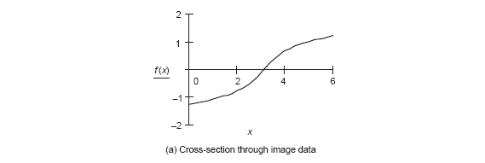
Second – Order Edge Detection Operators (1/6): Motivation
First-order edge detection is based on the premise that differentiation highlights change.
Image intensity f(x) changes in the region of a feature boundary as it is illustrated in figure (a).

Slide 63
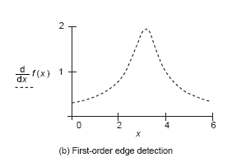
Second – Order Edge Detection Operators (2/6): Motivation
The result of first – order edge detection appears in figure (b) as a peak in the rate of change f’(x) = df / dx of the original signal f(x).

Slide 64
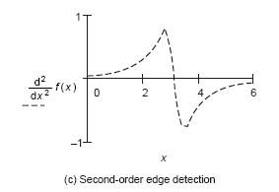
Second – Order Edge Detection Operators (3/6): Motivation
There are higher order derivatives such as the second-order derivative, f ″(x) = d²f / dx² that can be applied to the same cross-section of data as illustrated in figure (c).

Slide 65
Second – Order Edge Detection Operators (4/6): Motivation
f’’(x) is greatest where the rate of change of the signal is greatest and zero when the rate of change is constant.
The rate of change is constant at the peak of the first-order derivative.
This is where there is a zero-crossing (change in sign) in the second-order derivative.
Therefore, an alternative to first-order differentiation is to apply second-order differentiation and then find zero-crossings in the second-order information.

Slide 66
Second – Order Edge Detection Operators (5/6): Motivation
Edge points: peaks of the first derivative.
use of thresholds
detects too many edge points
Equivalently, zero’s of the second derivative.
Combine first and second derivatives.
Locate peak in the first derivative and zero - crossing in the second derivative.

Slide 67
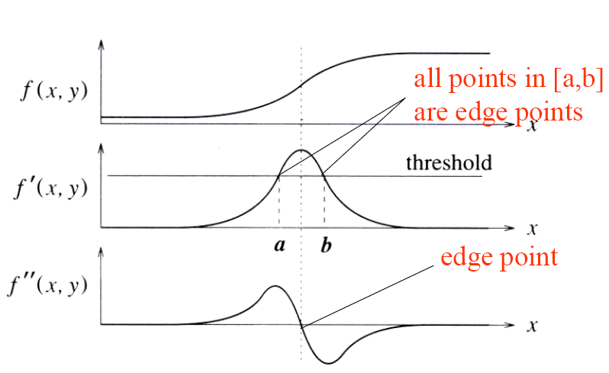
Second – Order Edge Detection Operators (6/6): Motivation
Combination of Derivatives:
smoothing by Gaussian.
presence of zero crossing in second derivative:
large peak in the first derivative:

Slide 68
Second – Order Edge Detection Operators (1/8): Laplacian Operator
The Laplace operator is defined as the dot product (inner product) of two gradient vector operators:

Slide 69
Second – Order Edge Detection Operators (2/8): Laplacian Operator
When applied to f(x,y), this operator produces a scalar function:
In discrete case, the second order differentiation becomes second order difference. In 1D case, if the first order difference is defined as:
the second – order difference will be defined as:

Slide 70
Second – Order Edge Detection Operators (3/8): Laplacian Operator
Note that f’’[n] is so defined that is symmetric to the center element f[n].
The 1D Laplacian operator can be carried out by 1D convolution with a kernel L_{1D} = [1 -2 1]
In 2D case, Laplace operator is the sum of two second order differences in both dimensions:

Slide 71
Second – Order Edge Detection Operators (4/8): Laplacian Operator
This operation can be carried out by 2D convolution kernel:
Other Laplace kernels can be used: (where diagonal elements are taken into consideration)

Slide 72
Second – Order Edge Detection Operators (5/8): Laplacian of a Gaussian
The second derivative responds strongly to noise.
It is desired to filter the noise before edge detection.
The Laplacian of a Gaussian (LoG) or the Marr–Hildreth operator combines Gaussian filtering with Laplacian for edge detection.

Slide 73
Second – Order Edge Detection Operators (6/8): Laplacian of a Gaussian
In principle, we require an image which is the second differential ∇² of a Gaussian operator g(x, y) convolved with an image P.
This convolution process can be separated as:
Accordingly, we need to compute a template for ∇²g(x, y) and convolve this with the image.

Slide 74
Second – Order Edge Detection Operators (7/8): Laplacian of a Gaussian

Slide 75
Second – Order Edge Detection Operators (8/8): Laplacian of a Gaussian

