Slide 1
Editing OWL Ontologies with Protégé

Slide 2
AGENDA
The semantic Web
Introduction to OWL
Editing OWL Ontologies with Protégé OWL Plugin: Theory + Walkthrough
Semantic Information Retrieval using Protégé

Slide 3
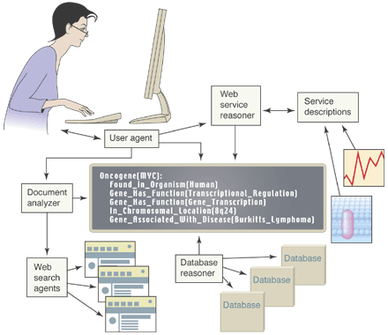
The Semantic Web
Shared ontologies help to exchange data and meaning between web-based services
(Image by Jim Hendler)

Slide 4
The Semantic Web
Since when does it start concerning us?
Semantic Nets:
(1909) Charles S. Peirce proposed "existential graphs" :
a graphical notation of nodes and edges -> «the logic of the future»
(Early ’60s) Allan M.Collins,M. Ross Quillian, Elizabeth F. Loftus:
First concept for the semantic web
Semantic Web is directly linked with the Artificial Intelligence research area, based on knowledge representation rules and assertions.
Semantics of “semantic” . . .
sēmainō , simasía (σημασία) < simasiakós < sēmantikós < semantics =
(ancient greek word)
the study of meaning, important, defining the concept of logical expression
Notes:
Δομημενη αναπαράσταση Γνώσης : κανόνων και δηλώσεων
1^{η} προσέγγιση σημασιολογικής γνώσης: γνωστικός επιστήμονας Άλαν Κόλλινς , γλωσσολόγος M. Ross Quillian και ψυχολόγος Elizabeth F. Loftus – γραφική αναπαράσταση κόμβων και ακμών. κόμβοι: υποδηλώνουν κλάσεις αντικειμένων (classes), αντικείμενα (objects), έννοιες (concepts), τιμές ιδιοτήτων (values)
δεσμοί: υποδηλώνουν σχέσεις (relations) μεταξύ αντικειμένων ή ιδιότητες που συνδέουν αντικείμενα με τιμές.
Richard H. Richens (1956 ) "interlingua" : machine translation of natural languages.

Slide 5
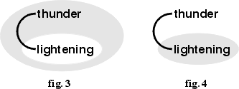
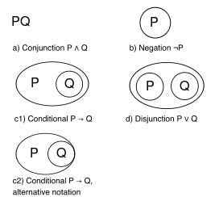
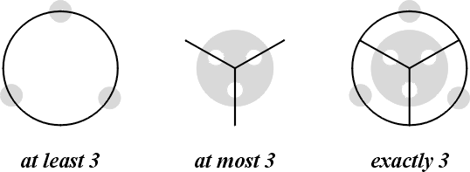
The Semantic Web
Charles Peirce Existential Graphs

Slide 6
The Semantic Web
The Semantic Web : the evolution of the current web!
“Semantic Web is not a separate Web but an extension of the current one, in which information is given well-defined meaning, better enabling computers and people to work in cooperation”
T.B.Lee , Scientific American, May 2001
A World Wide Web Consortium (W3C) initiatiive… http://www.w3.org
Linked Open Data = data published on the Web
connecting to each other with concrete statements, recommending a Web of Data using URI’s and the Resource Description Framework (RDF) standard
T. Berners-Lee, ‘‘Linked Data-The story so far’’
Notes:
Tim Bereners Lee (Επίτιμος Καθηγητής στο Southampton , Ερευνητής στο MIT) (Ιδρυτής του Παγκόσμιου Ιστού –τέλη 1990- και οραματιστής ενός ενιαίου παγκοσμίως Σημασιολογικού Ιστού 1998, Δ/ντης της Κοινοπραξίας World Wide Web Consortium – W3C
Εμπλουτισμός-μετεξέλιξη Παγκόσμιου Ιστού με σημασιολογική πληροφορία: καθίσταται δυνατή η χρήση και επεξεργασία του όχι μόνο από ανθρώπους αλλά και από μηχανές , πράκτορες λογισμικού.
Στόχος: η διευκόλυνση των εργασιών στο Διαδίκτυο = καλύτερη ποιότητα στις υπηρεσίες των επιχειρήσεων, έξυπνες ηλεκτρονικές αγορές, ακριβέστερη αναζήτηση και αποτελέσματα πιο κοντά στις προσδοκίες του χρήστη – μείωση όγκου πληροφορίας, μεγαλύτερη ικανότητα ανάκτησης πληροφορίας
Πώς? Με την αυτοματοποίηση των web λειτουργιών και υπηρεσιών

Slide 7
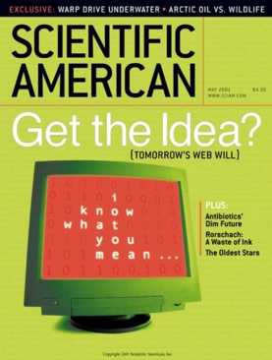
The Semantic Web
A new form of Web content that is meaningful to computers will unleash a revolution of new possibilities
by TIM BERNERS-LEE, JAMES HENDLER and ORA LASSILA
The entertainment system was belting out the Beatles‘
"We Can Work It Out" when the phone rang. When Pete answered, his phone turned the sound down by sending a message to all the other local devices that had a volume control. His sister, Lucy, was on the line from the doctor's office: "Mom needs to see a specialist and then has to have a series of physical therapy sessions. Biweekly or something. I'm going to have my agent set up the appointments." Pete immediately agreed to share the chauffeuring.
At the doctor's office, Lucy instructed her Semantic Web agent through her handheld Web browser. The agent promptly retrieved information about Mom's prescribed treatment from the doctor's agent, looked up several lists of providers, and checked for the ones in-plan for Mom's insurance within a 20-mile radius of her home and with a rating of excellent or very good on trusted rating services. It then began trying to find a match between available appointment times (supplied by the agents of individual providers through their Web sites) and Pete's and Lucy's busy schedules.

Slide 8
The Semantic Web
What’s the point in semantics?
If stored data on the Web could have a formal meaning and generate the appropriate semantics then these kind of data would be machine-readable aiming to automate web applications and services such as
improve the accuracy of search engines (as long as they can deal with complicated questions and bring more direct results)
increase the effectiveness of agents
(e.g. travel agents )
etc…
Semantic technologies
utilize knowledge-based approaches and reasoning techniques to represent a domain of interest and translate it into a machine-processible computational model facilitating accessing and sharing of information
Supporting reusability of information
Achieve interoperability in the information exchange

Slide 9
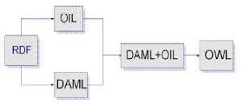
Introduction to OWL
The W3C Web Ontology Language (OWL) is a Semantic Web language designed to represent rich and complex knowledge about things, groups of things, and relations between things.
OWL is a Description Logic language
knowledge expressed in OWL can be exploited by computer programs
e.g., to verify the consistency of that knowledge or to make
implicit knowledge explicit.
OWL documents, known as ontologies, can be published in the World Wide Web and may refer to or be referred from other OWL ontologies.
OWL stores information on ontologies basically in a RDF/XML format
OWL-Full
Web Ontology Language (OWL) OWL-Lite
OWL-DL

Slide 10
Editing OWL Ontologies with Protégé OWL Plugin: Theory
Ontology Definition
“an explicit specification of a conceptualization” (…)
“In terms of Philosophy and Artificial Intelligence theories,
ontology is a systematic account of existence where everything that
exists can be represented”
Tom R.Gruber

Slide 11
Editing OWL Ontologies with Protégé OWL Plugin: Theory
The protégé knowledge Management tool
Stanford University
Developing a semantic ontology
using Protégé – OWL Editor
Following the logical structure of the RDF standard
The RDF triple logical expression
Subject
or Resource
Object
or
property value
Predicate
or property
e.g. The Chairman is responsible for the Supervisor of
Educational Dpt.

Slide 12
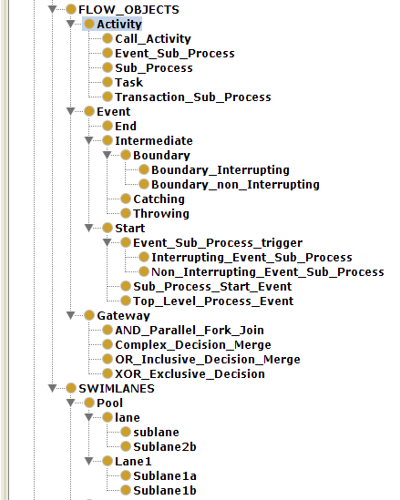
Editing OWL Ontologies with Protégé OWL Plugin: Walkthrough
Owl examples to download:
http://protegewiki.stanford.edu/wiki/Protege_Ontology_Library#OWL_ontologies
A Paper about developing ontologies:
Ontology Development 101: A Guide to Creating Your First Ontology
Authors
Natalya F. Noy and Deborah L. McGuinness
Stanford University
Semantic Ontology Example Overview
Notes:
Constructing a semantic representation of a business process model

Slide 13
Editing OWL Ontologies with Protégé OWL Plugin: Walkthrough
Camelback Notation : In Protégé every class name must begin with a capital letter and should not contain any space
Defining property types
Object Property
Symmetric: If set A is set B then set B is set A
e.g. Greece borders Bulgaria, Sophie has sibling Mark and Mark has sibling Sophie
Assymetric: If set A is set B then set B is set A is not true
e.g. Sophie isChildOf Chris but Chris is not aChildOf Sophie
Inverse: if set A belongs to set B the set B has set A
e.g. Athens is located in Greece and Greece has place Athens
Functional:Functional property has a unique individual
e.g. A person has a unique tax number
Inverse Functional: The inverse property has a unique individual
e.g. The tax number is unique for a person
Transitive: if set A belongs to set B and if set B belongs to set C then set A belongs to set C e.g. Athens belongs to Greece and Greece belongs to Europe so Athens belongs to Europe
Reflexional: set A is set A (something is equal to itself) e.g. Michael knows himself
Irreflexional: set A to set A is not true set A to set B is correct
e.g. Liza cannot be a mother on its own but Liza isMotherOf Alice

Slide 14
Editing OWL Ontologies with Protégé OWL Plugin: Walkthrough
Defining Restrictions:
Quantifier Restrictions existential/universal
Some(at least one) /only one
Cardinality Restrictions
hasValue Restrictions
IntersectionOf A∩B (and)
unionOf A∪B (or)
ComplementOf ¬A (not)
allValuesFrom ∀P.A universal,only
hasValue P.A
someValuesFrom ∃P.A existential,at least one
Value ∃P.{o}
minCardinality ≥n P.A
maxCardinality ≤n P.A
Cardinality =n P.A
A,B:set P:property
Defining Axioms
Inclusion
(subsumption) A ⊆B
A (is included in B)
Symmetric A ≡B
(every A is every B and vice versa)
Disjoint A ¬B
(cannot be A and B at the same time)
A,B:set

Slide 15
Editing OWL Ontologies with Protégé OWL Plugin: Walkthrough
Some hints…
How can I define the same class as subclass in different superclasses in an ontology?
By expanding its domain…adding both superclasses in the “SubclassOf” tab in the “Description” frame of Protégé
If a property is transitive then its inverse property should also be transitive
Note that if a property is transitive then it cannot be functional

Slide 16
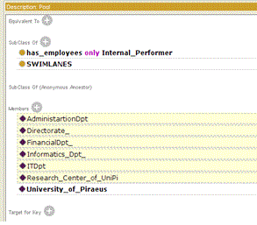
Editing OWL Ontologies with Protégé OWL Plugin: Walkthrough
Disjointness in Protégé Ontology

Slide 17
Editing OWL Ontologies with Protégé OWL Plugin: Theory
Validation of the semantic ontology
We have to visualize the ontology and evaluate the accuracy of taxonomy and ontology consistency using
the OntoGraph tool (Protégé owl/rdf format)
the OWLViz tool (Protégé owl/rdf format)
Pellet Reasoner (Protégé owl/rdf format)
of Protégé
Are there any overlaps, conflicts, or any other logical errors?
Notes:
Τεκμηρίωση: Αξιολόγηση Ακρίβεια ταξινομίας και συνοχή οντολογίας

Slide 18
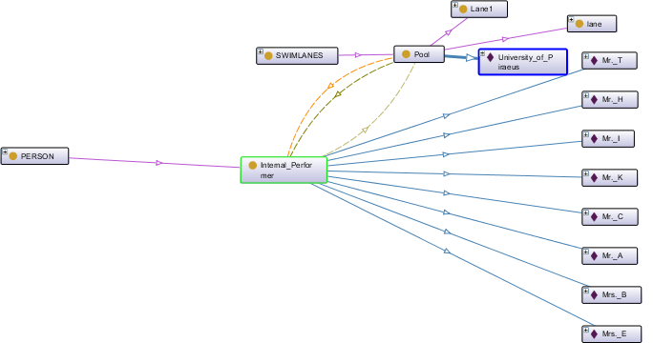
Editing OWL Ontologies with Protégé OWL Plugin: Walkthrough
Visualization of the semantic process model
using the OntoGraph tool of Protégé

Slide 19
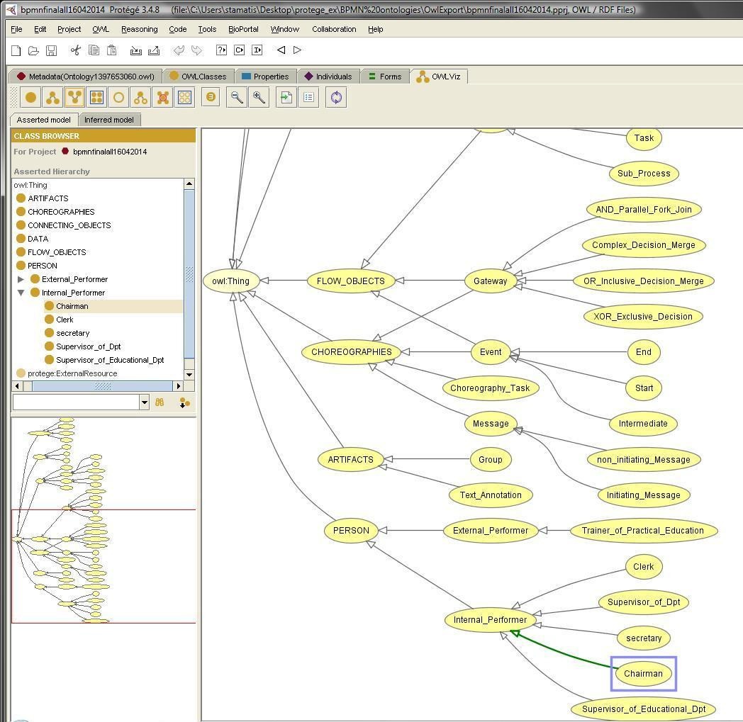
Editing OWL Ontologies with Protégé OWL Plugin: Walkthrough
Validation of the semantic process model
using the OwlViz tool of Protégé

Slide 20
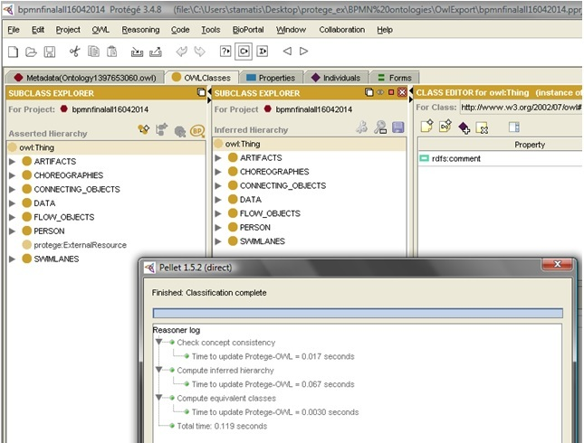
Editing OWL Ontologies with Protégé OWL Plugin: Walkthrough
Evaluation of the ontology
with Pellet Reasoner of Protégé

Slide 21
Semantic Information Retrieval using Protégé
Queuring and extracting results in Protégé
Trainers available to participate in seminar – gateway condition is “yes”
Query results showed that only 12 from 25 informed trainers accepted the invitation

Slide 22
Semantic Information Retrieval using Protégé
Protégé, can provide information retrieval process through simple and complex semantic querying methods using the SPARQL standard
SPARQL is the predominant query language to derive information from the triple statement pattern “subject – predicate – object ” of RDF (a W3C specification).
SPARQL queries
has the general structure SELECT-FROM-WHERE

Slide 23
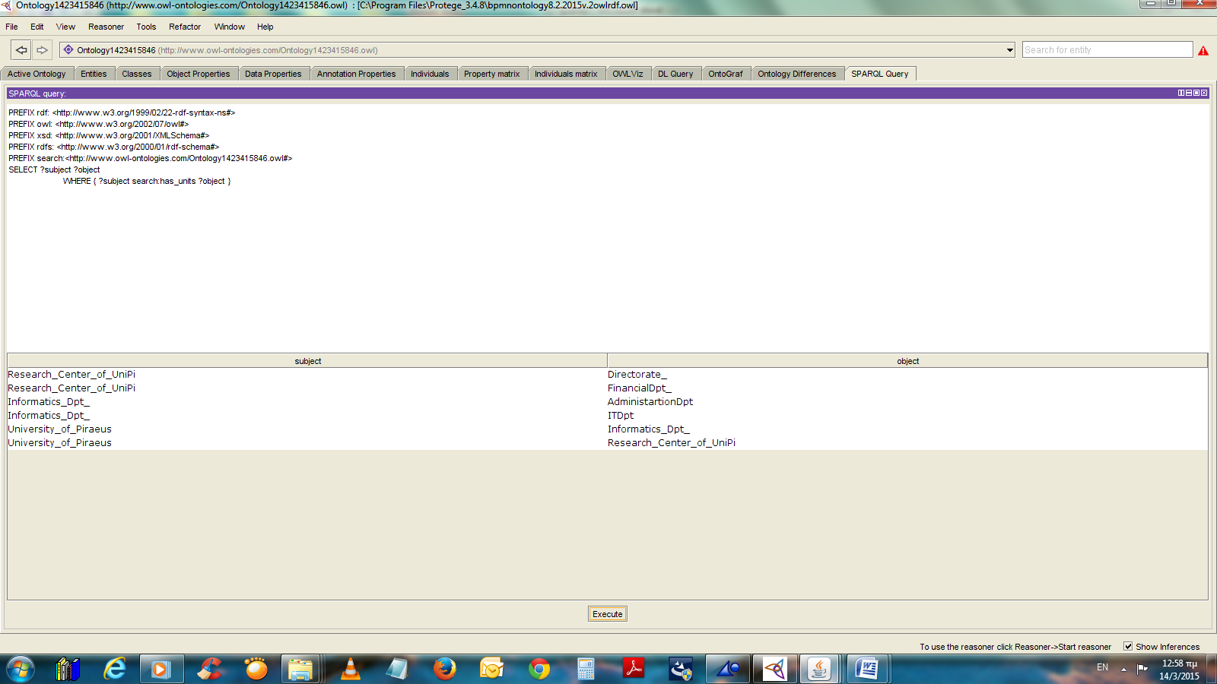
SPARQL Query 1: Give all the business entities and its Dpts/sub-Dpts of the ontology

Slide 24
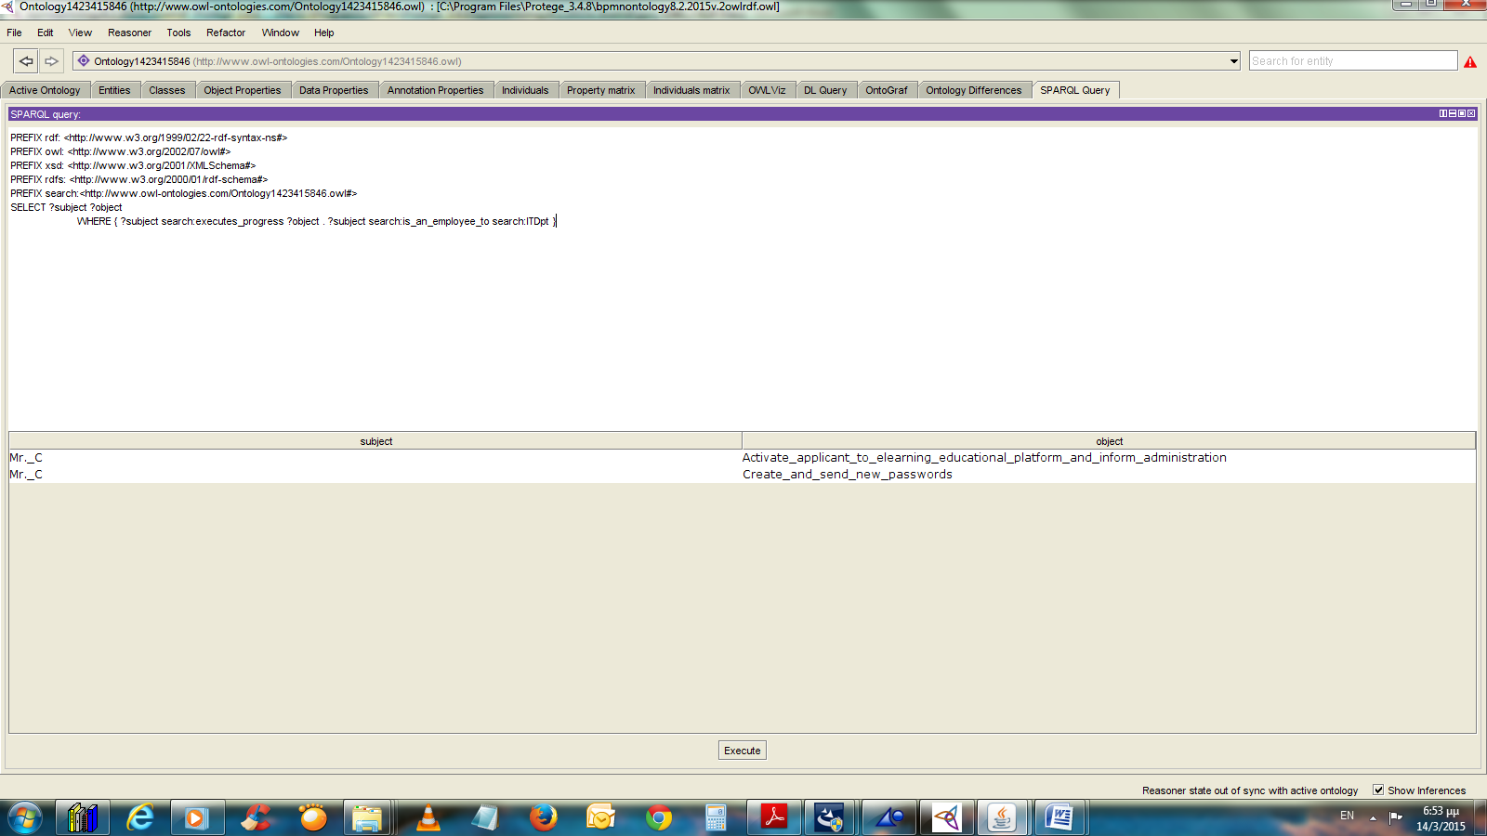
SPARQL Query 2: Which progresses are executed by the IT Dpt? And who executes them?

Slide 25
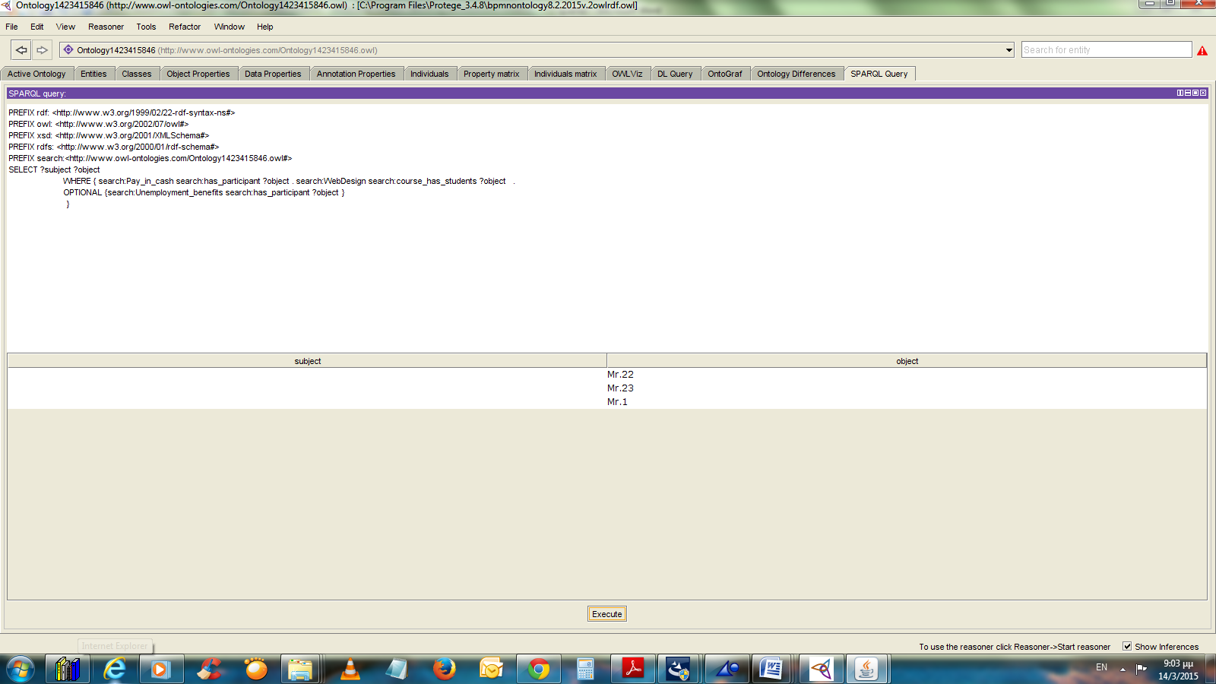
SPARQL Query 3: Find students pay in cash that have chosen Web Design E-Learning Course and are not necessary unemployed

Slide 26
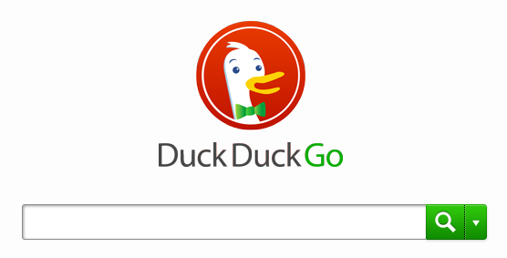
Semantic search engines that could help you understand
the use of semantic web technology…
1) Hakia
https://www.crunchbase.com/organization/hakia#/entity
2) DuckDuckgo
https://duckduckgo.com/

Slide 27
Thank you for your attention!
Themis Panayiotopoulos, Dimitris Apostolou, Eleni-Maria Kalogeraki

