Slide 1
Thematic labeling of Twitter accounts using DBpedia properties
Gerasimos Razis¹, Ioannis Anagnostopoulos¹,
Petr Saloun²
¹Computer Science and Biomedical Informatics Dpt. University of Thessaly
{razis, janag}@dib.uth.gr
²Faculty of Electrical Engineering and Computer Science
VSB-Technical University of Ostrava
petr.saloun@vsb.cz

Slide 2
Contents
Influence Tracker (IT)
  www.influencetracker.com
Origin of Thematic Categories
Similarity in Twitter
Labeling Twitter Accounts
  Thematic Category Labeling Algorithm (TCLA)
  Results of TCLA
Discovering DBpedia URIs
  “Search by Name”
  “URI Construction”
Conclusions

Slide 3
InfluenceTracker.com (IT)
Discover various characteristics of a Twitter Account:
adaptable Influence Metric
social analytics, real-time statistics, diagrams, etc.
evolution of accounts
comparison of accounts
Similarity Metric (SM)
IT Ontology: Semantification of Twitter
5 Star Data (LOD): IT URIs + DBpedia URIs

Slide 4
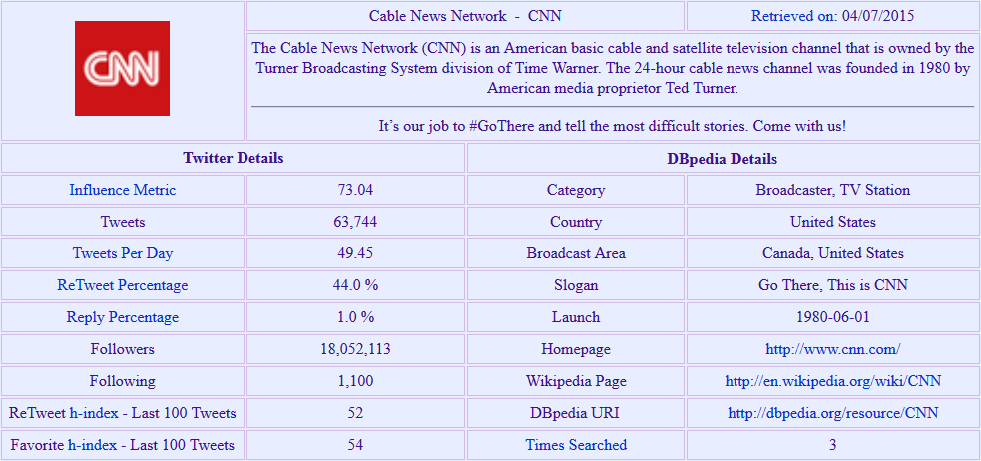
@CNN

Slide 5
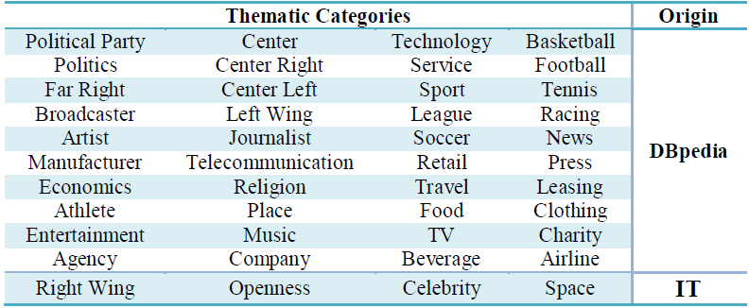
Origin of Thematic Categories (1/2)
44 Thematic Categories (Labels)
40 derived from DBpedia resources
  36 by values of “rdf:type” property
  4 by values of “dbp:position” property
4 proposed by IT
Notes:
rdf:type → instance of a class
dbp:position → political position

Slide 6
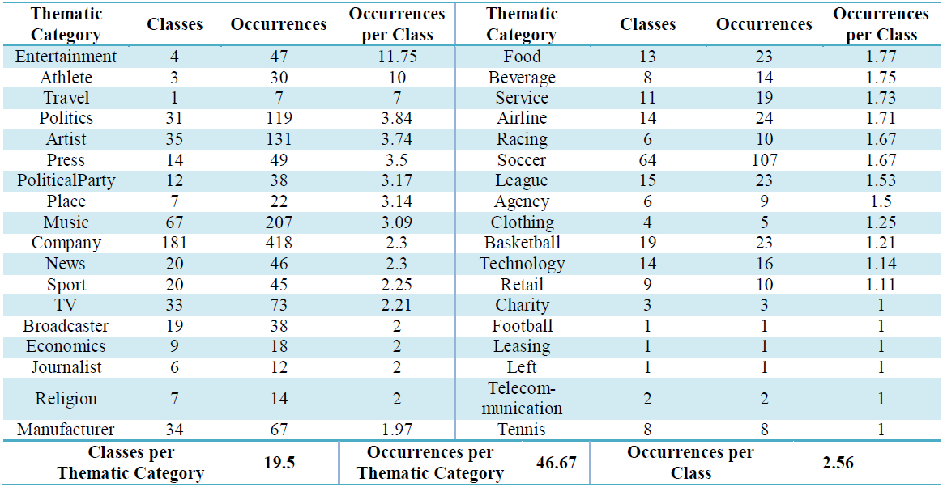
Origin of Thematic Categories (2/2)
Selection criteria:
“Similar” classes under same Label
number of occurrences in dataset

Slide 7
Similarity in Twitter
Similarity Metric: Aims at discovering similar accounts in terms of their disseminated entities
4 categories of entities (mentions, hashtags, URLs, domains)
Find total entities counter per category
  Frequency of use of categories
Find common entities counter per category
  Common counter → Category Similarity
Coefficient per category
  Categories with at least one common element

Slide 8
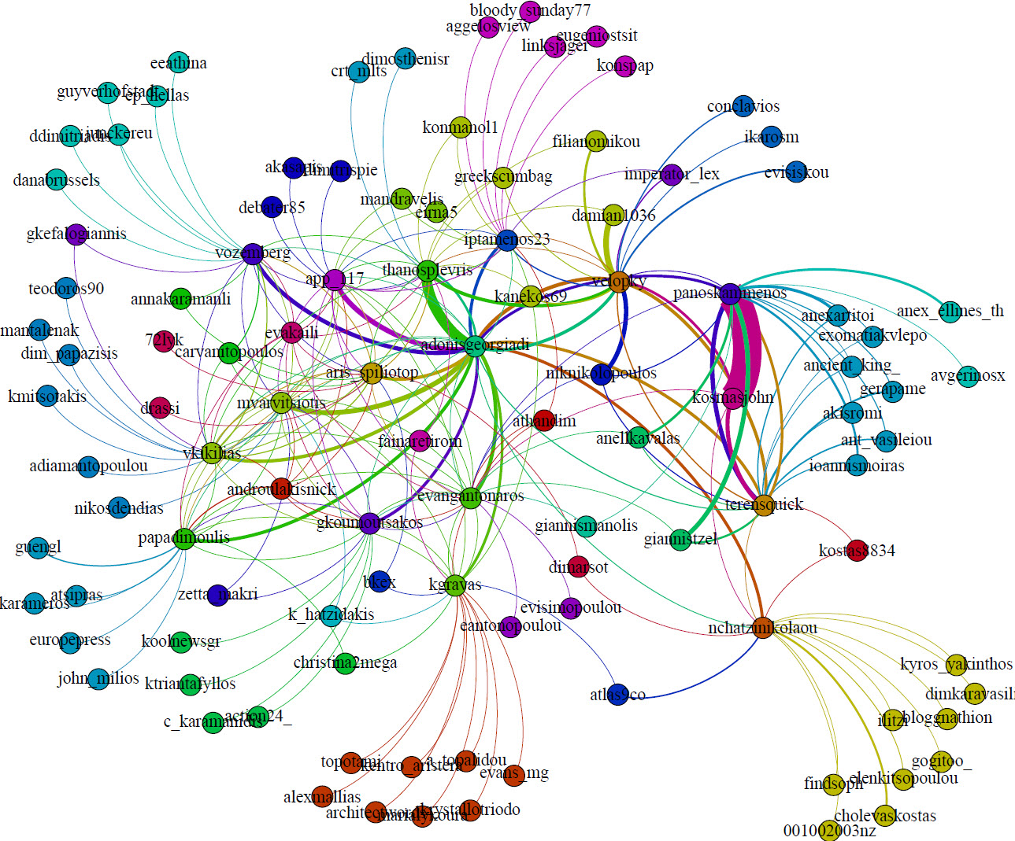
Example of Similarity Network

Slide 9
Dataset
Initial pool: 986 Twitter accounts registered at IT¹ (May 2015)
24 accounts had no similars due to the lack of entities in tweets
Final Dataset: 962 Twitter accounts
¹http://www.influencetracker.com/searchedAccounts

Slide 10
Labeling Twitter Accounts (1/4)
Thematic Category Labeling Algorithm (TCLA)
Based on Similarity of Twitter accounts
Consists of 3 Phases:
  Initial Thematic Category Labeling
  Iterative Thematic Category Labeling
  Thematic Categorization Results

Slide 11

Labeling Twitter Accounts (2/4)
Phase 1: Initial Thematic Category Labeling
Accounts with DBpedia URI are labeled
Perform Initial Labeling on an IT account
  top-k similars and their SM (they provide their weighted labels)
  Labels of account with “Thematic Category Weighted Score” (TCWS)
Repeat for all IT accounts
Store temporary results

Slide 12
Labeling Twitter Accounts (3/4)
  Phase 2: Iterative Thematic Category Labeling
  Based on results of Phase 1
Perform Iterative Labeling on an IT account
  Same functionality as in Phase 1 (enriched input)
Store temporary results of current iteration
Repeat for all IT accounts
Repeat for i iterations, (0 ≤ i ≤ 5)

Slide 13
Labeling Twitter Accounts (4/4)
  Phase 3: Thematic Categorization Results
  Based on results of Phase 2
Perform Final Labeling on an IT account
  Discover DominantTCWS
  Outliers
    Labels having TCWS < 20% of DominantTCWS
    DominantTCWS of i >= 200% of DominantTCWS of i-1, (1 ≤ i ≤ 5)
    e.g. AdonisGeorgiadi: {[Politics, 78.45], [Right Wing, 56.48], [Entertainment, 1.74]}
Repeat for all IT accounts
Display results
Notes:
DominantTCWS → The thematic category label having the greatest TCWS
If the DominantTCWS label of an iteration is double or more than the respective of the previous one then the labeling process ends

Slide 14
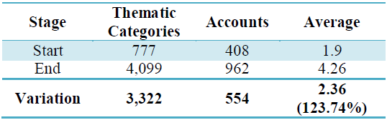
Results of TCLA (1/2)
Metrics Before and After Applying TCLA

Slide 15
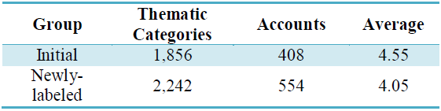
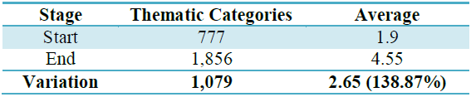
Results of TCLA (2/2)
Final Labeling of Group of Initial and Newly-Labeled Accounts
Metrics of Initial Accounts Before and After Applying TCLA

Slide 16
Discovering DBpedia URIs (1/6)
Which DBpedia URI describes best an IT URI (Twitter account)?
Two methodologies:
  Search by Name
  URI Construction

Slide 17
Discovering DBpedia URIs (2/6)
Search by Name
Use “Display Name” of Twitter accounts
Search in DBpedia for URIs containing the “Display Name”
Three properties model “Names” in DBpedia
  foaf:name
  dbp:name
  rdfs:label

Slide 18
Discovering DBpedia URIs (3/6)
URI Construction
Create DBpedia URI by formatting “Display Name” under name pattern conventions
  Replacement of spaces between words by underscores,
  Capitalized first letter of each word,
  Transliteration of special characters (e.g. "é" to "e", "ü" to "u", "ψ" to "ps"),
  Physical persons URI format: “First Name - Last Name”

Slide 19
Discovering DBpedia URIs (4/6)
Limitations
Disambiguation URIs (e.g. dbr:Android)
Lack of standard input by Twitter users (free text)
Synonymity
  Honda: Motor company or Comet?
  Nikos Pappas: Greek politician or Basketball player?
Recognition of URI policy of data source
Notes:
dbr: http://dbpedia.org/resource/

Slide 20
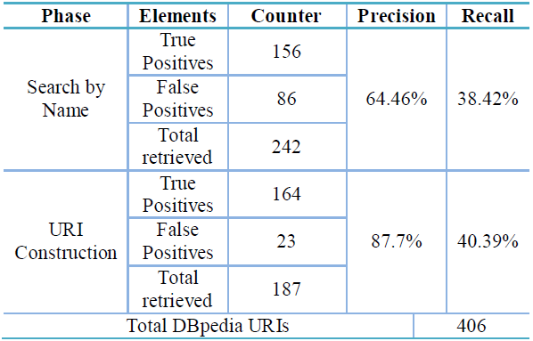
Discovering DBpedia URIs (5/6)
Effectiveness of URI Discovery Methodologies
Notes:
Precision: How many selected items are relevant
Recall: How many relevant items are selected

Slide 21
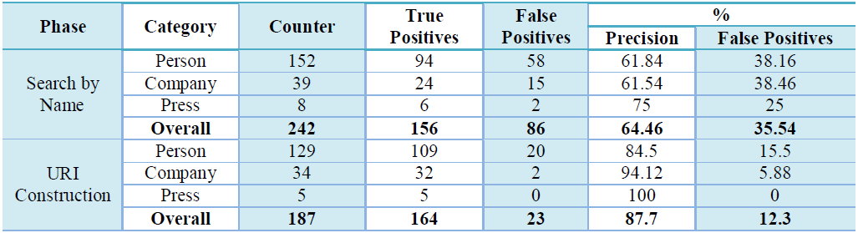
Discovering DBpedia URIs (6/6)
Effectiveness of URI Discovery Methodologies per Category

Slide 22
Conclusions
Automatic labeling of Twitter accounts with Thematic Categories from LOD cloud
Classification of Twitter accounts
Enrichment of available information
Automatic DBpedia URI discovery

Slide 23

QUESTIONS ?

