Slide 1
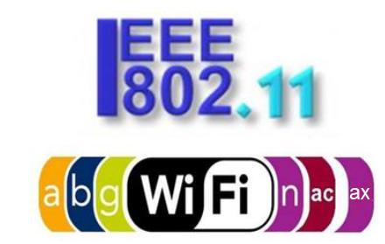

Slide 2
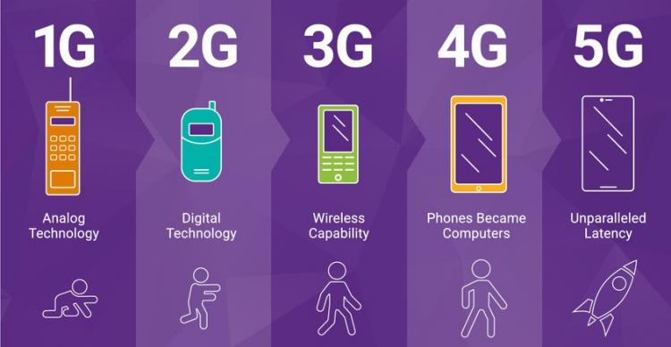
Εξέλιξη Συστημάτων Κινητών Επικοινωνιών
TDMA
CDPD
EDGE
GERAN
EDGE Upgrades
43.2 Kbps
384 Kbps
475 Kbps
2 Mbps
GSM HSCSD
GPRS
WCDMA TDD
LTE
LTE-A
LTE-A Pro
UMTS
Wide area coverage
115.2 Kbps
170 Kbps
2 Mbps
LTE-V2X
PDC/PDCP
WCDMA FDD
WCDMA HSPDA
Downlink
14.4 Kbps
2 Mbps
10 Mbps
Future wireless systems
cdmaOne
(IS-41)
cdma2000 1X
cdma2000 1XEV-DO
TD-SCDMA
IEEE 802.16m
WiMAX
76.8 Kbps
308 Kbps
2.4 Mbps
2 Mbps
IEEE 802.11p
2G
3G
cdma2000 1XEV-DV
IEEE 802.16e
WiMAX
5.4 Mbps
4G
3G Evolution
IEEE 802.11ac
IEEE 802.11ax
IEEE 802.11b
IEEE 802.11a
OFDM at the 5-6 GHz U-NII
Local area coverage
Higher data rate WLAN
(100 Mbps)
4G+
1-11 Mbps
6-54 Mbps
Harmonization
5G
HiperLAN
II
54 Mbps
___________________________________________________________________________________________________________________________________________

Slide 3
Fundamental Multiple Access methods
FDMA
Frequency division multiple access
TDMA
Time division multiple access
CDMA
Code division multiple access
ALOHA
satellite
802.11
CSMA/CA
OFDMA
Notes:
FDMA – brukere får allokert forskjellige bærebølge frekvenser av tilgjengelig radio spektrum
TDMA – brukere kan dele samme frekvens ved å dele frekvensen opp i tidslotter.
CDMA – deler ikke kanalen i frekvens eller tid, men koder dataen som blir sendt

Slide 4
What is 802.11?
Suitable for indoor/local wireless coverage
Typical range under 50 meters
Range highly dependent on the space layout
Optimized for packet based communication, e.g., Internet Protocol (IP)
Transmission speed
Up to 11 Mbps for 802.11b
Up to 54 Mbps for 802.11a or 802.11g

Slide 5
802.11 is an Open Technology
Anyone can build and sell WLAN equipment as long as
Power radiation regulations are obeyed
Interoperability standards are mature and openly available (IEEE 802.11 and WiFi Alliance)
No need for spectrum license to operate WLAN
WLAN operates in 2.4 GHz (b, g) or 5 GHz (a) unlicensed bands
Openness of technology is a blessing as well as a liability!
Compare Internet with telephone (fixed and mobile) networks

Slide 6
WLAN Already a Commodity
Variety of WLAN equipment is already available in the marketplace
Access point, PCIMCA cards for laptops, bridges for desktops
WLAN built in laptops, PDAs, Mobile phones
WLAN chipsets
WLAN related softwares
WLAN available for enterprise, domestic and public applications

Slide 7
Why use WLAN?
WLANs are an alternative to high installations and maintenance cost which is experienced with traditional LAN infrastructures.
Physical and environmental necessity is a driving factor in favor of WLAN
buildings which are difficult or impossible to wire:
Ex.: warehouses, campus and historical buildings
WLAN is better then LAN when networks are only temporarily:
Ad hoc networking
Emergency centers
Tactical military environments (sensor networks)
Notes:
Hvorfor bruke trådløse lokalnett
Trådløse nettverk er et alternativ til store installasjoner og høye vedlikeholds kostnader som vi har erfart ved tradsjonelle lokalnettverk.
Fysiske og miljømessige spørsmål er en drivende faktor i favør av WLAN
F.eks så kan bygninger være vanskelig å kable
Da warehouses, campus eller historiske bygninger
Trådløse nettverk er bedre enn kablede LAN når når nettverk er satt opp for en midlertidlig periode:
Da f.eks ad hoc nettverking
I et krisesentere
Taktiske militære områder, altså sensor nettverk

Slide 8
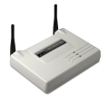
WLAN Network Architecture (1/2)
Basic Service Set (BSS): a set of stations which communicate with one another
Ad hoc network
Infrastructure Mode
Only direct communication possible
No relay function
Stations communicate with AP
AP provides connection to wired network (e.g. Ethernet)
Stations not allowed to communicate directly

Slide 9
WLAN Network Architecture (2/2)
ESS: a set of BSSs interconnected by a distribution system (DS)
Local Area Network (e.g .Ethernet)

Slide 10
802.11 Terminologies
BSS: Basic service set
Group of stations under the direct control of a single co-ordination function
All stations in a BSS can directly communicate with each other, without any infrastructure
Geographical area covered by BSS is BS Area
BSA is similar in concept to a ‘cell’ in a cellular network

Slide 11
802.11 Terminologies
Access Point (AP):
Similar to the base station in cellular network
Supports range extension by providing network connectivity between multiple BSSs
Multiple BSSs are connected together through a Distribution System (DS)
DS is similar to a backbone network
BSSs connected by a DS form an Extended Service Set (ESS)

Slide 12
Infrastructure Networks
Two advantages for infrastructure networks
The mobile stations need not to maintain neighbor relationships.
Access points assist with stations attempting to save power.
In an infrastructure network, stations must associate with an AP to obtain network services. (equivalent to plug in the network cable)
An extended service set (ESS) is created by chaining BSSs together with a backbone network.

Slide 13
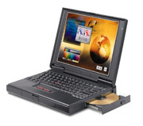
Typical Connection Procedure
1) Authentication exchange
Client proves its identity to AP
2) Association exchange
Client binds its identity to AP
3) Encrypted data exchange
Data communication may continue

Slide 14
WLAN Fundamental Standards
Standard | 802.11 | 802.11a | 802.11b | 802.11g
Year | 1997 | 1999 | 1999 | 2001
Freq | 2.4 GHz | 5 GHz | 2.4 GHz | 2.4 GHz
Speed | 2 Mbps | 54 Mbps | 11 Mbps | 54 Mbps
Modulation | FHSS / DPSK | OFDM /QAM | DSSS/ CCK | OFDM / CCK
Distance | 100 m | 30 m | 100 m | 100 m

Slide 15
802.11 task forces
802.11a
New physical layer using 5 GHz band utilizing Orthogonal Frequency-Division Multiplexing (OFDM) to provide speeds up to 54 Mbps
Lower range and higher power requirements
802.11b
Existing implementation using 2.4 GHz band to provide speeds up to 11 Mbps
High range and low power requirements
802.11d
AP specifies a client profile which includes channel set and power
Allows for single AP and client product which would self-configure to meet local RF regulations
International roaming – “World Mode”
802.11e
Quality of Service (QoS) support
Coupled with 802.1p (Class of Service) and 802.1q
Support for real-time applications like voice and streaming media
Dynamically-plumbed WEP keys
Notes:
The Future of WLAN Technology
For more information on existing and emerging standards, visit http://grouper.ieee.org/groups/802/11/
802.11d will enable a WLAN client adapter to be auto-configured by the AP with which it connects.
QoS, available in 802.11e, will allow the tagging of packets coming from a particular source or application type as a higher priority, thus increasing the rate at which these TCP/IP data packets are delivered and read. This is of great benefit to such technologies as streaming media and voice over IP.

Slide 16
802.11 task forces
802.11f
Seamless handoffs between access points
802.11g
New physical layer using 2.4 GHz band utilizing OFDM
Max speed 22 Mbps, but cannot coexist with 802.11b
802.11h
Enhancement to MAC to support EU power and RF requirements
Recommended feature for any future implementations
802.11i
Enhanced security
Advanced Encryption Standard (AES) strong contender for replacing WEP
May be used with 802.1X
Notes:
The Future of WLAN Technology
802.11h offers changes to the MAC layer for 802.11 which will allow a more dynamic control for transmit power and frequency settings.
802.11i is an enhancement to security for 802.11. Instead of using WEP, 802.11i will use a new technology called Advanced Encryption Standard (AES). 802.1X is an interim solution, whereas 802.11i is the final, formal solution.
802.11q provides support for virtual LANs (VLANs) within a bridge or switch. Consider that the AP is a switch. With 802.1X, if a user is authenticated, the user gets a corporate LAN connection, which also provides a connection to the Internet. Currently, however, if the authentication fails, the user does not get connected to anything. 802.11q will enable the user, such as a visiting business partner who does not have valid corporate network credentials, to at least receive a fail-over connection to the Internet when corporate network authentication fails.

Slide 17
802.11 task forces
802.11j
The 802.11j Task Group is working on Japanese regulatory extensions to allow for operation in the 4.9 GHz and 5GHz bands in Japan. This is expected to be approved in 2005.
802.11k
802.11k is focused on standardizing the radio measurements that will allow uniform measurement of radio information across different manufacturer platforms.
By having standardized, repeatable measurements, system designers can utilize radio environment information to make better decisions as to frequency use, transmit power levels, etc.
802.11n
The 802.11n Task Group is focusing on creating a standard to further increase the net throughput of wireless networks.
The goal is to achieve greater than 150 Mbps usable throughput over an 802.11.
Both physical and MAC layer changes are being considered, but backward compatibility is required.

Slide 18
802.11 task forces
802.11r
The 802.11r Task Group is working on reducing the handoff latency when client devices transition between access points or cells in an ESS.
This standard will facilitate the deployment of SIP-based Voice over Wi-Fi (VoWi-Fi) portable phones.
802.11s
The 802.11s Task Group is working on an infrastructure mesh standard to allow 802.11 access points or cells from multiple manufacturers to self-configure into multi-hop wireless topologies.
Example usage scenarios for mesh networks include interconnectivity for devices in the digital home, unwired campuses, and community area networks or hotzones.

Slide 19
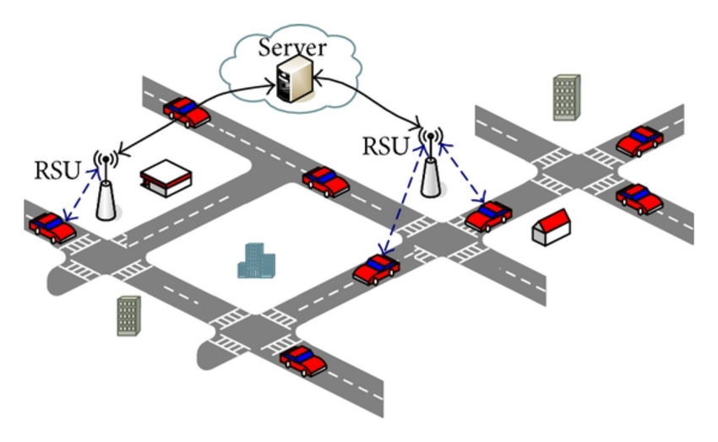
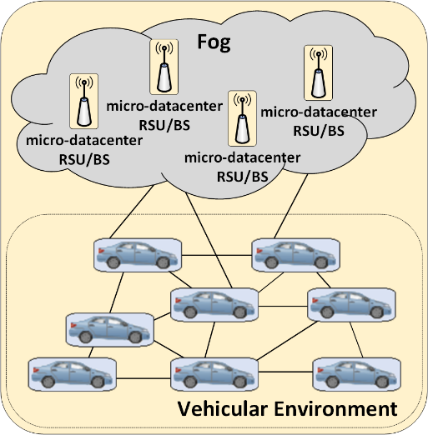
802.11 task forces
802.11p
Wireless Access for Vehicular Environment (WAVE).
Dedicated short-range communications (DSRC) frequencies are used.
The concept of Road Side Units (RSUs) is applied.

Slide 20
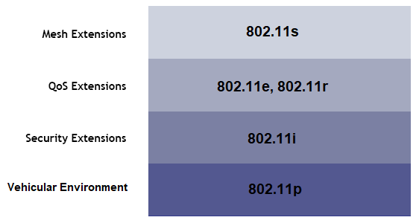
802.11 task forces
Multiple 802.11 standards can coexist

Slide 21
802.11 Generations
Regarding the design of MAC & Physical layers

Slide 22
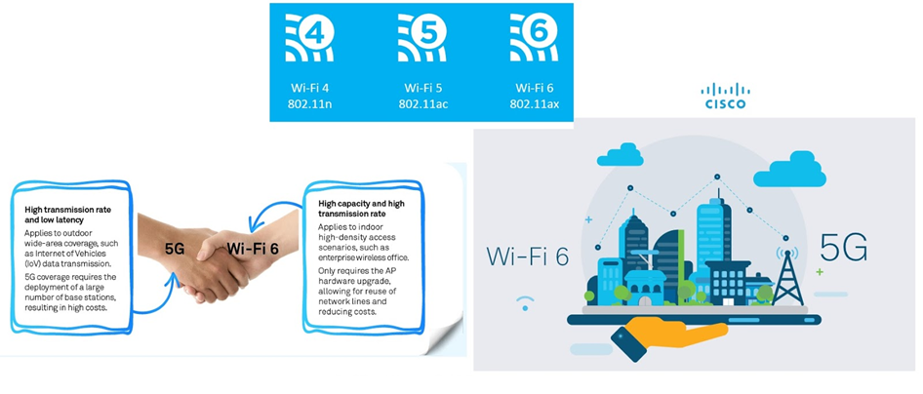
Enhancing 5G indoor infrastructures

Slide 23
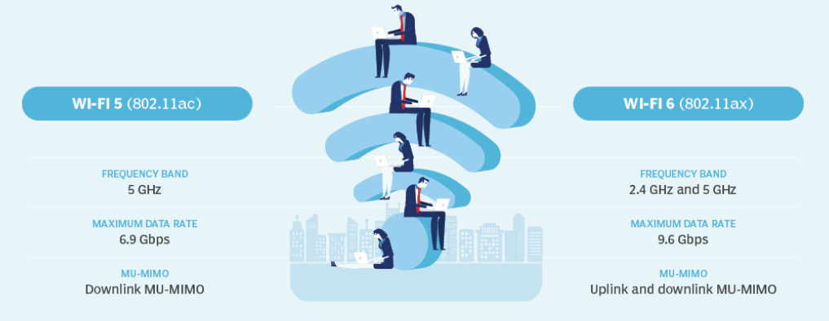
WiFi 5 vs WiFi 6: What is the difference?

Slide 24
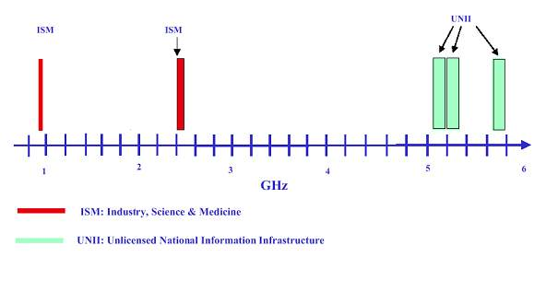
WLAN Characteristics - Frequency Bands
Cordless Phone
GSM Handphone
802.11b Wireless LAN
Bluetooth
802.11a Wireless LAN

Slide 25
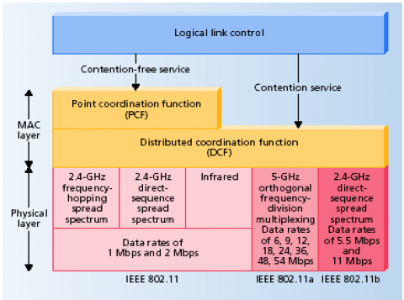
WLAN Protocol Stack
OFDM
PHY
PHY – Converts signals from the MAC Layer to Radio Signals
MAC – Implements the CSMA / CA Mechanism
LLC – Provides Interface to upper Layers

Slide 26
WLAN Technical – Physical Layer
Transmission Method
Spread spectrum (DSSS) for 11 Mbps 802.11b in 2.4 GHz band
Orthogonal frequency division multiplexing (OFDM) for 54 Mbps 802.11g in 5 GHz band
OFDM for 54 Mbps 802.11a in 5 GHz band

Slide 27
Radio technology
IEEE 802.11 provides for two variations of the PHY using RF technology:
Direct Sequence Spread Spectrum (DSSS)
Frequency Hopped Spread Spectrum (FHSS)
The DSSS and FHSS PHY options is designed for operations in the 2.4 GHz ISM band.
Two new techniques were introduced to achieve higher bandwidth:
Orthogonal Frequency Division Multiplexing (OFDM) modulation and High Rate – DSSS with transmission rates >=54 Mbps and >=11 Mbps, respectively.

Slide 28
Channel bandwidth for DSSS
802.11b with DSSS has a available throughput-capacity of 11 Mbps/channel
Divides spectrum in 3 channels to reduce co-channel interference.
The channel bandwidth is 22 MHz for DSSS systems.
Notes:
DSSS benytter 3 kanaler i 2.4 GHz båndet.
Hver kanal har da en overførings-kapasitet på 11 Mbps i 802.11b.
Radiospekteret er oppdelt i 3 kanaler for å minske interferens mellom kanaler.
Båndbredden for hver kanal er da 22 MHz

Slide 29
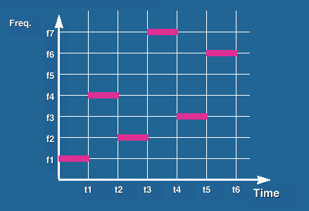
Frequency Hopped Spread Spectrum (FHSS)
FHSS is a spread-spectrum method of transmitting radio signals by rapidly switching a carrier among many frequency channels, using a pseudorandom sequence known to both transmitter and receiver.
High effect in a narrow frequency band (1 MHz = 1 Channel)
Different hopping sequences enables multiple BSS to coexist in the same geographical area.
Alleviate congestion and maximize total throughput in BSS
Currently used in Bluetooth.
Notes:
Frekvens hoppende spread spektrum
Teknikk for å overføre radio-signaler ved å bytte bærebølge mellom flere frekvens-kanaler
FHSS sender ut høy effekt i en liten del av frekvensbåndet
Forskjellige hoppesekvenser muliggjør at flere BSSs kan operere i samme område
Brukes nå bare i bluetooth

Slide 30
Medium Access Control (MAC) Layer
Manages access of multiple wireless stations to shared wireless medium.
CSMA/CA (Carrier Sense Multiple Access with Collision Avoidance)
Assists in security over the wireless link
Encrypt all wireless communication
Authenticate clients before granting access
Assists in association management
Binding client identity of access point
Portability, mobility

Slide 31
Medium Access Control (MAC) Layer
Activities:
Channel allocation procedures
Protocol Data Unit (PDU) addressing
Frame formatting
Error checking
Fragmentation and reassembly
Medium alternates between two modes:
Contention Period (CP)
Contention Free Period (CFP)
Notes:
Medium Access Control sublaget har ansvaret for
Prosedyrer for å allokere kanaler. Situasjonen her blir litt annerledes når vi opererer trådløst enn i ether.
Addressering av protocol data units
Formaterring av rammer
Feilsjekking av MPDU
Fragmentering og reassembleringav pakker
Aksess mediet kan befinne seg i 2 tilstander
Contention period
Contention free period
Mediet kan operere eksklusivt i konkurranse-modus. Da må alle nodene konkurrere om aksess til kanalen for hver pakke som skal sendes.

Slide 32
802.11 MAC Frames
Management Frames: Used for
Station association, dissociation, timing and synchronization, authentication
Control Frames: Used for
Handshaking during CP (RTS/CTS)
ACK frames during CP
Data Frames: Used for
Sending data during CP and CFP

Slide 33
802.11 frame format
IEEE 802.11 support three types of frames:
Management frames: station association and disassociation with AP, timing and sychronization, authentication and deauthentication.
Control frames: handshaking and ack during CP, and to end the CFP
Data frames: transmission of data, can be combined with polling and acknowledgements
Notes:
IEEE 802.11 tilbyr tre typer frames.
Vi har management-frames som brukes for å assosiere en stasjon med et aksesspunkt. Og for deassosiering. Brukes for tids-styring og synkronisering, samt autentisering og deautentisering.
Kontroll frames brukes for handshaking under Konkurranse Perioden, samt positive acknowledgements. De brukes også ved avslutning av en en konkurranse fra periode.
Data Frames brukes hovedsaklig for transmisjon av data under Konkurranse Perioden, og kan kombineres med pollling og acknowledgements i konkurranse fri modus.
Tegningen viser et standard IEEE 802.11 ramme format.
(Merk:
Frame body er variabel. Dette hvis er hvis en Wireless equivalent privacy (WEP) protokoll er implementert.
Duration field er en viktig del av koordineringsprotokollene. Forteller bl.a. Hvor lenge mediet vil bli opptatt ved sending av en ramme.
Hver addresse er en 48-bit MAC-addresse. Grunnen til så mange addresse-felt er at man bl.a. angir sender, mottaker, hvilke AP man vil sende gjennom eller til.
Type bitet forteller om det er en managament, kontroll eller data ramme.
(Noe av innholdet i rammen vil bli mer klart etter at vi har vist hvordan koordineringsprotokollene fungerer))

Slide 34
Hidden Terminal Problem
D will not transmit
Data
D
A
B
Data
C
C may corrupt the
transmission between
A and B.
Hidden Terminal Problem!
Notes:
Explain the interference range, there could be a node farther out which can interfere with B but cannot hear it. But still…

Slide 35
CSMA/CA
Carrier Sense Multiple Access with Collision Avoidence (CSMA/CA)
Listen before talking
RTS - Request To Send
CTS - Clear To Send
Notes:
I WLAN brukes en Multipple aksess-metode som kalles CSMA/CA
Carrier sense beskriver det at senderen må lytte til mediet, etter bære-bølger, før man sender.
dvs. prøver å detektere et signal fra en annen stasjon før man sender
Hvis han oppdager et signal, venter han med å sende
Multiple Access beskriver det at flere noder prøver å sende på mediet samtidig
Informasjon sendt fra en node blir mottatt av alle nodene innenfor dens rekkevidde.
The hidden terminal problem løses ved å innføre to nye meldinger
RTS er et en kort melding som sendes før dataene blir sendt. Denne spør om lov til å sende.
CTS er et svar fra mottaker om at sender nå kan begynne transmisjon av dataene.
Disse meldingene vil da inneholde
sender addressen,
mottaker addressen og
pakke størrelsen på dataene som skal sendes.
CSMA/CD kan ikke brukes fordi stasjonen ikke KAN lytte etter kollisjoner på kanalen samtidig som man sender.

Slide 36
CSMA/CA (2)
D will not transmit
RTS
D
A
B
C
CTS
C will not
transmit to B.
Data
ACK
Hidden Terminal Problem Solved
through RTS-CTS exchange!
Notes:
Her er det enorme gevinster å hente, fordi en stasjon ville ha fortsatt å sende hele PDUen uten å oppdage at en kollisjon hadde ødelagt hele transmisjonen. Grunnen til gevinst er at RTS og CTS er veldig små rammer.

Slide 37
Two different MAC schemes
Distributed coordination function – DCF
Best-effort
Designed for asynchronous data transport
All users have same chance of accessing the network
Point coordination function – PCF
Optional
Based on polling by an access point
Designed for time-bounded traffic
Notes:
På mac laget har vi to koordineringsfunksjoner.
Den første DCF er påkrevd. Dvs. at alle stasjoner må støtte denne koordinering-funksjonen.
Så det er den fundamentale aksesseringsmetoden for å støtte asynkon data overføring med best-effort.
Altså på en best mulig måte.
PCF er valgfri. Den baseres på polling fra et aksess-punkt. Den brukes som regel i kommunikasjon som stiller krav til tid.
PCF er påkrevd for contention frie perioder, mens DCF er basis ved contention periods.
Her ser vi en illustrasjon av hvordan PCF ligger over DCF på MAC laget.
DCF ligger rett over det fysiske laget.
DCF opererer da enten allene, eller sammen med PCF.

Slide 38
MAC Access Modes
Distributed coordination function (DCF):
CSMA/CA.
DCF may use CTS/RTS to reduce the possibility of collisions.
Point coordination function (PCF):
Contention-free services. Special stations called point coordinators are used to ensure contention-free.
The coordinators reside in AP.
PCF is only for infrastructure mode and not widely implemented.

Slide 39
Distributed Coordination Function (DCF)
Used for contention services (CP)
Operates in ad-hoc networks
Operates either solely or coexist with PCF in infrastructure networks
Based on CSMA/CA
Uses RTS and CTS
Network Allocation Vector (NAV)
A timer that indicates the amount of time the medium is to be reserved
Each stations sets their NAV timer when a frame with a duration field is received
Notes:
Brukes der stasjoner konkurerer om å få tilgang til mediet.
I ad-hoc nettverk operer den alene, mens den enten brukes alene, eller sammen med PCF i infrastruktur nettverk (nettverk som snakker med et AP).
DCF baserer seg på CSMA/CA, og RTS og CTS blir brukt.
Snakker gjerna om physical carrier sensing og virtual carrier sensing
PHYSICAL – en bruker observerer andre WLAN brukere ved å analysere deres pakker. Og at man oppdager aktivitet på kanalen ved å registrere signalstyrke fra andre kilder.
VÌRTUAL carrier sensing gjøres ved å sende varighet for en data enhet i duration feltet i rammene til RTS og CTS.
NAV: Brukes til å reservere mediet for en bestemt periode. En teller som indikerer hvor lenge mediet er opptatt.
Hver stasjon oppdaterer telleren i vektoren når de mottar en ramme som inneholder et duration felt.
I løpet av denn perioden vil ingen av stasjonen sende. Når telleren da når null vil mediet være ledig, og stasjoner kan begynne å konkurrere om tilgang til mediet.

Slide 40
Virtual Carrier Sense
Used “Network Allocation Vector” (NAV)
A timer for channel reserved period
Included in the RTS and CTS frames
Each station will count down until NAV = 0
If NAV ≠ 0 ➔ Medium is Busy
If NAV = 0 ➔ Medium is idle
The data frame has the ‘duration’ field, which indicates for how long the sender wants to hold the medium
Other stations read this field, and adjust a parameter called ‘Network Allocation Vector’ (NAV)
NAV indicates the amount of time that must elapse until the channel can be sampled again for idle status
NAV value thus indirectly indicates if the channel is free at any given time
Using NAV value to determine channel status is called as ‘Virtual Carrier Sensing’

Slide 41
Virtual Carrier Sense
A
SIFS
SIFS
CTS
A
B
SIFS
RTS
Data(Z)
Medium Busy
Medium Idle
Y
NAV set

Slide 42
Access Spacing
DIFS
PIFS
Data
SIFS
time
IFS | Interframe Space
SIFS | Short IFS | Highest priority | ACK, CTS, 2nd MSDU
PIFS | PCF IFS | 2nd priority | PCF operation mode
DIFS | DCF IFS | 3rd priority | DCF operation mode
EIFS | Extended IFS | Lowest priority | Waiting period

Slide 43
Backoff algorithm
B1 = 25
B1 = 5
wait
data
data
wait
B2 = 20
B2 = 15
B2 = 10
cw = 31
B1 and B2 are backoff intervals
at nodes 1 and 2
Notes:
Vi har to noder. Node 1 med backoff interval B1 og node 2 med backoff interval B2.
Contention window er i dette eksemplet 31.
Nodene får så et tilfeldig backoff interval
Node 1 B1=25
Node 2 B2=20
Node2 har kortest interval, vinner og får da sende først.
Når den har sendt ferdig velger den et nytt backoff interval, B2=15
Node1 har nå bare 5 time-slots igjen av backoffintervalet, og får da sende etter 5 time-slots.
Etter dette er Node1 ferdig, og Node2 kjører når backoff-intervallet dens er nedtelt.

Slide 44
DCF Backoff
Min: Window = 31 slots
Similar to Ethernet
Collision is detected through a lack of ACK
If collision occurs, the station backs-off again; the mean of the back-off time is now doubled
Each retry
window size increases
For DSSS
Contention window = 2n – 1
Smallest = 31, Biggest = 1023
DIFS
Start
…
Window = 63 slots
DIFS
…
#1 retry
…
Max: Window = 1023 slots
#6 retry
DIFS
…

Slide 45
Sending Data and Ack
DIFS
Source
Data
SIFS
Destination
Ack
DIFS
Contention Window
Other
Next MPDU
Defer Access
Backoff after Defer
From WaveLAN Slide

Slide 46
PCF operation
A Point Coordinator (PC), located in the Access Point (AP) controls the PCF
PC
PIFS
B
Data(Z)
Poll(Z)
End
Y
Busy
A
Z
A
Data(Y)
NAV
NAV set

Slide 47
The coexist of DCF & PCF
A Point Coordinator (PC) resides in the Access Point and controls frame transfers during a Contention Free Period (CFP)
The CFP alternates with a Contention Period (CP) in which data transfers happen as per the rules of DCF
CFP Repetition Interval
CFP Repetition Interval
CFP
CP
CFP
CP
B
B
PCF
DCF
PCF
DCF

Slide 48
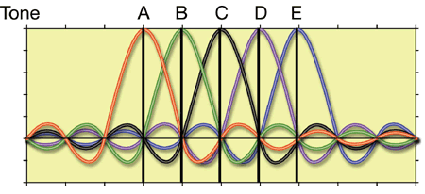
Orthogonal Frequency Division Multiple Access (OFDMA)
Multicarrier Spread Spectrum Technique
High-rate serial data stream divided into numerous parallel low-rate data streams that are modulated by a set of subcarriers
Subacarriers are orthogonal with overlapping spectra
Pilot subcarriers for channel estimation

Slide 49
Take advantage of OFDMA

