Slide 1
Chapter 5. Cloud Access and Cloud Interconnection Networks

Slide 2
Contents
Examples of real cloud infrastructures.
Infrastructure issues.
Clouds and networks.
Packet-switched networks.
Internet.
Relations between Internet networks.
Transformation of the Internet.
Web access and TCP congestion
Named data networks
Interconnection networks for computer clouds.
Clos networks, Myrinet, InfiniBand, fat trees.
Storage area networks.
Data center networks.
Network management algorithms.
Content delivery networks.
Overlay and scale-free networks.

Slide 3
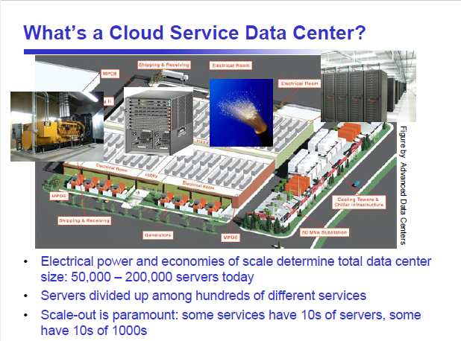

Slide 4
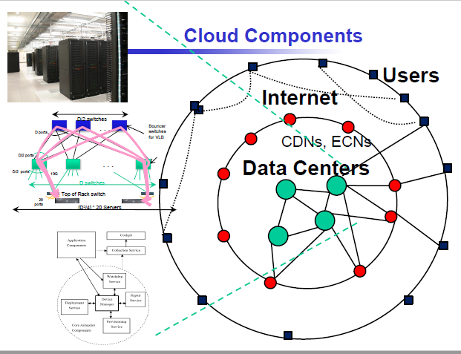

Slide 5
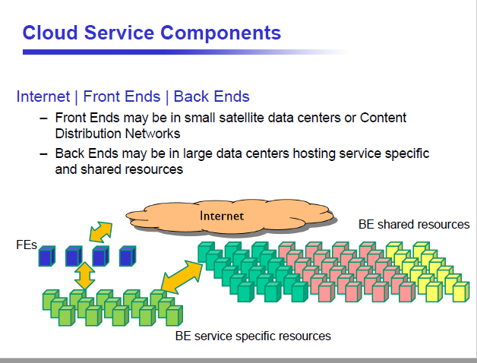

Slide 6
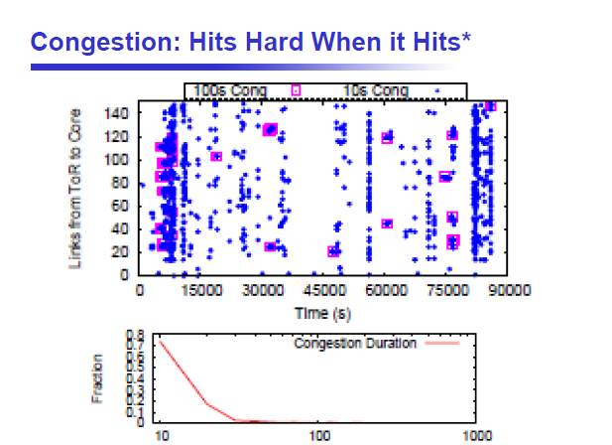

Slide 7
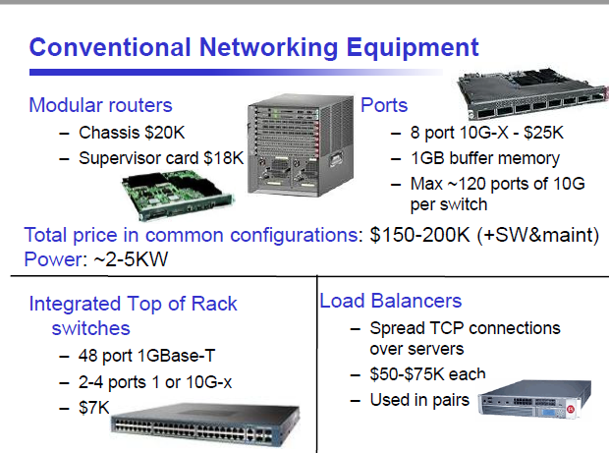

Slide 8
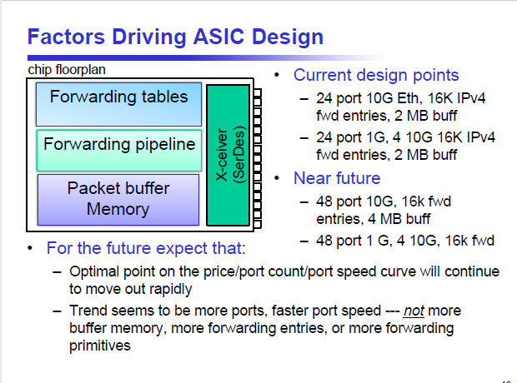

Slide 9
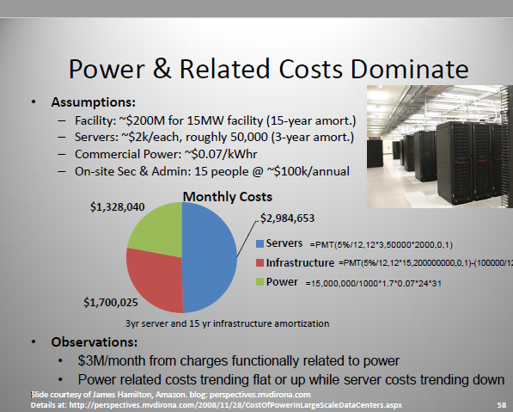

Slide 10
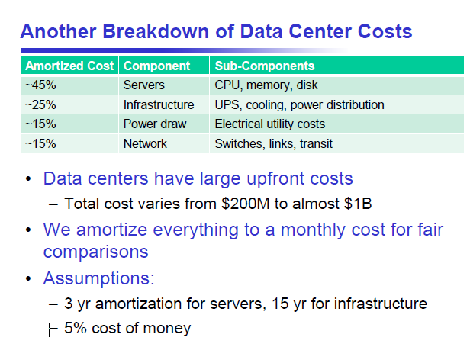

Slide 11
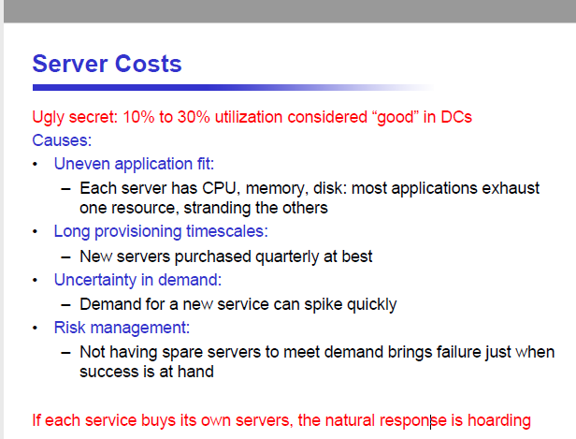

Slide 12
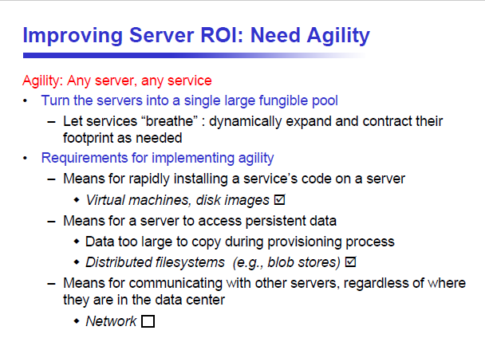

Slide 13
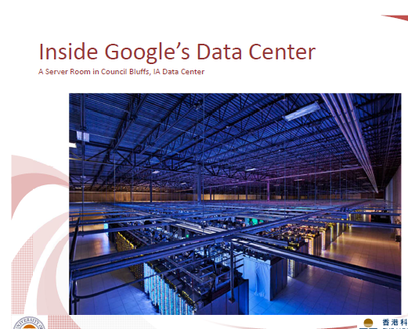

Slide 14
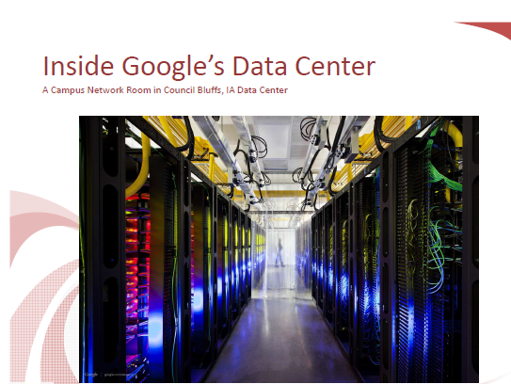

Slide 15
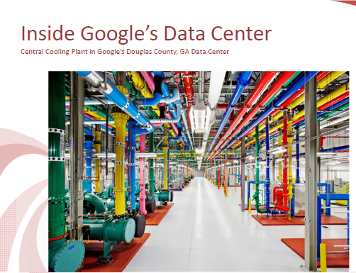

Slide 16
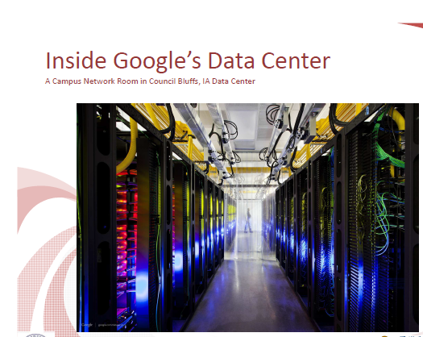
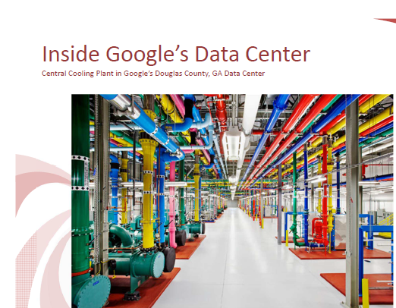
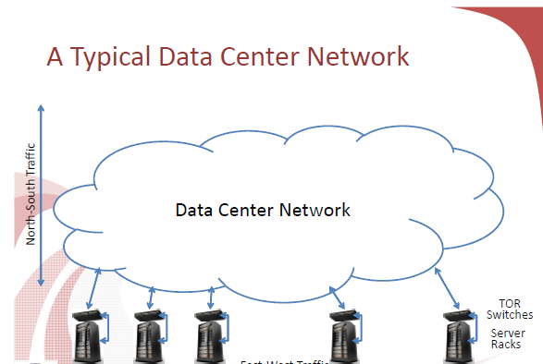
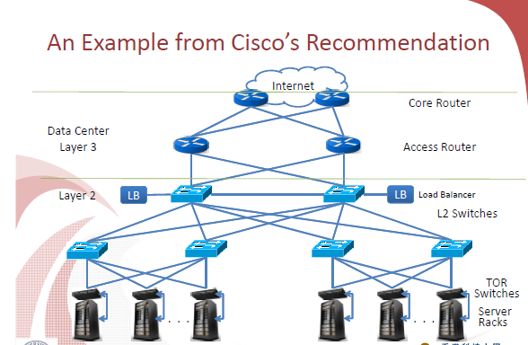

Slide 17
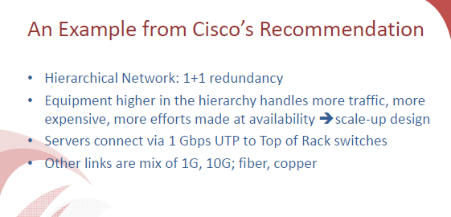

Slide 18
1. Clouds and networks
Unquestionably, communication is at the heart of cloud computing.
  Interconnectivity supported by a continually evolving Internet made cloud computing feasible.
  A cloud is built around a high-performance interconnect, the servers of a cloud infrastructure communicate through high-bandwidth and low-latency networks.
Cloud workloads fall into four broad categories based on their dominant resource needs: CPU-intensive, memory-intensive, I/O-intensive, and storage-intensive. While the first two benefit from, but not do not require, high-performing networking, the last two do. Networking performance directly impacts the performance of I/O- and storage-intensive workloads
The designers of a cloud computing infrastructure are acutely aware that the communication bandwidth goes down and the communication latency increases the farther from the CPU data travels.

Slide 19
2. Packet-switched networks
A packet-switched network transports data units called packets through a maze of switches where packets are queued and routed towards their destination.
A datagram is a transfer unit in a packet-switched network. In addition to its payload a datagram has of a header containing control information necessary for its transport through the network.
A packet-switched network consists of:
  Network core made up from routers and control systems interconnected by very high bandwidth communication channels.
  Network edge where the end-user systems/hosts reside.
A switch is a device connecting together other devices. A switch manage the flow of data across a network by transmitting a received network packet to the devices the packet is intended for.
A networked device connected to a switch can be identified by its network address, allowing the switch to regulate the flow of traffic.

Slide 20
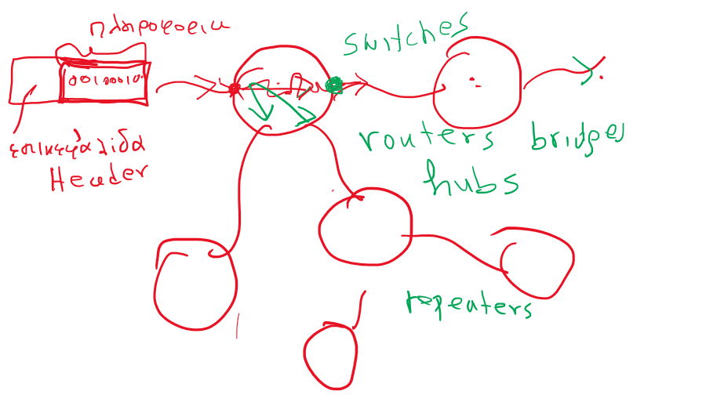

Slide 21
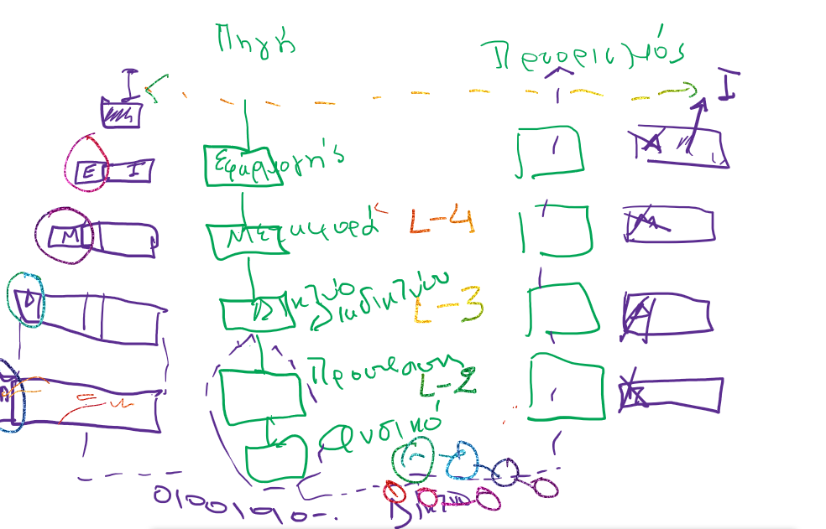

Slide 22
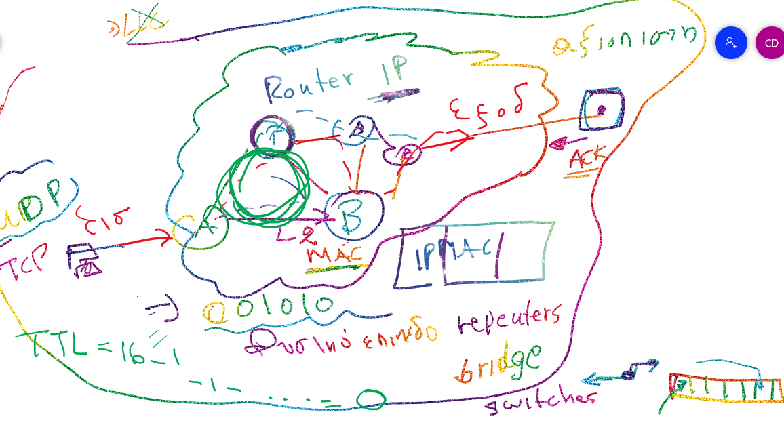

Slide 23
Basic concepts
Packet → consists of a header which contains control information necessary for its transport through the network and a payload or data.
Packets are subject to a variable delay, errors, and loss.
A network architecture describes the protocol stack.
Protocol → a discipline for communication, it specifies the actions taken by the sender and the receiver of a data unit.
Host → a system located at the network edge capable to initiate and to receive communication, e.g., computer, mobile device, sensor.

Slide 24
3. The Internet
Collection of separate and distinct networks.
All networks operate under a common framework consisting of:
  globally unique IP addressing.
  IP routing.
  global Border Gateway Routing (BGP) protocols.
IP only provides best effort delivery - any router on the path from the source to the destination may drop a packet if it is overloaded.
The Internet uses two transport protocols
  UDP (User Datagram Protocol) - a connectionless datagram protocol. The UDP transport protocol assumes that error checking and error correction are either not necessary or performed by the application. Datagrams may arrive out of order, duplicated, or may not arrive at all.
  TCP (Transport Control Protocol) - a connection-oriented protocol. TCP provides reliable, ordered delivery of a stream of bytes from an application on one system to its peer on the destination system.

Slide 25
The hourglass Internet architecture

Slide 26
The Internet protocol stack

Slide 27
IPv4 versus IPv6
Why is migration to IPv6 necessary?
  IPv4 has an addressing capability of 2³², or approximately 4.3 billion addresses, a number that proved to be insufficient.
  IPv6 has an addressing capability of 2¹²⁸, or 3.4x10³⁸ addresses.
Major differences between IPv4 and IPv6:
  IPv6 supports new multicast solutions and but not traditional IP broadcast.
  IPv6 hosts can configure themselves automatically when connected to a routed IPv6 network using the Internet Control Message Protocol version 6.
  Mandatory support for network security. Internet Network Security(IPsec) is an integral part of the base protocol suite in IPv6.
Migration from IPv4 to IPv6 is a very challenging and costly proposition.

Slide 28
IP and MAC addresses, ports and sockets
IP address → logical address assigned dynamically by a DHCP server. A host may have multiple IP addresses as it may be connected to more than one network.
MAC address → unique physical address of each network interface.
Network interface → hardware connecting a host with a network.
Port → software abstraction for message delivery to an application.
Sockets → software abstraction allowing an application to send and receive messages at a given port; implemented as two queues, one for incoming and the other for outgoing messages.

Slide 29
Sockets and ports

Slide 30
4. The relations between Internet networks
Three type of relations:
  Peering - two networks exchange traffic between each other's customers freely.
  Transit - a network pays to another one to access the Internet.
  Customer - a network is paid to allow Internet access.
The networks are commonly classified as:
  Tier 1 - can reach every other network on the Internet without purchasing IP transit or paying settlements.
  Tier 2 - an Internet service provider who engages in the practice of peering with other networks, but who still purchases IP transit to reach some portion of the Internet; the common providers on the Internet.
  Tier 3 - purchases transit rights from other networks (typically Tier 2 networks) to reach the Internet.

Slide 31
The relation of Internet networks based on the transit and paying settlements. There are three classes of networks, Tier 1, 2, and 3; an IXP is a physical infrastructure allowing ISPs to exchange Internet traffic.

Slide 32
5. The transformation of the Internet
Web applications, cloud computing, and content-delivery networks are reshaping the definition of a network.
Data streaming consumes an increasingly larger fraction of the available bandwidth as high definition TV sets become less expensive and content providers, such as Netflix and Hulu, offer customers services that require a significant increase of the network bandwidth.
The “last mile” - the link connecting the home to the Internet Service Provider (ISP) network is the bottleneck.
Google has initiated the Google Fiber Project which aims to provide 1Gb/s access speed to individual households through FTTH.

Slide 33
The transformation of the Internet. The traffic carried by Tier 3 networks increased from 5.8% in 2007 to 9.4% in 2009; Goggle applications accounted for 5.2% of the traffic in 2009.

Slide 34
The average download speed for broadband access advertised by several countries

Slide 35
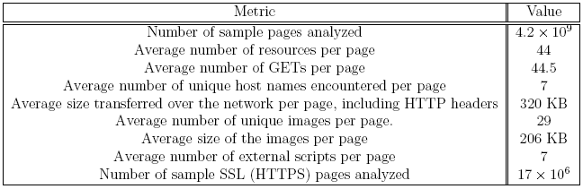
6. Web access and TCP congestion
HTTP - the application protocol for Web access uses the TCP transport protocol.
TCP supports mechanisms to avoid congestion and limit the amount of data transported over the Internet.
Web access requires the transfer of large amounts of data as we can see in measurements reported by Google

Slide 36
TCP congestion control
Algorithms to control congestion include Tahoe, an algorithm based on: (1) slow start, (2) congestion avoidance, and (3) fast retransmit.
Slow start means that:
  (a) the sender starts with a window of two times MSS (Maximum Segment Size).
  (b) for every packet acknowledged, the congestion window increases by 1 MSS so that the congestion window effectively doubles for every RTT (Round Trip Time).
To overcame the limitations of the slow start application, strategies have been developed to reduce the time to download data over the Internet. For example,
  Firefox 3 and Google Chrome open up to six TCP connections per domain.
  Internet Explorer 8 opens 180 connections.

Slide 37
TCP congestion control
The strategies used by the browsers to avoid the congestion control mechanisms circumvent the mechanisms for congestion control and incur a considerable overhead.
The TCP latency is dominated by the number of RTTs during the slow start phase.
Given that the average page size is 384 KB, a single TCP connection requires multiple RTTs to download a single page.
It is argued that a better solution is to increase the initial congestion window of TCP. The effects of this solution:
  It ensures fairness between short-lived transactions which are a majority of Internet transfers and the long-lived transactions which transfer very large amounts of data, e.g., audio and video streaming.
  It allows faster recovery after losses through Fast Retransmission.

Slide 38
7. Named data networks (NDN)
Internet is a network of communication networks:
  Communication units, the packets, only name the communication end points.
  Data in a communication networks is tied to a particular host and this makes data replication and migration difficult.
Now Internet is mostly used as a distribution network by applications in: digital media, electronic commerce, Big Data analytics, and so on.
NDN communication is content-centric:
  Named objects are requested by an agent and, once a site holding the object is located, the network transports it to the site that requested the object.
  The end user in a distribution network is oblivious to the location of the data and it is only interested in the content.

Slide 39
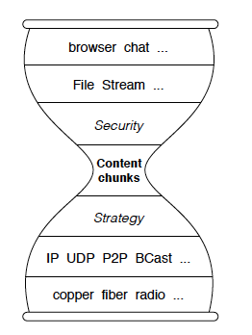
(Left) Internet hourglass architecture - regardless of application transport protocol, and physical network, all packets are routed from the source to the destination using the IP protocol and the IP address of the destination.
(Right) NDN hourglass architecture - parallels the one of the Internet, it separates lower layers of the protocol stack from the upper ones thus, naming of the data can evolve independently from networking.

Slide 40
NDN versus Internet
NDN networking service semantics → fetch a data chunk identified by name.
Internet semantics → a packet to a given network address through an end-to-end channel identified by the source and the destination IP addresses
NDN packet delivery is driven by the data consumers.

Slide 41
NDN Communication is initiated by an agent generating an Interest packet containing the name of the data.
Once the Interest packet reaches a network host which has a copy of the data item, a Data packet containing the name, the contents of the data, and the signature is generated.
The signature consists of the producer's key.
The Data packet follows the route traced by the Interest packet and it is delivered to the data consumer agent..

Slide 42
NDN routing data structures
Content Store → local cache for Data packets previously crossing the router. When an Interest packet arrives, a search of the content store determines if a matching data exists and if so the data is forwarded on the same router interface the Interest packet was received. If not, the router uses a data structure, the Forwarding Information Base, to forward the packet.
Forwarding Information Base → entries in the data structure are populated by a name-prefix based procedure. Forwarding Strategy retrieves longest prefix matched entry from forwarding information base for an Interest packet.
Pending Interest Table (PIT) → stores Interest packets the router has forwarded, but have not been satisfied yet. A PIT entry records the data name, together with its incoming and outgoing router interface(s). When a Data packet arrives, the router finds the matching PIT entry and forwards the data to all downstream interfaces listed in that PIT entry, then removes the PIT entry, and caches the Data packet in Content Store.

Slide 43
8. Interconnection networks for computer clouds
While processor and memory technology have followed Moore's Law, interconnection networks have evolved at a slower pace.
From 1997 to 2010 the speed of the ubiquitous Ethernet network has increased from 1 to 100 Gbps. This increase is slightly slower than the Moore's Law for traffic which predicted, 1 Tbps Ethernet by 2013.
Interconnection networks are a major factor in determining the overall performance and cost of the system.

Slide 44
Basic concepts
A network consists of nodes and links or communication channels.
An interconnection network can be:
  Non-blocking if it is possible to connect any permutation of sources and destinations at any time.
  Blocking if this requirement is not satisfied.
Switches and communication channels are the elements of the interconnection fabric.
  Switches→ receive data packets, look inside each packet to identify the destination IP addresses, then use the routing tables to forward it to the next hop towards its final destination.
  An n-way switch→ has n ports that can be connected to n communication links.
The degree of a node is the number of links the node is connected to.
Nodes → could be processors, memory units, or servers.
Network interface of a node → hardware connecting it to the network.

Slide 45
Interconnection networks
Interconnection networks are distinguished by:
  Topology - is determined by the way nodes are interconnected
  Routing - routing decides how a message gets from source to destination.
  Flow control - negotiates how the buffer space is allocated.
The topology of an interconnection network determines:
  Network diameter - the average distance between all pairs of nodes
  Bisection width - the minimum number of links cut to partition the network into two halves. When a network is partitioned into two networks of the same size the bisection bandwidth measures the communication bandwidth between the two.
There are two basic types of network topologies:
  Static networks where there are direct connections between servers; for example: (a) Bus; (b) Hypercube; (c) 2D-mesh: (d) 2D-torus.
  Switched networks where switches are used to interconnect the servers.

Slide 46
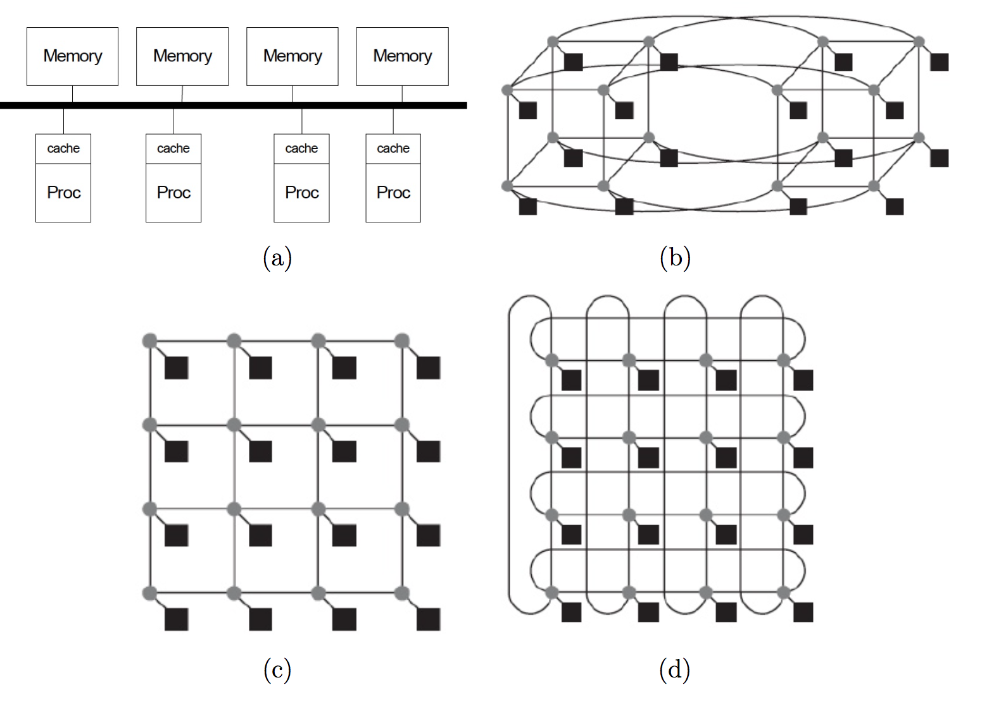
Static networks: (a) Bus; (b) Hypercube; © 2D-mesh; and (d) Torus.

Slide 47
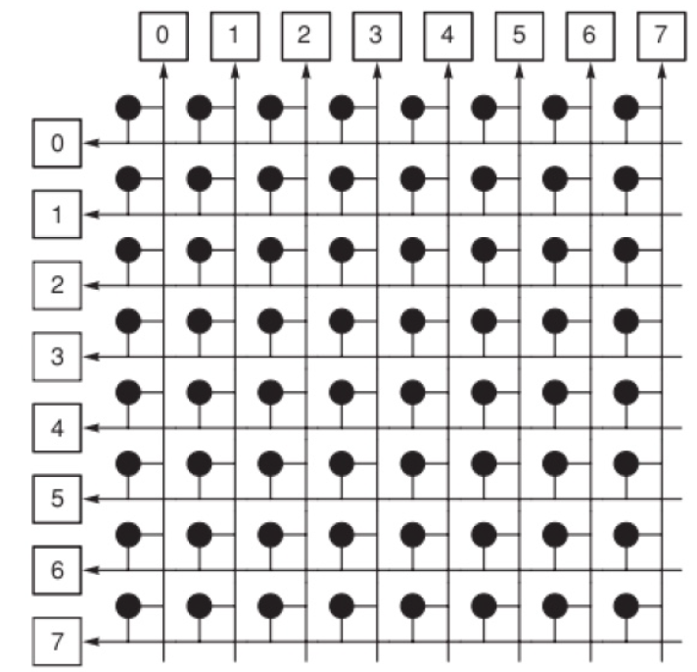
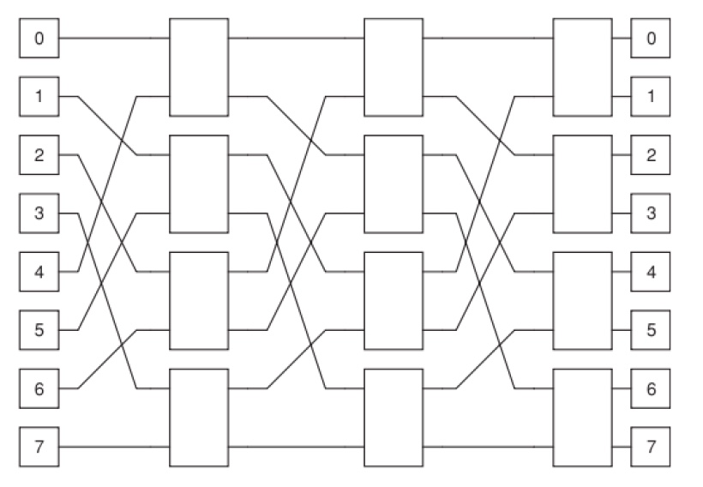
Switched networks.
(Left) An 8 x 8 crossbar switch. 16 nodes are interconnected by 49 switches represented by the dark circles.
(Right) An 8 x 8 Omega swch. 16 nodes are interconnected by 12 switches represented by white rectangles.

Slide 48
Cloud interconnection networks
While processor and memory technology have followed Moore's law, the interconnection networks have evolved at a slower pace and have become a major factor in determining the overall performance and cost of the system.
The networking infrastructure is organized hierarchically: servers are packed into racks and interconnected by a top of the rack router; the rack routers are connected to cluster routers which in turn are interconnected by a local communication fabric.
The networking infrastructure of a cloud must satisfy several requirements:
  Scalability.
  Low cost.
  Low-latency.
  High bandwidth.
  Provide location transparent communication between servers.

Slide 49
Location transparent communication
  Every server should be able to communicate with every other server with similar speed and latency.
  Applications need not be location aware.
  It also reduces the complexity of the system management.
  In a hierarchical organization true location transparency is not feasible and cost considerations ultimately decide the actual organization and performance of the communication fabric.

Slide 50
Store and forward and cut-through networks
Store and-forward networks → an entire packet is buffered and its checksum is verified in each node along the path from the source to the destination.
Cut-through (wormhole) networks → packet is forwarded to its next hop as soon as the header is received and decoded. This decreases the latency, but a packet can still experience blocking if the outgoing channel expected to carry it to the next node is in use. In this case the packet has to wait until the channel becomes free.

Slide 51
Routers and switches
The cost of routers and the number of cables interconnecting the routers are major components of the cost of interconnection network.
Better performance and lower costs can only be achieved with innovative router architecture → wire density has scaled up at a slower rate than processor speed and wire delay has remained constant .
Router – switch interconnecting several networks.
  low-radix routers – have a small number of ports; divide the bandwidth into a smaller number of wide ports.
  high-radix routers - have a large number of ports; divide the bandwidth into larger number of narrow ports
The number of intermediate routers in high-radix networks is reduced; lower latency and reduced power consumption.
The pin bandwidth of the chips used for switching has increased by approximately an order of magnitude every 5 years during the past two decades.

Slide 52
Network characterization
The diameter of a network is the average distance between all pairs of nodes; if a network is fully-connected its diameter is equal one.
When a network is partitioned into two networks of the same size, the bisection bandwidth measures the communication bandwidth between the two.
The cost.
The power consumption.

Slide 53
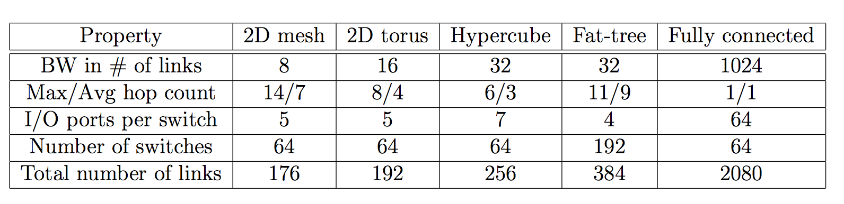
A side-by-side comparison of performance and cost figures of several interconnection network topologies for 64 nodes.

Slide 54
9. Clos networks, InfiniBand, Myrinet, fat trees
Clos → Multi­stage non­blocking network with an odd number of stages.
  Consists of two butterfly networks. The last stage of the input is fused with the first stage of the output.
  All packets overshoot their destination and then hop back to it; most of the time, the overshoot is not necessary and increases the latency, a packet takes twice as many hops as it really needs.
Folded Clos topology → the input and the output networks share switch modules. Such networks are called fat trees.
  Myrinet, InfiniBand, and Quadrics implement a fat-tree topology.
Butterfly network → the name comes from the pattern of inverted triangles created by the interconnections, which look like butterfly wings.
    Transfers the data using the most efficient route, but it is blocking, it cannot handle a conflict between two packets attempting to reach the same port at the same time.

Slide 55
a) A 5-stage Clos network with radix-2 routers and unidirectional channels; the network is equivalent to two back-to-back butterfly networks.
(b) The corresponding folded-Clos network with bidirectional channels; the input and the output networks share switch modules.

Slide 56
(a) A 2-ary 4-fly butterfly with unidirectional links.
(b) The corresponding 2-ary 4-flat flattened butterfly is obtained by combining the four switches S₀, S₁, S₂, and S₃, in the first row of the traditional butterfly into a single switch S₀‘, and by adding additional connections between switches

Slide 57
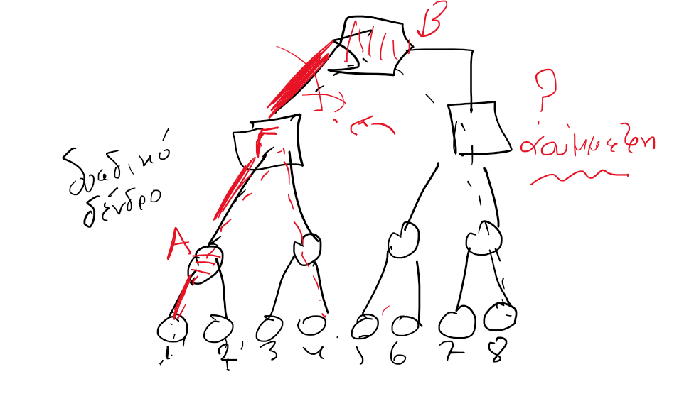

Slide 58
Fat trees
Optimal interconnects for large-scale clusters and for WSCs.
Servers are placed at the leafs.
Switches populate the root and the internal nodes of the tree.
Have additional links to increase the bandwidth near the root of the tree.
A fat-tree network can be built with cheap commodity parts as all switching elements of a fat-tree are identical.

Slide 59
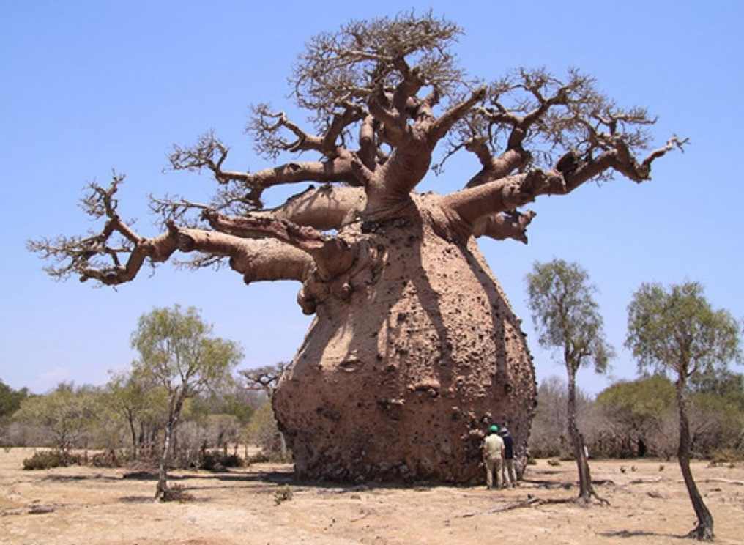

Slide 60
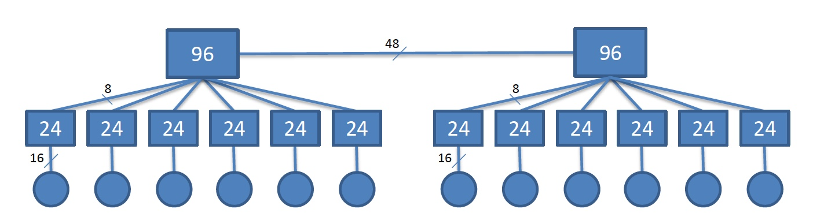
A 192 node fat-tree interconnection network with two 96-way and twelve 24-way switches in a computer cloud. The two 96-way switches at the root are connected via 48 links. Each 24-way switch has 6 x 8 uplink connections to the root and 6 x 16 down connections to 16 servers.

Slide 61
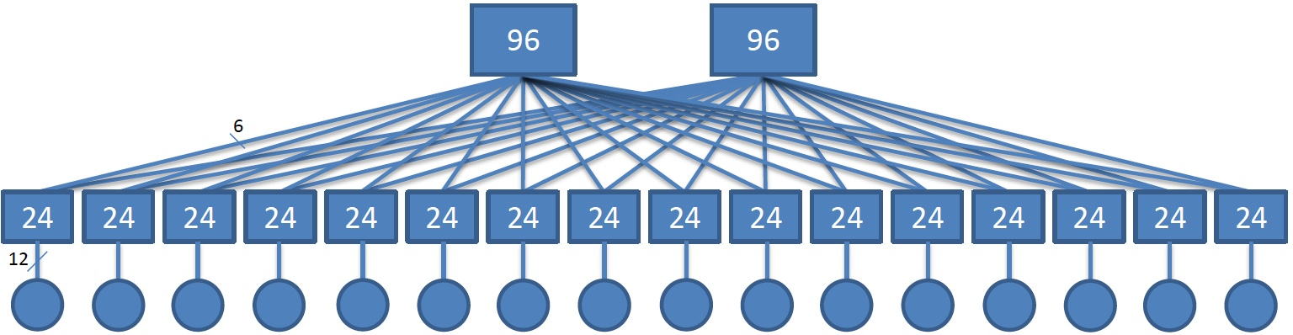
A192 node fat-tree interconnect with two 96-way and sixteen 24-way switches. Each 24-way switch has 2 x 6 uplink connections to the root and 12 down connections to 12 servers.

Slide 62
InfiniBand
Interconnection network used by supercomputers and computer clouds.
  Has a switched fabric topology designed to be scalable.
  Supports several signaling rates.
  The energy consumption depends on the throughput.
  Links can be bonded together for additional throughput.
Offers point-to-point bidirectional serial links intended for the connection of processors with high-speed peripherals, such as disks, as well as multicast operations. Advantages.
  high throughput, low latency.
  supports quality of service guarantees and failover - the capability to switch to a redundant or standby system

Slide 63
InfiniBand (Cont’d)
InfiniBand supports:
  Quality of service guarantees.
  Failover - the capability to switch to a redundant or standby system.
The data rates.
  single data rate (SDR) - 2.5 Gbps in each direction per connection.
  double data rate (DDR) - 5 Gbps.
  quad data rate (QDR) – 10 Gbps.
  fourteen data rate (FDR) – 14.0625 Gbps.
  enhanced data rated (EDR) – 25.78125 Gbps.

Slide 64
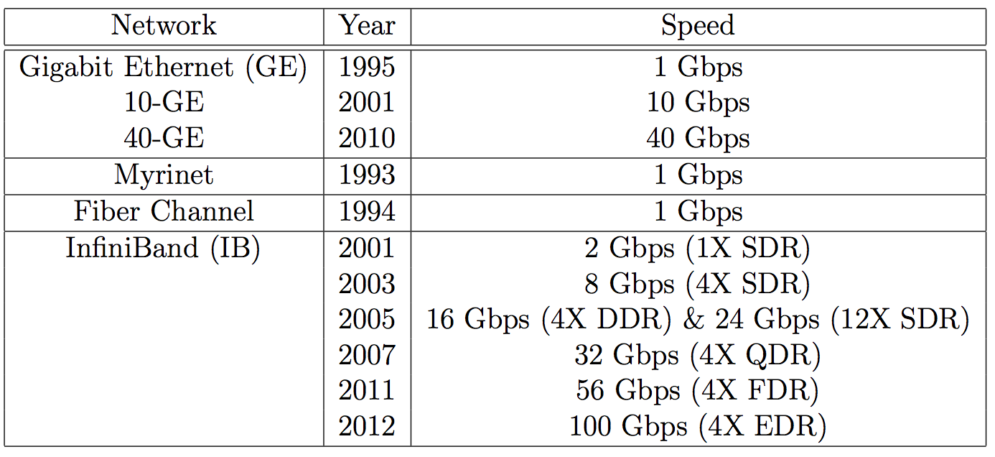
The evolution of the speed of several high speed interconnects. The data rates supported by InfiniBand: SDR, DDR, QDR, FDR, and EDR

Slide 65
Myrinet
Myrinet → interconnect for massively parallel systems developed at Caltech. Features:
  Robustness ensured by communication channels with flow control, packet framing, and error control.
  Self-initializing, low-latency, cut-through switches.
  Host interfaces that can map the network, select routes, and translate from network addresses to routes, as well as handle packet traffic.
  Streamlined host software that allows direct communication between user processes and the network.
  The network is scalable, its aggregate capacity grows with the number of nodes
Supports high data rates.
A Myrinet link consists of a full-duplex pair of 640 Mbps channels and has regular topology with elementary routing circuits in each node.. Simple algorithmic routing avoid deadlocks and allow multiple packets to flow concurrently through the network.

Slide 66
10. Storage area networks
Specialized, high-speed network for data block transfers between computer systems and storage elements.
Consists of a communication infrastructure and a management layer.
The Fiber Channel (FC) → dominant architecture of SANs.
FC → a layered protocol.

Slide 67
A storage area network interconnects servers to servers, servers to storage devices, and storage devices to storage devices.

Slide 68
FC protocol layers
Three lower-layer protocols: FC-0, the physical interface; FC-1, the transmission protocol responsible for encoding/decoding; and FC-2, the signaling protocol responsible for framing and flow control.
  FC-0 uses laser diodes as the optical source and manages the point-to-point fiber connections.
  FC-1 controls the serial transmission and integrates data with clock information.
  FC-2 handles the topologies, the communication models, the classes of service, sequence and exchange identifiers, and segmentation and reassembly.
Two upper-layer protocols:
  FC-3 is common services layer.
  FC-4 is the protocol mapping layer.

Slide 69
FC (Fiber Channel) protocol layers

Slide 70
FC classes of service
Class 1 → rarely used blocking connection-oriented service.
Class 2 → acknowledgments ensure that the frames are received; allows the fabric to multiplex several messages on a frame-by-frame basis; does not guarantee in-order delivery.
Class 3 → datagram connection; no acknowledgments.
Class 4 → connection-oriented service for multimedia applications; virtual circuits (VCs) established between ports, in-order delivery, acknowledgment of delivered frames; the fabric is responsible for multiplexing frames of different VCs. Guaranteed QoS, bandwidth and latency.
Class 5 → isochronous service for applications requiring immediate delivery, without buffering.
Class 6 → supports dedicated connections for a reliable multicast.
Class 7 → similar to Class 2, used for the control and management of the fabric; connectionless service with notification of non-delivery.

Slide 71
The format of a FC frame

Slide 72
FC networks
An FC device has a unique id called the WWN (World Wide Name), a 64 bit address, the equivalent of the MAC address.
Each port in the switched fabric has its own unique 24-bit address consisting of: the domain (bits 23 - 16), the area (bits 15 - 08), and the port physical address (bits 07-00).
A switch assigns dynamically and maintains the port addresses.
When a device with a WWN logs into the switch on a port, the switch assigns the port address to that device and maintains the correlation between that port address and the WWN address of the device using a Name Server.
The Name Server is a component of the fabric operating system, running on the switch.

Slide 73
11. Data center networks (DCNs)
Challenges :
  Aggregate cluster bandwidth scales poorly with cluster size.
  Bandwidth needed by many cloud applications comes at a high price.
  The cost increases dramatically with cluster size.
  Communication bandwidth may become oversubscribed by a significant factor depending on the communication patterns.
DCN architectural styles:
  Three-tier → multiple-rooted tree topology with three layers, core, aggregate, and access. The architecture is not suitable for computer clouds, it is not particularly scalable, the bisection bandwidth is not optimal; switches at the core layer are expensive and power-hungry. Servers are directly connected to switches at the leafs of the tree at the access layer.
  Fat-tree → optimal for computer clouds, the bandwidth is not severely affected for messages crossing multiple switches and interconnection network can be built with commodity, rather than enterprise switches.

Slide 74
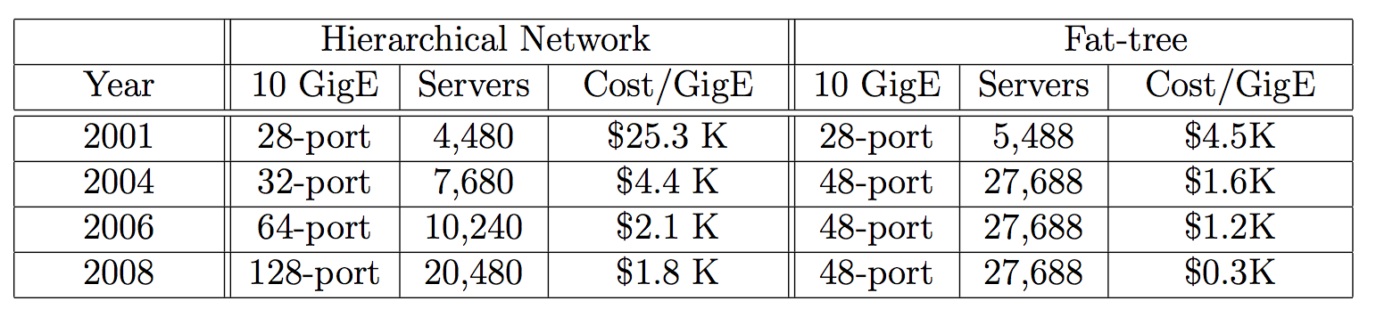
Comparison of performance and cost of hierarchical and fat-tree DCNs

Slide 75
Fat-tree DCNs
Design principles:
  The network should scale to a very large number of nodes.
  The fat-tree should have multiple core switches.
  The network should support multi-path routing. The equal-cost multi-path (ECMP) routing algorithm which performs static load splitting among flows should be used.
A WSC interconnect consists of k pods;
  Each pod has two layers and k/2 switches at each layer.
  Each switch at the lower layer is connected directly to k/2 servers. The other k/2 ports are connected to k/2 of the k ports in the aggregation layer.
  The total number of switches is k(k+1) and the total number of servers connected to the system is k². There are (k/2)² paths connecting every pair of servers.

Slide 76
Fat-tree interconnection network for k=4. The core, the aggregation, and the edge layers are populated with 4-port switches. Each core switch is connected with one of the switches at the aggregation layer of each pod.
The network has four pods, there are four switches at each pod, two at aggregation layer and two at the edge. Four servers are connected to each pod.

Slide 77
IP addresses of switches have the form 87.pod.switch.1; switches are numbered left to right, and bottom to top. Core switches have IP addresses of the form 87.k.j.i where k=4, j and i denote the coordinates of the switch in the (k/2)² core switch grid starting from top-left. The four switches of pod 2 have IP addresses 87.2.0.1, 87.2.1.1, 87.2.2.1, and 87.2.3.1.
Servers have IP addresses of the form 87.pod.switch.serverID; serverID is the server position in the subnet of the edge router starting from left to right; e.g., IP addresses of the two servers connected to the switch with IP address 87.2.0.1 are 87.2.0.2 and 87.2.0.3.

Slide 78
IP addresses of switches have the form 87.pod.switch.1; switches are numbered left to right, and bottom to top.
Core switches have IP addresses of the form 87.k.j.i where j and i denote the coordinates of the switch in the (k/2)² core switch grid starting from top-left, e.g., the four switches of pod 2 have IP addresses 87.2.0.1, 87.2.1.1, 87.2.2.1, and 87.2.3.1.
Servers have IP addresses of the form 87.pod.switch.serverID where serverID is the server position in the subnet of the edge router starting from left to right; e.g., IP addresses of the two servers connected to the switch with IP address 87.2.0.1 are 87.2.0.2 and 87.2.0.3.
(Left) The two level routing tables for switch 87.2.2.1. Two incoming packets for IP addresses 87.2.1.2 and 87.3.0.3 are forwarded on ports 1 and 3, respectively.
(Right) The RAM implementation of a two-level TCAM routing table

Slide 79
12. Network resource management algorithms
Aim → guarantee the communication bandwidth required by an application as specified by an SLA.
Scope → manage
  Communication links of limited bandwidth.
  Switches of limited capacity.
How → apply strategies to support the data streaming QoS requirements.
A switch handles multiple flows, pairs of source-destination end-points of the traffic.
A scheduling algorithm has to manage several quantities:
  Bandwidth → the amount of data each flow is allowed to transport.
  Timing → when the packets of individual flows are transmitted.
  Buffer space allocated to each flow.
FCFS algorithms → simple management of: bandwidth, timing, and buffer space. Do not guarantee fairness, greedy flow sources can transmit at a higher rate and benefit from a larger share of bandwidth.

Slide 80
Fair-queuing (FQ); Stochastic Fair Queuing (SFQ)
FQ → ensures that a high-data-rate flow cannot use more than its fair share of the link capacity.
FQ's objective → max-min fairness, first it maximizes the minimum data rate of any data flows, then it maximizes the second minimum data rate.
FQ throughput is low but starvation of expensive flows is avoided.
Packets are first classified into flows by the system and then assigned to a queue dedicated to the flow. Packet queues are serviced one packet at a time in round­-robin (RR) order.
SFQ → simpler and less accurate implementation of the FQ algorithms and requires less calculations.
SFQ → ensures that each flow has the opportunity to transmit an equal amount of data and takes into account data packet sizes

Slide 81
Fair Queuing - packets are first classified into flows and then assigned to a queue dedicated to the flow; queues are serviced one packet at a time in round­robin order and empty queues are skipped

Slide 82
Class-Based Queuing (CBQ)
Objective → support flexible link sharing for applications which require bandwidth guarantees such as VoIP, video-streaming, and audio-streaming.
Ensures balance between short-lived network flows, e.g., web searches, and long-lived ones, e.g., video-streaming or file transfers.
Uses several functional units:
  Classifier - uses the information in the packet header to assign arriving packets to classes.
  Estimator of the short-term bandwidth for the class.
  Selector/scheduler, identifies the highest priority class to send next and, if multiple classes have the same priority, to schedule them on a round-robin base.
  Delayer - computes the next time when a class that has exceeded its link allocation is allowed to send.

Slide 83
CBQ link sharing for two groups A, of short-lived traffic, and B, of long-lived traffic, allocated 25% and 75% of the link capacity, respectively. There are six classes of traffic with priorities 1, 2, and 3.
Priority 1 → RT (real-time) and the video streaming have are allocated 3% and 60% of link capacity.
Priority 12 → Web transactions and audio streaming are allocated 20% and 10% of link capacity.
Priority 3 → Intr (interactive applications) and FTP (file transfer protocols) are allocated 2% and 5% of link capacity.

Slide 84
CBQ classes
CBQ classes are organized in a tree-like hierarchy.
A class is:
  Overlimit if over a certain recent period it has used more than its bandwidth allocation (in bytes per second).
  Underlimit - if it has used less than its bandwidth allocation.
  Atlimit - if it has used exactly its bandwidth allocation.
A leaf class is
  Satisfied if it is underlimit and has a persistent backlog;
  Unsatisfied otherwise.
A non-leaf class is unsatisfied if it is underlimit and has some descendent class with a persistent backlog. A class should be regulated if it is overlimit and if some other class is unsatisfied and this regulation should continue until the class is no longer overlimit or until there are no unsatisfied classes.

Slide 85
There are two groups A and B and three types of traffic, e.g., web, real-time, and interactive, denoted as 1, 2, and 3.
Group A and class A.3 traffic are underlimit and unsatisfied; classes A.1, A.2 and B.1 are overlimit, unsatisfied and with persistent backlog and have to be regulated; type A.3 is underlimit and unsatisfied; group B is overlimit.
Group A is underlimit and unsatisfied; Group B is overlimit and needs to be regulated; class A.1 traffic is underlimit; class A.2 is overlimit and with persistent backlog; class B.1 traffic is overlimit and with persistent backlog and needs to be regulated.

Slide 86
Hierarchical Token Buckets (HTB)
Linux kernel implements HTB, a link sharing algorithm inspired by CBQ. In CBQ every class has an assured rate (AR); in addition to the AR every class in HTB has also a ceil rate (CR).
Main advantage of HTB over CBQ, allows borrowing; if class C needs a rate above its AR it tries to borrow from its parent; then the parent examines its children and, if there are classes running at a rate lower that their AR, the parent can borrow from them and reallocate it to C.

Slide 87
13 Content delivery networks (CDNs)
CDNs are designed to support scalability, to increase reliability and performance, and to provide better security. In 2013, Internet video is expected to generate over 18 exabytes of data per month.
A CDN receives the content from an origin server, then replicates it to its edge cache servers; the content is delivered to an end-user from the “closest” edge server.
A CDN can deliver static content and/or live or on-demand streaming media.
  Static content - media that can be maintained using traditional caching technologies as changes are infrequent. Examples: HTML pages, images, documents, software patches, audio and video files.
  Live media - live events when the content is delivered in real time from the encoder to the media server.
Protocols used by CDNs: Network Element Control Protocol (NECP), Web Cache Coordination Protocol (WCCP), SOCKS, Cache Array Routing Protocol (CARP), Internet Cache Protocol (ICP), Hypertext Caching Protocol (HTCP), and Cache Digest.

Slide 88
CDN design and performance
Design and policy decisions for a CDNs.
  The placement of the edge servers.
  The content selection and delivery.
  The content management.
  The request routing policies.
Critical metrics for CDN performance
  Cache hit ratio - the ratio of the number of cached objects versus total number of objects requested.
  Reserved bandwidth for the origin server.
  Latency - based on the perceived response time by the end users.
  Edge server utilization.
  Reliability - based on packet-loss measurements.

Slide 89
14 Overlay and scale-free networks
An overlay network, or a virtual network, is a network built on top of a physical network.
  The nodes of an overlay network are connected by virtual links which could traverse multiple physical links.
  Overlay networks are widely used in many distributed systems such as peer-to-peer systems, content-delivery systems, and client-server systems; in all these cases, the distributed systems communicate through the Internet.

Slide 90
Scale-free networks
The degree distribution of scale-free networks follows a power law.
Many physical and social systems are interconnected by a scale-free network. Empirical data available for power grids, the web, the citation of scientific papers, or social networks confirm this trend.
The majority of the vertices of a scale-free network:
  Are directly connected with the vertices with the highest degree.
  Have a low degree and only a few vertices are connected to a large number of edges.

Slide 91
A scale-free network is non-homogeneous; the majority of vertices have a low degree and only a few vertices are connected to a large number of edges; the majority of the vertices are directly connected with the highest degree ones.

Slide 92
Epidemic algorithms
Epidemic algorithm mimic the transmission of infectious diseases and are often used in distributed systems to accomplish tasks such as:
  disseminate information, e.g., topology information.
  compute aggregates, e.g., arrange the nodes in a gossip overlay into a list sorted by some attributes in logarithmic time.
  manage data replication in a distributed system.
Game of life is a popular epidemic algorithm invented by John Conway.
Several classes of epidemic algorithms exist. The concepts used to classify these algorithms
  Susceptible (S),
  Infective (I),
  Recovered (R)
refer to the state of the population subject to infectious disease and,
by extension, to the recipient of information in a distributed system.

Slide 93
SI, SIR, and SIS epidemic algorithms
Susceptible-Infective (SI) algorithms ➔ apply when the entire population is susceptible to be infected; once an individual becomes infected it remains in that state until the entire population is infected.
Susceptible-Infectious-Recover (SIR) ➔ based on the model developed by Kermack and McKendrik which assumes
  the following transition from one state to another S → I → R;
  that the size of the population is fixed (S(t) + I(t) + R(t) =N.
Susceptible-Infective-Susceptible (SIS) algorithms ➔ are particular cases of SIR models when individuals recover from the disease without immunity. If p=R(r)/I(r), then the number of newly infected grows until (1-p)/2 are infected and then decreases exponentially to (1-p).

