Slide 1
SDN, NFV, MEC and Fog Computing
Networking Concepts
Angelos Michalas

Slide 2
Today Networks

Slide 3
Software-defined networking (SDN)
An approach to network virtualization that seeks to optimize network resources and quickly adapt networks to changing business needs, applications, and traffic.
It works by separating the network's control plane and the data plane, creating software-programmable infrastructure that is distinct from physical devices.
With SDN, the functions of network orchestration, management, analytics, and automation become the job of SDN controllers.
Because these controllers are not networking devices, they can take advantage of the scale, performance, and availability of modern cloud computing and storage resources.
SDN controllers are built on open platforms, using open standards and open APIs, enabling them to orchestrate, manage, and control network equipment from different vendors.
SDN dovetails with another technology, Network Functions Virtualization (NFV).
NFV offers the ability to virtualize appliance-based network functions such as firewalls, load balancers, and WAN accelerators. The centralized control that SDN provides can efficiently manage and orchestrate virtual network functions that are enabled by NFV.

Slide 4
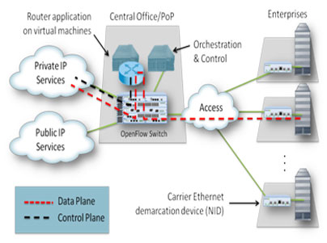
Network functions virtualization (NFV)
NFV decouples the network functions, such as network address translation (NAT), firewalling, intrusion detection, domain name service (DNS), and caching, etc., from proprietary hardware appliances so they can run in software.
It utilizes standard IT virtualization technologies that run on high-volume service, switch and storage hardware to virtualize network functions.
It is applicable to any data plane processing or control plane function in both wired and wireless network infrastructures.
In this figure all that is left at the customer site is a Network Interface Device (NID) for providing a point of demarcation as well as for measuring performance.

Slide 5
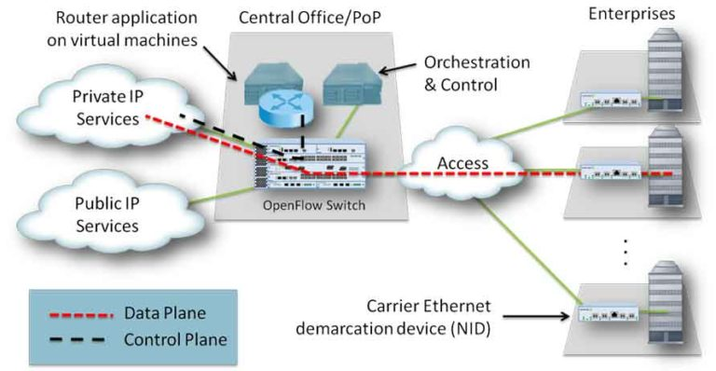
NFV & SDN
Network Functions Virtualization is highly complementary to Software-Defined Networking (SDN) but not dependent on it (or vice-versa)
Approaches relying on the separation of the control and data forwarding planes as proposed by SDN can enhance NFV performance, simplify compatibility with existing deployments, and facilitate operation and maintenance procedures
In Figure SDN is introduced to separate the control and data, as shown. Now, the data packets are forwarded by an optimized data plane, while the routing (control plane) function is running in a virtual machine running in a rack mount server.

Slide 6

Per-router control plane
Individual routing algorithm components in each and every router interact in the control plane
Routing
Algorithm
control
plane
data
plane
values in arriving
packet header
0111
1
3
2

Slide 7
Software-Defined Networking (SDN) control plane
Remote controller computes, installs forwarding tables in routers
Remote Controller
control
plane
data
plane
CA
CA
CA
CA
CA
values in arriving
packet header
0111
1
3
2

Slide 8
Software defined networking (SDN)
…
3. control plane functions external to data-plane switches
4. programmable control applications
routing
access control
load
balance
Remote Controller
control
plane
data
plane
CA
2. control, data plane separation
CA
CA
CA
CA
1: generalized “flow-based” forwarding (e.g., OpenFlow)

Slide 9
Software defined networking (SDN)
Data-plane switches:
fast, simple, commodity switches implementing generalized data-plane forwarding (Section 4.4) in hardware
flow (forwarding) table computed, installed under controller supervision
API for table-based switch control (e.g., OpenFlow)
  defines what is controllable, what is not
protocol for communicating with controller (e.g., OpenFlow)
network-control applications
…
routing
access
control
load
balance
control
plane
northbound API
SDN Controller
(network operating system)
southbound API
data
plane
SDN-controlled switches

Slide 10
Software defined networking (SDN)
SDN controller (network OS):
maintain network state information
interacts with network control applications “above” via northbound API
interacts with network switches “below” via southbound API
implemented as distributed system for performance, scalability, fault-tolerance, robustness
network-control applications
…
routing
access
control
load
balance
control
plane
northbound API
SDN Controller
(network operating system)
southbound API
data
plane
SDN-controlled switches

Slide 11
Software defined networking (SDN)
network-control apps:
“, API provided by SDN controller
unbundled: can be provided by 3rd party: distinct from routing vendor, or SDN brains” of control: implement control functions using lower-level services controller
network-control applications
…
routing
access
control
load
balance
control
plane
northbound API
SDN Controller
(network operating system)
southbound API
data
plane
SDN-controlled switches

Slide 12
Components of SDN controller
routing
access
control
load
balance
interface layer to network control apps: abstractions API
Interface, abstractions for network control apps
…
network graph
RESTful
API
intent
network-wide state management : Keeps state of networks links, switches, services: a distributed database. Its final goal is the definition of routing tables for the controlled switches.
…
statistics
flow tables
SDN
controller
Network-wide distributed, robust state management
…
Link-state info
host info
switch info
…
communication: communicate between SDN controller and controlled switches
OpenFlow
SNMP
Communication to/from controlled devices
Notes:
Representational state transfer (REST) is a software architectural style that defines a set of constraints to be used for creating Web services. Web services that conform to the REST architectural style, called RESTful Web services, provide interoperability between computer systems on the internet. RESTful Web services allow the requesting systems to access and manipulate textual representations of Web resources by using a uniform and predefined set of stateless operations. Other kinds of Web services, such as SOAP Web services, expose their own arbitrary sets of operations.^{[1]}

Slide 13

OpenFlow protocol
operates between controller, switch
TCP used to exchange messages
  optional encryption
three classes of OpenFlow messages:
  controller-to-switch
  asynchronous (switch to controller)
  symmetric (misc.)
distinct from OpenFlow API
  API used to specify generalized forwarding actions
OpenFlow Controller

Slide 14
OpenFlow: controller-to-switch messages
Key controller-to-switch messages
features: controller queries switch features, switch replies
configure: controller queries/sets switch configuration parameters
modify-state: add, delete, modify flow entries in the OpenFlow tables
packet-out: controller can send this packet out of specific switch port
OpenFlow Controller

Slide 15
OpenFlow: switch-to-controller messages
Key switch-to-controller messages
packet-in: transfer packet (and its control) to controller. See packet-out message from controller
flow-removed: flow table entry deleted at switch
port status: inform controller of a change on a port.
OpenFlow Controller
Fortunately, network operators don’t “program” switches by creating/sending OpenFlow messages directly. Instead use higher-level abstraction at controller

Slide 16
SDN: control/data plane interaction example
Dijkstra’s link-state
routing
1
S1, experiencing link failure uses OpenFlow port status message to notify controller
4
…
network graph
RESTful
API
intent
3
…
2
SDN controller receives OpenFlow message, updates link status info
statistics
flow tables
…
Link-state info
host info
switch info
3
2
Dijkstra’s routing algorithm application has previously registered to be called when ever link status changes. It is called.
…
OpenFlow
SNMP
1
4
Dijkstra’s routing algorithm access network graph info, link state info in controller, computes new routes
s2
s1
s4
s3

Slide 17
SDN: control/data plane interaction example
Dijkstra’s link-state
routing
4
5
…
network graph
RESTful
API
intent
5
link state routing app interacts with flow-table-computation component in SDN controller, which computes new flow tables needed
3
…
statistics
flow tables
…
Link-state info
host info
switch info
2
…
OpenFlow
SNMP
6
controller uses OpenFlow to install new tables in switches that need updating
1
6
s2
s1
s4
s3

Slide 18
OpenDaylight (ODL) controller
Traffic Engineering
…
Firewalling
Load Balancing
Network Orchestrations and Applications
Northbound API
REST/RESTCONF/NETCONF APIs
Enhanced Services
Basic Network Functions
…
Topology
processing
Switch
mgr.
Stats
mgr.
AAA
…
Forwarding rules mgr.
Host
Tracker
Service Abstraction Layer:
interconnects internal, external applications and services
config. and operational data store
messaging
Service Abstraction Layer (SAL)
…
Southbound API
OpenFlow
NETCONF
SNMP
OVSDB

Slide 19
ONOS controller
Traffic Engineering
…
Firewalling
Load Balancing
Network Applications
Northbound API
control apps separate from controller
intent framework: high-level specification of service: what rather than how
considerable emphasis on distributed core: service reliability, replication performance scaling
REST API
Intent
northbound abstractions,
protocols
hosts
paths
flow rules
topology
ONOS
distributed core
devices
links
statistics
device
link
host
flow
packet
southbound abstractions,
protocols
OpenFlow
Netconf
OVSDB
Southbound API
Notes:
REST stands for REpresentational State Transfer. REST is web standards based architecture and uses HTTP Protocol. It revolves around resource where every component is a resource and a resource is accessed by a common interface using HTTP standard methods. REST was first introduced by Roy Fielding in 2000.
In REST architecture, a REST Server simply provides access to resources and REST client accesses and modifies the resources. Here each resource is identified by URIs/ global IDs. REST uses various representation to represent a resource like text, JSON, XML. JSON is the most popular one.

Slide 20
MEC (Mobile Edge Computing) &
Fog Computing
MEC refers to computing at the edge of a network.
MEC offers IT service and cloud-computing capabilities at the edge of the mobile network in an environment that is characterized by proximity, ultra-low latency, and high bandwidth. Furthermore, it provides exposure to a real-time radio network and context information.
Fog computing extends the edge of the network. It’s not as close but it covers more area than the edge.
Fog is a system-level horizontal architecture that distributes resources and services of computing, storage, control and networking anywhere along the continuum from Cloud to Thing.”
Fog computing shares similar benefits to edge computing including low latency, storage-focused, and real-time analytics.

Slide 21
Differences between MEC and Fog
Fog covers mobile and wireline
Fog covers the edge but also intermediate layers between the edge and the cloud
MEC standards are mostly compute oriented, while Fog embraces storage and deep packet networking.
Fog computing has a deeper hierarchy than MEC;
MEC’s hierarchy features a single layer of nodes or base transceiver station.
Fog computing focuses more on privacy and security
Fog includes the cloud; the edge does not.

Slide 22
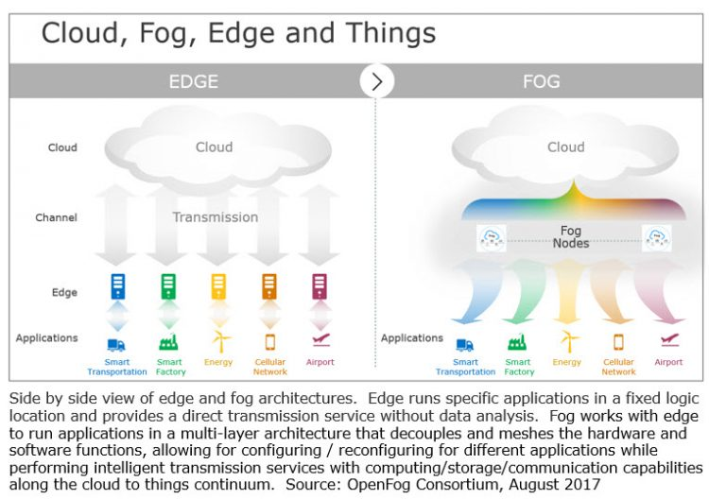
Differences between MEC and Fog

Slide 23
Evolved Packet Core (EPC), the core network of the LTE system
HSS (Home Subscriber Server): Περιέχει πληροφορίες (συνδρομής κτλ.) σχετικά με τους χρήστες.
ΜΜΕ (Mobility Management Entity) : Οντότητα Υποστήριξης Κινητικότητας
P-GW (Packet Gateway): Παρέχει πρόσβαση σε ένα δίκτυο μεταγωγής πακέτων
S-GW (Service Gateway): Παρέχει πρόσβαση στο δίκτυο κορμού του LTE
EPC (Evolved Packet Core): Δίκτυο κορμού
E-UTRAN (Evolved Universal Terrestrial Radio Access): Δίκτυο πρόσβασης

Slide 24
TelcoFog: A Unified Flexible Fog and Cloud
Computing Architecture for 5G Networks
Ricard Vilalta, Victor López, Alessio Giorgetti, Shuping Peng, Vittorio Orsini, Luis Velasco, René Serral-Graciá, Donal Morris, Silvia De Fina, Filippo Cugini, Piero Castoldi, Arturo Mayoral, Ramon Casellas, Ricardo Martínez, Christos Verikoukis, and Raul Muñoz

Slide 25
Challenge 1:
Fog Computing for Network Operators
It is clear that a distributed data center (DC) architecture is needed for network operators so as to:
  Improve the perceived quality of experience (QoE) for their users.
  Reduce energy consumption [8].
  Or even have high-level and fast reaction in response to events such as network failures.
Such distributed cloud architecture was named the telecom cloud in [9].
Scalability also has to be considered in the telecom cloud since.
  In contrast to a small number of warehouse-sized DCs commonly used in public clouds,
  The telecom cloud must support a large number of small, distributed DCs.
    To reduce traffic in the core network.

Slide 26
Challenge 1:
Fog Computing for Network Operators
Fog computing:
  Enables a new breed of applications and services.
    That goes beyond the regular telecom services.
  So there is a fruitful interplay between the cloud and the fog.
Therefore, there is a need for a distributed intelligent platform at the edge.
  That manages distributed computing, networking, and storage resources.

Slide 27
Challenge 2:
Fog and Cloud Computing Interconnection through Operator SDN-Enabled Networks
A hybrid cloud-fog computing architecture is needed.
  Which spans from the edge (fog) to the core (cloud).
Services deployed in fog nodes will interwork with cloud-located services.
  Thus, developing a resource orchestration mechanism will be of the essence.
It shall interconnect both fog and cloud domains.
  Which will be interconnected through heterogeneous operators’ networks.
A related challenge is the fact that operators are reluctant to incorporate the principles of SDN.

Slide 28
Challenge 3:
Decentralized NFV Services
The growth of NFV:
  Is driving the softwarization of all functions in the network.
    That are traditionally deployed in dedicated hardware.
By eliminating specialized network processors:
  Multiple heterogeneous workloads can be consolidated onto a single architecture.
  Thus reducing complexity and simplifying operation.
    Which leads to reducing total cost of ownership (TCO).
Therefore, NFV enables:
  The migration into a telecom cloud.
  The transition of the operator network to SDN control.
  At the same time allowing the programmability of the network resources.
    For fully utilizing the capacity of the deployed physical resources [4].

Slide 29
Challenge 4:
Mobile Edge Computing and D2D Communication
Besides NFV:
  Telecom operators are also studying the benefits and business models of addressing MEC.
    Which provides IT and cloud-computing capabilities.
      Within the RAN in close proximity to mobile subscribers.
MEC allows content, services, and applications to be accelerated.
  Increasing responsiveness from the network edge.
The user’s experience can be enriched:
  Through efficient network and service operations.
Using MEC, network operators can:
  Deploy fog nodes in the RAN.
  Open the radio network edge to third-party partners.
    Allowing them to rapidly deploy innovative applications and services.
      Toward mobile subscribers, enterprises and other vertical segments.

Slide 30
Challenge 5:
Smart City Services on Top of a Fog Computing Architecture
The need for data processing, analysis and security close to the connected things at the edge of the network:
  Leads to an explosive growth of independent gateways, repeaters and systems.
    With vendors’ proprietary information models that do not interoperate.
This results in siloed solutions (application that does not interact with other applications or information systems) .
  That do not interoperate and increase TCO (Total Cost of Ownership) for smart city operators and vertical industries.
They must have an open, flexible and secure platform:
  On which to consolidate siloes and services at the edge.
    And to connect intelligently with the cloud [12].

Slide 31
Challenge 6:
Integration with a Big Data and Analytics Framework
In recent years, the term big data has emerged:
  To describe a new paradigm for data applications.
The heart of the big data paradigm is that data:
  is too broad,
  arrives too fast,
  changes too fast,
  contains too much noise,
  is too diverse to be processed within a local computing structure.
    Using traditional approaches and techniques.

Slide 32
Challenge 6:
Integration with a Big Data and Analytics Framework
The big data paradigm consists of:
  The distribution of data systems across horizontally coupled independent resources.
    To achieve the scalability needed for the efficient processing of extensive datasets.
The challenge is to provide the necessary extensions to big data frameworks:
  In order to provide the necessary TelcoFog node computational and storage resources for applications.

Slide 33
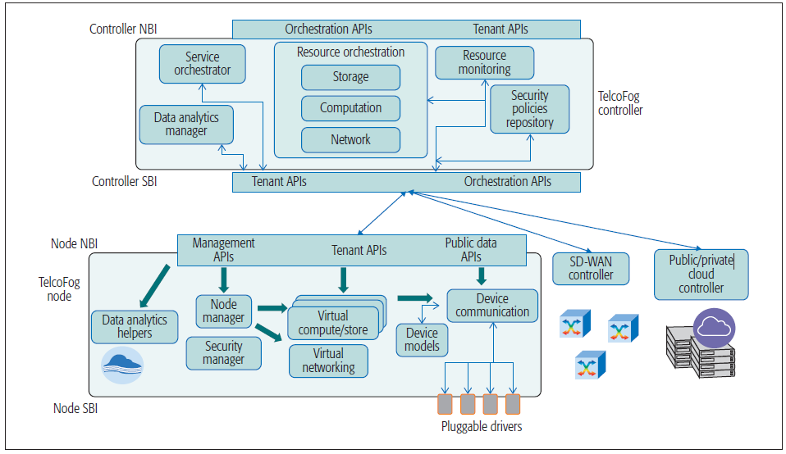
TelcoFog System Architecture
Overall description of the basic components.
Telco- Fog node
  Secured, and resilient
TelcoFog controller
  Responsible for the orchestration of TelcoFog resources.
  As well as their interconnection through highly programmable networks.
Figure 2. Detailed TelcoFog system architecture.

Slide 34
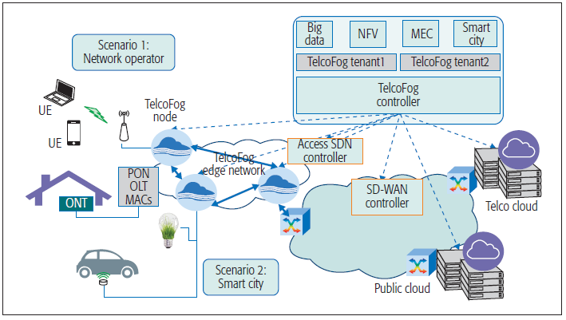
TelcoFog System Architecture
The TelcoFog architecture.
  Introduced at the edge of a network operator infrastructure.
    To fulfill the presented challenges.
TelcoFog nodes are placed at the edge of the network.
Two scenarios are envisaged:
  Integrated network operator services
  Integrated smart city services.
Figure 1. TelcoFog architecture

Slide 35
TelcoFog System Architecture
TelcoFog nodes might create an overlay network on top of the operator’s access network.
  In order to interwork, allowing different networking services.
  e.g. multicast or anycast services based on the emerging segment routing technology.
  It is referred to as a TelcoFog edge network.
In both scenarios, the TelcoFog node plays a significant role:
  By providing the necessary distributed and secure computing, storage, and networking infrastructure.
Figure 1. TelcoFog architecture

Slide 36
TelcoFog Node
The TelcoFog node is the fog/network infrastructure.
  It is responsible for provisioning the necessary computation, storage and networking resources.
Physically, a TelcoFog node might consist of:
  Servers.
  Additional storage devices.
  Network interface cards.
Logically, a TelcoFog node incorporates
  A node manager.
    In order to handle the offered TelcoFog virtual resources.
  A Security Manager is responsible for handling the device authorization, authentication and encryption.
  A device communication module:
    Allows the abstraction and control of the underlying smart things and devices, through the data modeling of the devices.
  Devices’ configuration, procedures and notifications:
    Are modeled and can be (auto) discovered and related through services running in the TelcoFog node.

Slide 37
TelcoFog Node
The Node Manager:
  Handles the optimal allocation of the required virtual resources:
    Onto the node physical resources.
      Which are the pool of existing resources within the node.
The virtual allocated resources might include:
  Containers or virtual machines.
    Depending on the capabilities of the node.
  Allocated virtual memory.
  Virtual disk space.
  Virtual network interface cards.
  Virtual switches.

Slide 38
TelcoFog Node
Communication module.
  This module provides a set of Pluggable Drivers that:
    Allow uniform access to the things.
    Are extensible.
    Use a public interface to allow the easy integration of sensors, actuators, or any other devices.
      By modeling their behavior in the Device Models.
  This allows the disaggregation of the fog resources
    Toward the extreme edge of the network.
      As smart devices could also be used for processing, storage and networking purposes.
Another important component within the node is the Data Analytics.
  It consists of Helpers:
    Predefined set of functionalities for data analysis and evaluation.
      Can be provided as services running on top of allocated virtual resources.

Slide 39
TelcoFog Node
TelcoFog services:
  Abstract the access to the different smart things and devices.
    By means of a Device Proxy.
      As part of the Device Communication module.
      Which interplays between the users, the tenants (through a privileged API allowing an enhanced set of features), and the things.
The main purpose of this proxy:
  Provide finer granularity and a more powerful system to control the access to the things.
  Enforce the necessary Security Policies.
    Using the Security Manager to:
      Offer the sufficient smart caching capabilities.
      Avoid the unnecessary resource consumption of the things.

Slide 40
TelcoFog Node
Finally, in order to allow the usage of all these functionalities:
  The TelcoFog node offers a common northbound interface (NBI).
    Can be split into three different views:
      Management API.
      Tenant API.
      Public data API.
The management API:
  Manages the resources within the TelcoFog node.
  Should be only used from the TelcoFog Controller.
    The Security Manager enforces this.

Slide 41
TelcoFog Node
The tenant API:
  It is used as a private interface.
  Allows the different tenants to control and manage TelcoFog services.
    Which gather data from the allocated virtual resources.
The public data API:
  Provides access to the monitored data.
    That Security Manager policy specifies as publicly available.

Slide 42
TelcoFog Controller
Extends the concept of an NFV orchestrator.
  In order to support the dynamic deployment of generic virtualized functions (TelcoFog services).
Its main role is the distributed orchestration of resources and services.
The core block of this unit is the Resource Orchestration.
  Its main role is to define and enforce the resource orchestration logic.
    Defining the particular logic that allows the system to allocate the different storage, computation and network resources.
    Into the deployed TelcoFog nodes, or in centralized cloud DCs
  To achieve this, the Resource Orchestrator:
    Will receive information about the status of each fog node through its Resource Monitoring module.
      Which will have an updated view of the resource consumption and general status of the system.
.

Slide 43
TelcoFog Controller
The Service Orchestrator module
  Manages the deployment of the different services
  It is also in charge of guaranteeing that the service is functioning properly.
It is responsible for:
  Requesting the necessary resources.
  Deploying the requested services on top of them.
  It acts as generalized NFV management and orchestration (NFV MANO):
    Services are generic virtualized functions - might or not be network related.
  It is expected to leverage the work done in NFV
    And align it with MEC servers.
    While providing access to the data obtained from the smart things and devices.
Notes:
MANO - network functions virtualization management and orchestration

Slide 44
TelcoFog Controller
A Security Policies Repository module.
  Where the policies are stored and securely pushed to the fog node.
Thus the access to the different resources is controlled and security policies enforced on each fog node are defined.
TelcoFog services are modeled using their YANG data models:
  They can be deployed on top of the allocated TelcoFog resources reserved for each tenant.

Slide 45
TelcoFog Controller
The Resource monitoring module provides service assurance.
  It inspects the provided TelcoFog services.
  In order to anticipate future degradation of the QoE.
The Data analytics manager module
  Allows the triggering of a specifically configured set of functionalities for data analysis.
  Evaluation can be provided to services running on top of allocated virtual resources.

Slide 46
TelcoFog Big Data and Analytics Framework
One of the main objectives of data analytics is Knowledge Discovery from Data (KDD) [13].
To that end, the following steps are performed in an iterative way.
Data Pre-Processing:
  Basic operations include:
    Data selection.
      To retrieve data relevant to the KDD task from the database.
    Data cleaning.
      To remove noise and inconsistent data, handle the missing data fields, etc.
    Data integration.
      To combine data from multiple sources.

Slide 47
TelcoFog Big Data and Analytics Framework
Data Transformation:
  The goal is to transform data into forms.
    Appropriate for the learning and mining task.
      To find useful features to represent the data.
    Feature selection and feature transformation are basic operations.
Data Mining and Machine Learning:
  This is an essential process.
    Where intelligent methods are employed.
      To make predictions and extract patterns.
        e.g., classification, regression, clustering.
Pattern Evaluation and Presentation:
  Identifies the truly interesting patterns.
    That represent knowledge in an easy-to-understand fashion.

Slide 48
TelcoFog Big Data and Analytics Framework
The TelcoFog allows the KDD process to offer knowledge as a service to TelcoFog services.
The real-time capability:
  Provides mission-critical business intelligence.
    In support of enterprise decision making.
Such a framework allows applications to monitor and manage computation and storage resources.
  While protecting the privacy and integrity of data.

Slide 49
TelcoFog Big Data and Analytics Framework
Each component in the fog computing architecture:
  Generates detailed event records for every significant event.
    These event records are kept/ sent to one or multiple instances of TelcoFog nodes.
      That collate, store and process the information.
        In a horizontally scalable framework for distributed storage and processing of very large data sets.
The nodes include mechanisms to automatically trigger the collection of more detailed records.
  When a certain event occurs.
  The goal is to be able to get to the root cause of any issue without having to reproduce it.

Slide 50
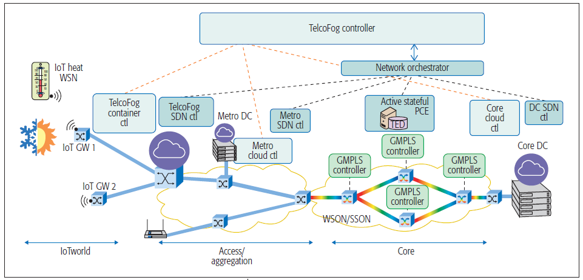
TelcoFog Proof of Concept (PoC) for IoT Services
TelcoFog proof of concept scenario.

Slide 51
TelcoFog Proof of Concept for IoT Services
The IoTWorld testbed:
  Consists of a set of heating, ventilating, and air conditioning (HVAC) modules and actuators.
It also includes a wireless sensor network (WSN).
  Which forwards measurements of temperature and energy consumption to an IoT gateway.
The ADRENALINE testbed:
  A cloud computing platform distributed across access/ aggregation and core networks [14].
  An SDN/NFV-enabled TelcoFog node has been deployed in ADRENALINE.
  It have been interconnected to IoT gateways from IoTWorld by means of an end-to-end (E2E) TelcoFog controller.
Figure 3. TelcoFog proof of concept scenario.

Slide 52
TelcoFog Proof of Concept for IoT Services
The network orchestrator:
  Provides network connectivity between IoT gateways and deployed containers.
The TelcoFog node has been implemented using Docker containers and OpenVSwitch.
  Containers might be allocated in the TelcoFog node or toward virtual machines which have been allocated in a DC in the core network.
  An agent allows the dynamic creation of containers and their attachment to the underlying virtual switch.
Cloud Controller has been implemented using OpenStack Mitaka.
TelcoFog proof of concept scenario.

Slide 53
TelcoFog Proof of Concept for IoT Services
An HVAC application has been defined.
  It models HVAC services such as temperature control.
  It is responsible for:
    Monitoring temperature sensors.
    Uploading the data into a database running on the cloud.
If the application detects an increase of temperature:
  It is able to activate the AC actuator.
    In order to reduce the measured temperature.
The YANG model used for the HVAC agent:
  Uses three containers to organize the necessary config/status data for temperature, heat and AC, respectively.

Slide 54
TelcoFog Proof of Concept for IoT Services
The HVAC application.
  Runs at the TelcoFog node at the network edge.
The location of the application at the network edge:
  Improves the latency of the application.
  Reduces the necessary bandwidth.
  Since cloud resources, typically located in distant locations.
The TelcoFog Controller:
  Responsible for handling computational and network connectivity requests.
    Which are processed through the Cloud Controller/TelcoFog node and network orchestrator.
The Cloud Controller (OpenStack):
  It is accessed through its REST API.
The Telco-Fog node and Network Orchestrator are handled using the YANG-based APIs.

Slide 55
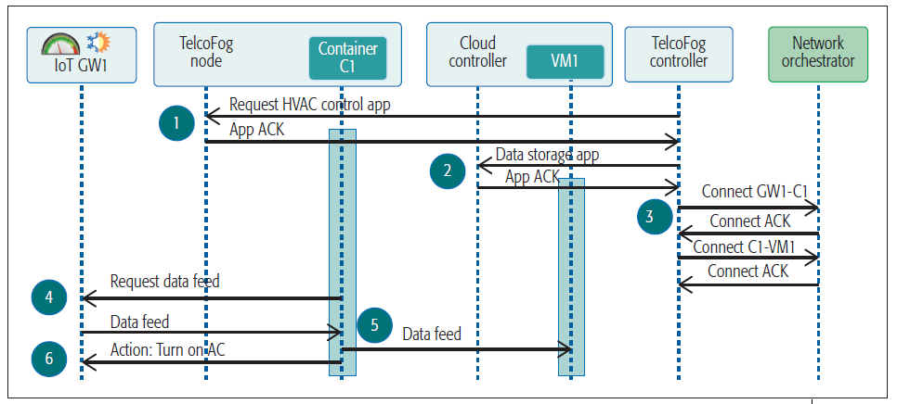
TelcoFog Proof of Concept for IoT Services
The orchestration process for the deployment of the HVAC application consists of steps 1, 2 and 3, while the HVAC operations include steps 4, 5 and 6.
Step 0:
  The TelcoFog controller is requested to deploy an HVAC service.
    Which will be able to control the temperature locally and store the measurements on a cloud-based database.
Step 1:
  The TelcoFog controller will first request of a fog node the creation of a container (C1) running the HVAC application.
Figure 4. Message Exchange workflow for the deployment and operations of a HVAC application.

Slide 56
TelcoFog Proof of Concept for IoT Services
Step 2:
  Once the container is available the TelcoFog controller triggers the creation of a database running on a cloud DC (VM1).
Step 3:
  Once the computational resources have been obtained:
    The TelcoFog controller requests the connectivity services to the network orchestrator.
  Connectivity services are requested between the HVAC container and the cloudbased database, as well as between the HVAC container and the IoT gateway (GW1).
  Once the HVAC service has been fully deployed:
    The HVAC enters operation mode.
Figure 4. Message Exchange workflow for the deployment and operations of a HVAC application.

Slide 57
TelcoFog Proof of Concept for IoT Services
Step 4:
  The HVAC application continuously monitors the temperature using a standardized HVAC YANG service.
Step 5:
  The data is stored toward the database running on the cloud.
Step 6:
  If a high temperature is detected:
    A YANG remote procedure call (RPC) will be triggered toward the IoT GW1.
      In order to turn on the AC.
Figure 4. Message Exchange workflow for the deployment and operations of a HVAC application.

Slide 58
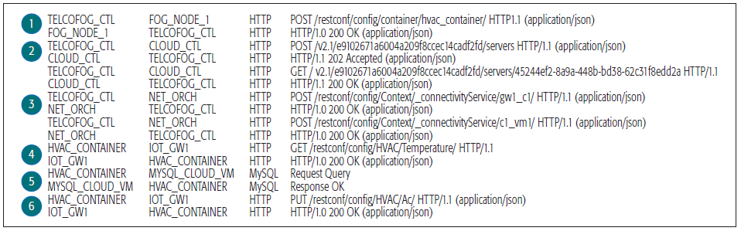
TelcoFog Proof of Concept for IoT Services
Figure 5 shows:
  The captured Wireshark traces for the TelcoFog orchestration process.
    For HVAC service deployment.
  The traces from the operation of the HVAC application.
It can be observed that the RESTconf Protocol is used for the HVAC, Container and Connectivity Service YANG data models.
These Wireshark traces demonstrate the feasibility of the proposed approach.
  In order to use YANG-based services for both IoT and NFV applications.
Figure 5. Wireshark capture of the HVAC service deployment and operation.

Slide 59
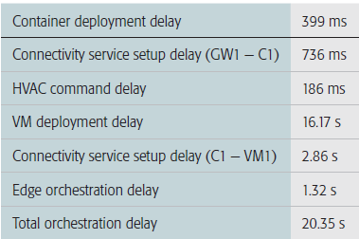
TelcoFog Proof of Concept for IoT Services
Table 1 shows the mean delays for 10 orchestration cycles of the proposed experimental PoC.
It can be observed that container deployment delay is two orders of magnitude inferior to virtual machine deployment delay.
  Thus allowing faster service deployment.
Table 1. Experimental result for TelcoFog orchestration.

Slide 60
TelcoFog Proof of Concept for IoT Services
Connectivity services delay.
  It is influenced by:
    The delay between network elements and network orchestrator.
    The need for establishment of dynamic optical paths
      Which significantly increases the setup delay.
In case only edge services are deployed,
  Orchestration delay is reduced to 1.32 s.
Table 1. Experimental result for TelcoFog orchestration.

Slide 61
Conclusions
This article describes a novel architecture:
  For providing unified cloud and fog resources.
    For deploying NFV, MEC and IoT services.
      On the top of a telecom operator’s network.
A proof of concept for the TelcoFog architecture has been introduced.
  It focuses on distributed and programmable fog technologies.
TelcoFog is capable of integrating an ecosystem for network operators.
  Willing to provide NFV, MEC and IoT services.
The HVAC service demonstartes:
  The feasibility of the proposed approach.
    Using YANG modeling language for IoT services description.
  The basis for unifying the NFV and MEC services.
    Allowing telecom operators to reduce their TCO.

Slide 62
References
F. Bonomi et al., “Fog Computing and Its Role in the Internet of Things,” Proc. MCC Wksp. Mobile Cloud Computing, 2012, pp. 13–16.
OpenFog Consortium Architecture WG, “OpenFog Architecture Overview,” white paper, Feb. 2016.
J. Halpern and C. Pignataro, “Service Function Chaining (SFC) Architecture,” IETF RFC 7665, Oct 2015.
R. Vilalta et al., “Transport Network Function Virtualization,” J. Lightwave Technology, vol. 33, no. 5, Apr. 2015, pp. 1–8.
M. Dallaglio et al., “YANG Model and NETCONF Protocol for Control and Management of Elastic Optical Networks,” OFC, 2016, pages 1–3.
B. Claise, “YANG as the Data Modeling Language in the IoT Space,” Proc. IoT Semantic Interoperability Wksp., 2016; https://www.iab.org/activities/workshops/iotsi/, accessed Feb. 5, 2017.
UNIFY Project, “D5.1: Universal Node Functional Specification and Use Case Requirements on Data Plane,” 2014; http://www.fp7-unify.eu/files/fp7-unify-eu-docs/Results/ Deliverables/UNIFY-WP5-D5.1-Universal_node_functional_ specification.pdf, accessed Dec. 22, 2016.

Slide 63
References
L. Velasco et al., “Elastic Operations in Federated Datacenters for Performance and Cost Optimization,” Elsevier Computer Commun., vol. 50, 2014, pp. 142–51.
L. Velasco et al., “A Service-Oriented Hybrid Access Network and Cloud Architecture,” IEEE Commun. Mag., vol. 53, 2015, pp. 159–65.
V. López et al., “Transport API: A Solution for SDN in Carriers Networks,” Proc. 42nd Euro. Conf. Optical Commun., Düsseldorf, Germany.
R. Muñoz et al., “Integrated SDN/NFV Management and Orchestration Architecture for Dynamic Deployment of Virtual SDN Control Instances for Virtual Tenant Networks,” J. Optical Commun. Networking, vol. 7, no. 11, 2015.
“Building Scalable, Sustainable, Smart+Connected Communities with Fog Computing”; http://blogs.cisco.com/innovation/ barcelona-fog-computing-poc, 2015, accessed Dec. 22, 2016.
U. Fayyad, G. Piatetsky-Shapiro, and P. Smyth, “From Data Mining to Knowledge Discovery in Databases,” AI Mag., 17:3, vol. 37, 1996.
R. Vilalta et al., “End-to-End SDN Orchestration of IoT Services Using an SDN/NFV-Enabled Edge Node,” Proc. OFC, 20–24 Mar. 2016, Anaheim, CA.
https://github.com/rvilalta/iotworld, accessed Dec. 12, 2016.

