Slide 1
INTRODUCTION TO Cloud Computing
Άγγελος Μιχάλας
Καθηγητής
Τμήμα Ηλεκτρολόγων Μηχανικών & Μηχανικών Υπολογιστών
Πανεπιστήμιο Δυτικής Μακεδονίας

Slide 2
Outline
Introduction
Cloud Computing
Examples

Slide 3
Evolution
Classical Computing
  Buy & Own
    Hardware,
    System Software,
    Applications often to meet peak needs.
  Install, Configure, Test, Verify
  Manage
  ..
  Finally, use it
  $$$$....$(High CapEx)
Cloud Computing
  Subscribe
  Use
  $ - pay for what you use, based on QoS

Slide 4
Definition (1)
Cloud
Computing
The “Cloud” is the default symbol of the Internet in diagrams.
The broader term of “Computing” encompasses:
Computation
Coordination logic
Storage
Cloud Computing is about moving computing from the single desktop pc/data centers to commercial service providers on the Internet.

Slide 5
Definition (2)
Cloud Computing: Internet-based computing, whereby shared resources, software and information are provided to computers and other devices on-demand.
Numerous previous attempts:
  on-demand computing, utility computing, ubiquitous computing, autonomic computing, platform computing, edge computing, elastic computing, grid computing, …

Slide 6
Cloud characteristics
Uses Internet technologies to offer scalable and elastic services. The term “elastic computing” refers to the ability of dynamically acquiring computing resources and supporting a variable workload.
The resources used for these services can be metered and the users can be charged only for the resources they used.
The maintenance and security are ensured by service providers.
The service providers can operate more efficiently due to specialization and centralization.

Slide 7












Cloud Service Models
Office Applications, CRM, E-mail, Media, Gaming
SaaS
SalesForce.com
Google Docs
Applications
& Services
Development Platforms, Runtime environments for applications, APIs
PaaS
Heroku
Microsoft Azure
Development Platform
IaaS
Virtual servers, virtual storage, and networking
Amazon EC2, S3
Joyent, Rightscale
Infrastructure

Slide 8
Types of clouds
Public Cloud - the infrastructure is made available to the general public or a large industry group and is owned by the organization selling cloud services.
Private Cloud – the infrastructure is operated solely for an organization.
Community Cloud - the infrastructure is shared by several organizations and supports a community that has shared concerns.
Hybrid Cloud - composition of two or more clouds (public, private, or community) as unique entities but bound by standardized technology that enables data and application portability.

Slide 9

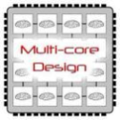
Cloud supporting technologies
Cloud applications: data-intensive, compute-intensive, storage-intensive
Bandwidth
WS
Services interface
Web-services, SOA, WS standards
VM0
VM1
VMn
Storage Models: S3, BigTable, BlobStore, ...
Virtualization: bare metal, hypervisor. …
Multi-core architectures
64-bit processor

Slide 10
Virtual machine monitor (VMM / hypervisor)
Is the software that partitions the resources of computer system into one or more virtual machines (VMs). Allows several operating systems to run concurrently on a single hardware platform.
A VMM allows
  Multiple services to share the same platform.
  Live migration - the movement of a server from one platform to another.
  Enforces isolation among the systems, thus security.

Slide 11
Virtual machines (VMs)
VM - isolated environment that appears to be a whole computer, but actually only has access to a portion of the computer resources.
Two VM Types:
  Process VM - a virtual platform created for an individual process and destroyed once the process terminates.
  System VM - supports an operating system together with many user processes (eg. Java Virtual Machine – JVM).

Slide 12
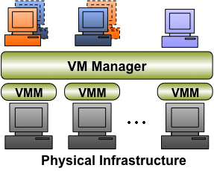
Provisioning of virtual resources
Cloud systems provide virtualized resources as a service
VM Manager
  Submission
  Control
  Monitoring

Slide 13
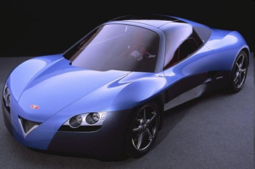

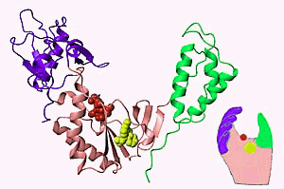
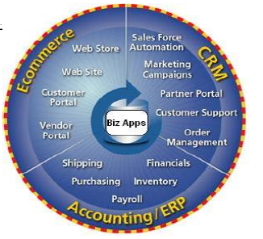



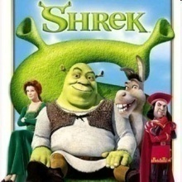




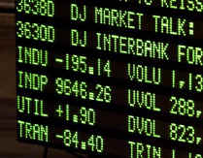

Cloud Applications
Scientific/Tech Applications
Business Applications
Customer/Social Applications
Science and Technical Applications
Business Applications
Customer/Social Applications

Slide 14

Windows Azure
Enterprise-level on-demand capacity builder
Computational cycles and storage available on-request for a cost
You have to use Azure API to work with the infrastructure offered by Microsoft
Significant features: web role, worker role , blob storage, table and drive-storage

Slide 15

Amazon web services (AWS)
Provision of multiple service models:
  IaaS: EC2, S3, ELB, AutoScaler
  PaaS: Elastic Beanstalk, EMR
  SaaS: CloudSearch, Elastic Transcoder

Slide 16
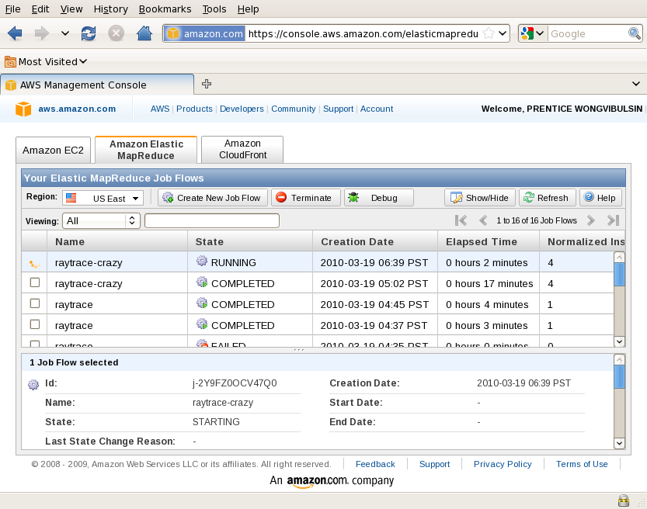
Amazon Elastic Compute Cloud (EC2)
A web service for instantiating computing instances with any of the operating systems supported.
Features: Cloud Management Console, MapReduce Cloud, Cloud monitoring tools

Slide 17
EC2 pricing
Type | U$ per hour | Ratio to Small | Compute Units | Virtual Cores | Compute Unit/ Core | Memory (GB) | Disk (GB) | Addr. (bits)
Standard Small | 0,115 | 1 | 1 | 1 | 1 | 1,7 | 160 | 32/64
Standard Medium | 0,230 | 2 | 2 | 1 | 2 | 3,75 | 410 | 32/64
Standard Large | 0,460 | 4 | 4 | 2 | 2 | 7,5 | 850 | 64
Standard Extra Large | 0,920 | 8 | 8 | 4 | 2 | 15 | 1690 | 64
High-Memory Extra Large | 0,680 | 5,9 | 6,5 | 2 | 3,25 | 17,1 | 420 | 64
High-Memory Double Extra Large | 1,360 | 14,1 | 13 | 4 | 3,25 | 34,2 | 850 | 64
High-Memory Quadruple Extra Large | 2,720 | 28,2 | 26 | 8 | 3,25 | 68,4 | 1690 | 64
High-CPU Medium | 0,230 | 2 | 5 | 2 | 2,5 | 1,7 | 350 | 32/64
High-CPU Extra Large | 0,920 | 8 | 20 | 8 | 2,5 | 7 | 1690 | 64
Cluster QuadrupleCloud Management Console, MapReduce Cloud, Amazon Machine Image (AMI) Extra Large | --- | 15,3 | 33,5 | 16 | 2,09 | 23 | 1690 | 64
Eight Extra Large | --- | 28,2 | 88 | 32 | 2,75 | 60,5 | 1690 | 64

Slide 18


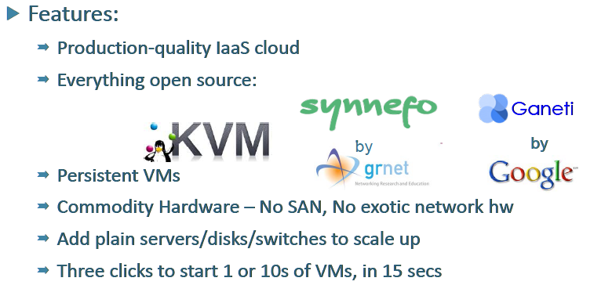

Slide 19
Resources
An Introduction to Virtualization and Cloud Technologies to Support Grid Computing, Ignacio M. Llorente
Cloud Computing: Concepts, Technologies and Business Implications, B. Ramamurthy & K. Madurai
Introduction to Cloud Computing, Dr. Rodrigo Calheiros
~OKEANOS presentation at cloudforum 2013, Nectarios Koziris, GRNET
Cloud Computing Theory and Practice, Dan C. Marinescu

Slide 20

Questions?

