Slide 1
Semantic Social Analytics and Linked Open Data Cloud
Gerasimos Razis¹, Ioannis Anagnostopoulos¹,
Michalis Vafopoulos²
¹Computer Science and Biomedical Informatics Dpt. University of Thessaly
{razis, janag}@dib.uth.gr
²Software and Knowledge Engineering Laboratory
NCSR “Demokritos”
vafopoulos@gmail.com

Slide 2
Contents
What is Influence Tracker (IT)?
www.influencetracker.com
Semantification of Twitter
Questions Part 1
From Open Data to Linked Data
Benefits of publishing Linked Data
Questions Part 2
Conclusions

Slide 3
InfluenceTracker.com
The user can discover various characteristic of a Twitter Account (as provided by Twitter API)
Aims to provide
adaptable Influence Metric of Twitter accounts (last 100 tweets)
social analytics, real-time statistics, diagrams, etc.
direct comparison among multiple accounts
it:Influence = function (activity, social degree, social diffusion/ack)
Followers / Following
Tweeting / Re-tweet rate, reply rate
h-index of retweeted / favorited messages

Slide 4
@TimBerners_Lee (1)

Slide 5
Social Analytics(1/2)

Slide 6
Social Analytics(2/2)

Slide 7
www.InfluenceTracker.com
Rating of Influence Metric of Twitter accounts
Real-time rating of Influence Metric and other social analytics
Analysis and comparison of characteristics of Twitter accounts using diagrams/figures
Evolution of these characteristics
InfluenceTracker Ontology: Semantification of Twitter

Slide 8
Semantifying the Twitter
How can we exploit all this information ?
How can we provide meaningful questions ? and…
How can we receive combined information provided by Twittersphere ?
… or by other sources ?

Slide 9
Questions
Q1.1: What URLs are related with @SMAPinfo ?
Q1.2: Can you find the top-10 influential users that tweeted the hashtag #breaking?
Q1.3: Can you find the similar users (in terms of content) of @BarackObama?

Slide 10
Questions
Q1.1: What URLs are related with @SMAPinfo ?
Q1.2: Can you find the top-10 influential users that tweeted the hashtag #breaking?
Q1.3: Can you find the similar users (in terms of content) of @BarackObama?

Slide 11
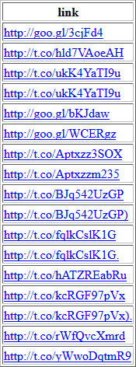
Question 1.1 (IT ontology)

Slide 12
Questions
Q1.1: What URLs are related with @SMAPinfo ?
Q1.2: Can you find the top-10 influential users that tweeted the hashtag #breaking?
Q1.3: Can you find the similar users (in terms of content) of @BarackObama?

Slide 13
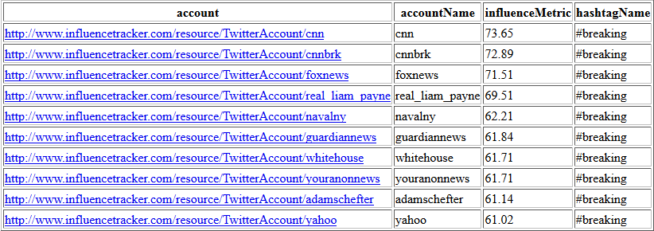
Question 1.2 (IT ontology)

Slide 14
Questions
Q1.1: What URLs are related with @SMAPinfo ?
Q1.2: Can you find the top-10 influential users that tweeted the hashtag #breaking?
Q1.3: Can you find the similar users (in terms of content) of @BarackObama?

Slide 15
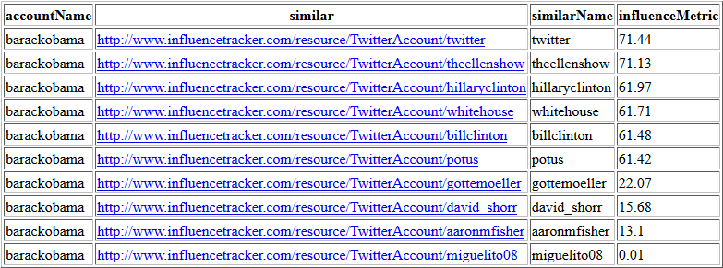
Question 1.3 (IT ontology)

Slide 16
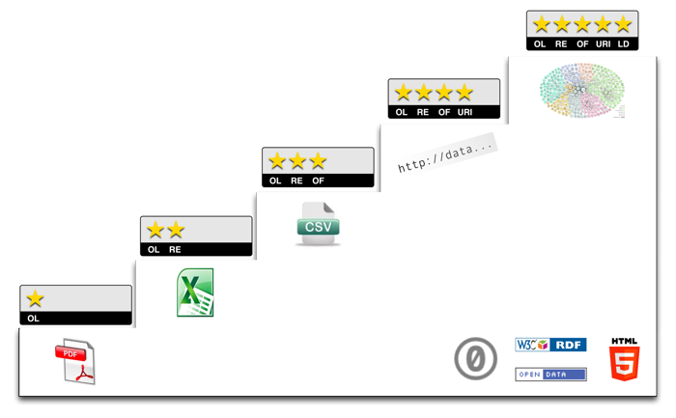
From Open Data to Linked Data
RDF/S
csv, xml, json
excel
pdf, image
5 ★ Open Data
http://5stardata.info

Slide 17
Publishing IT data as Linked Data
InfluenceTracker Data
RDF Standards → 4 Stars
InfluenceTracker Data + DBpedia Data
Linked Data → 5 Stars
Associate IT Twitter Accounts URIs with DBpedia URIs

Slide 18
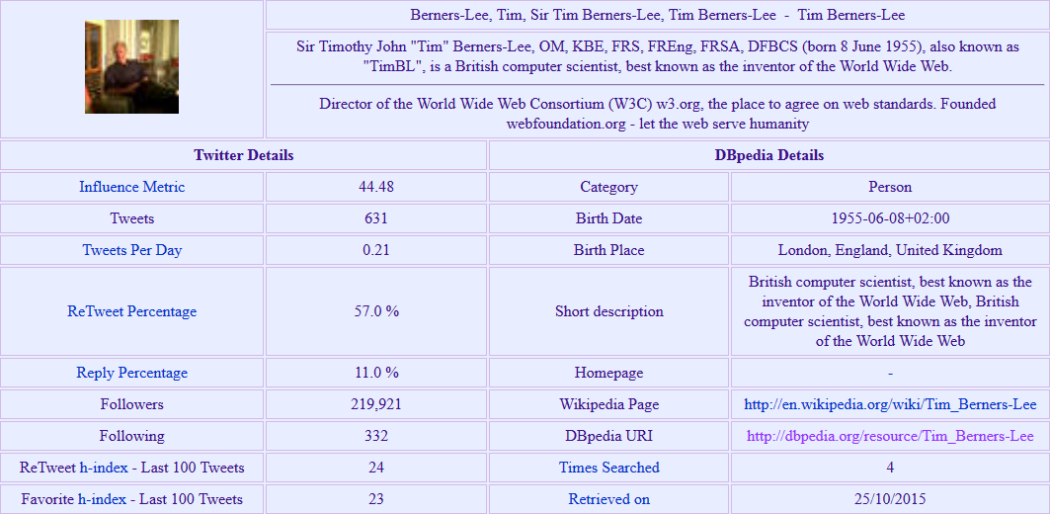
@TimBerners_Lee (2)

Slide 19
Benefits of publishing IT data as LOD
Enriched IT data from multiple domains
Increased data value
Multiple distinct datasets are treated as one
Twitter Accounts have specific type (e.g. Person, Place, Event, Press, etc)
More interesting questions … and answers

Slide 20
Questions (enriched!)
Q2.1: Can you find IT and DBpedia data regarding @BarackObama?
Q2.2: Can you find the top-10 influential Persons ?
Q2.3: Can you find the top-5 most followed Companies?
Q2.4: Can you enrich the results of Q1.3 (similar accounts of @BarackObama) ?
Q2.5: Can you show me information from different sources regarding @Oracle ?

Slide 21
Questions (enriched!)
Q2.1: Can you find IT and DBpedia data regarding @BarackObama?
Q2.2: Can you find the top-10 influential Persons ?
Q2.3: Can you find the top-5 most followed Companies?
Q2.4: Can you enrich the results of Q1.3 (similar accounts of @BarackObama) ?
Q2.5: Can you show me information from different sources regarding @Oracle ?

Slide 22
Question 2.1 (IT & Dbpedia ontology)

Slide 23
Questions (enriched!)
Q2.1: Can you find IT and DBpedia data regarding @BarackObama?
Q2.2: Can you find the top-10 influential Persons ?
Q2.3: Can you find the top-5 most followed Companies?
Q2.4: Can you enrich the results of Q1.3 (similar accounts of @BarackObama) ?
Q2.5: Can you show me information from different sources regarding @Oracle ?

Slide 24
Question 2.2 (IT & Dbpedia ontology)

Slide 25
Question 2.2 (more specific) (IT & Dbpedia ontology)

Slide 26
Questions (enriched!)
Q2.1: Can you find IT and DBpedia data regarding @BarackObama?
Q2.2: Can you find the top-10 influential Persons ?
Q2.3: Can you find the top-5 most followed Companies?
Q2.4: Can you enrich the results of Q1.3 (similar accounts of @BarackObama) ?
Q2.5: Can you show me information from different sources regarding @Oracle ?

Slide 27
Question 2.3 (IT & Dbpedia ontology)

Slide 28
Questions (enriched!)
Q2.1: Can you find IT and DBpedia data regarding @BarackObama?
Q2.2: Can you find the top-10 influential Persons ?
Q2.3: Can you find the top-5 most followed Companies?
Q2.4: Can you enrich the results of Q1.3 (similar accounts of @BarackObama) ?
Q2.5: Can you show me information from different sources regarding @Oracle ?

Slide 29
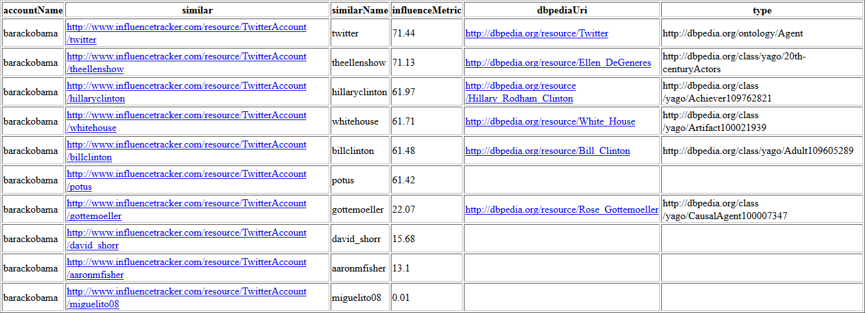
Question 2.4 (IT & Dbpedia ontology)

Slide 30
Questions (enriched!)
Q2.1: Can you find IT and DBpedia data regarding @BarackObama?
Q2.2: Can you find the top-10 influential Persons ?
Q2.3: Can you find the top-5 most followed Companies?
Q2.4: Can you enrich the results of Q1.3 (similar accounts of @BarackObama) ?
Q2.5: Can you show me information from different sources regarding @Oracle ?

Slide 31
Question 2.5 (IT & Dbpedia & LinkedEconomy ontology)

Slide 32
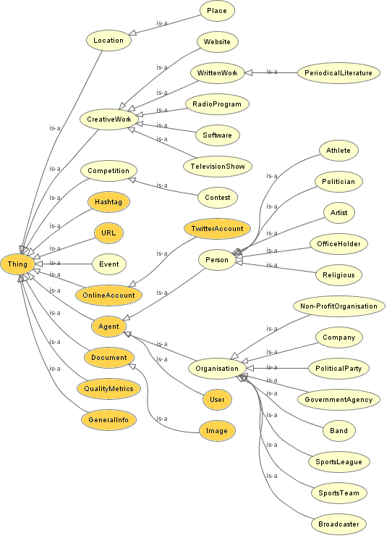
The combined ontological scheme
IT ontology
DBpedia ontology

Slide 33
Conclusions
InfluenceTracker.com offers:
Influence Metric
Real-time statistics, diagrams, etc.
Comparison of Twitter Cccounts
Semantic capabilities for combining social content
Similarity (in terms of content) of Accounts
Creativity in questions
Enriched available data through LOD
Real world entities (Persons, Companies, Places, etc.) and sub entities (Politicians, Actors, Athletes, etc.)
Influence Metric per domain
Smarter questions
More useful answers

Slide 34
www.InfluenceTracker.com
Enjoy our site, discover your influence !
Research → Search Multiple Account functionality
Find your similar Accounts !
Notify us and we will create your similarity network !
Enjoy semantic search in a social world (Twitter)
Send us questions, we will create the semantification and return you the results

Slide 35
Example of Similarity Network
Notes:
Μπορείς να βάλεις το network του @matteorenzi !!!

Slide 36
Example of Similarity Network
Notes:
Μπορείς να βάλεις το network του @matteorenzi !!!

Slide 37
QUESTIONS ?

Slide 38
SPARQL
Queries

Slide 39
Question 1.1 (IT ontology)
PREFIX it: <http://www.influencetracker.com/ontology#>
SELECT ?link
WHERE {
<http://www.influencetracker.com/resource/User/smapinfo> it:includedUrl ?actualUrl .
?actualUrl it:url ?link .
}
Notes:
http://www.influencetracker.com:8890/sparql
Delete “Default Data Set Name (Graph IRI)”

Slide 40
Question 1.2 (IT ontology)
PREFIX it: <http://www.influencetracker.com/ontology#>
SELECT ?account ?accountName ?influenceMetric ?hashtagName
FROM <http://influenceTracker/twitterGraph>
WHERE {
?account foaf:accountName ?accountName .
?user foaf:account ?account ;
it:hasQualityMetrics ?qm ;
it:includedHashtag <http://www.influencetracker.com/resource/Hashtag/breaking> .
?qm it:influenceMetric ?influenceMetric .
<http://www.influencetracker.com/resource/Hashtag/breaking> it:hashtag ?hashtagName .
}
ORDER BY DESC (?influenceMetric)
LIMIT 10
Notes:
http://www.influencetracker.com:8890/sparql
Delete “Default Data Set Name (Graph IRI)”

Slide 41
Question 1.3 (IT ontology)
PREFIX it: <http://www.influencetracker.com/ontology#>
SELECT ?accountName ?similar ?similarName ?influenceMetric
FROM <http://influenceTracker/twitterGraph>
FROM <http://influenceTracker/twitterSimilarity>
WHERE {
<http://www.influencetracker.com/resource/TwitterAccount/barackobama> foaf:accountName ?accountName ;
it:hasSimilar ?similar .
?similar foaf:accountName ?similarName .
?user foaf:account ?similar ;
it:hasQualityMetrics ?qm .
?qm it:influenceMetric ?influenceMetric .
}
ORDER BY DESC (?influenceMetric)
Notes:
http://www.influencetracker.com:8890/sparql
Delete “Default Data Set Name (Graph IRI)”

Slide 42
Question 2.1 (IT & Dbpedia ontology)
PREFIX it: <http://www.influencetracker.com/ontology#>
PREFIX dbpedia-owl: <http://dbpedia.org/ontology/>
PREFIX dbpprop: <http://dbpedia.org/property/>
SELECT (<http://www.influencetracker.com/resource/User/barackobama> AS ?URI) ?influenceMetric ?hIndexRt ?dbpediaUri ?birthDate ?birthPlace ?shortDescription
WHERE {
GRAPH <http://influenceTracker/twitterGraph> {
<http://www.influencetracker.com/resource/User/barackobama> it:hasQualityMetrics ?qm;
foaf:account ?account .
?qm it:influenceMetric ?influenceMetric ; it:hIndexRt ?hIndexRt .
}
GRAPH <http://influenceTracker/dbpediaGraph> {
?account it:dbpediaUri ?dbpediaUri .
}
SERVICE <http://dbpedia.org/sparql> {
?dbpediaUri dbpedia-owl:birthDate ?birthDate ;
dbpprop:birthPlace ?birthPlace ;
dbpprop:shortDescription ?shortDescription .
}
}
Notes:
http://www.influencetracker.com:8890/sparql
Delete “Default Data Set Name (Graph IRI)”

Slide 43
Question 2.2 (IT & Dbpedia ontology)
PREFIX it: <http://www.influencetracker.com/ontology#>
PREFIX foaf: <http://xmlns.com/foaf/0.1/>
SELECT ?user ?influenceMetric ?dbpediaUri ?type
WHERE {
GRAPH <http://influenceTracker/twitterGraph> {
?user it:hasQualityMetrics ?qm; foaf:account ?account .
?qm it:influenceMetric ?influenceMetric .
}
GRAPH <http://influenceTracker/dbpediaGraph> {
?account it:dbpediaUri ?dbpediaUri .
FILTER (!regex(?dbpediaUri, 'http://el.dbpedia.org')) .
FILTER (!regex(?dbpediaUri, '\u0027')) .
}
SERVICE <http://dbpedia.org/sparql> {
?dbpediaUri rdf:type ?type.
FILTER (?type = foaf:Person) . OR FILTER ( (?type = yago:Politician110451263) || (?type = yago:Holder110180178) || (?type = dbpedia-owl:Politician) ) .
}
}
ORDER BY DESC (?influenceMetric)
LIMIT 10
Notes:
http://www.influencetracker.com:8890/sparql
Delete “Default Data Set Name (Graph IRI)”

Slide 44
Question 2.3 (IT & Dbpedia ontology)
PREFIX it: <http://www.influencetracker.com/ontology#>
PREFIX dbpedia-owl: <http://dbpedia.org/ontology/>
SELECT ?user ?followers ?dbpediaUri ?type
WHERE {
GRAPH <http://influenceTracker/twitterGraph> {
?user it:hasGeneralInfo ?gi ;
foaf:account ?account .
?gi it:followers ?followers .
}
GRAPH <http://influenceTracker/dbpediaGraph> {
?account it:dbpediaUri ?dbpediaUri .
FILTER (!regex(?dbpediaUri, 'http://el.dbpedia.org'))
FILTER (!regex(?dbpediaUri, '\u0027'))
}
SERVICE <http://dbpedia.org/sparql> {
?dbpediaUri rdf:type ?type.
FILTER (?type = dbpedia-owl:Company)
}
}
ORDER BY DESC (?followers)
LIMIT 5
Notes:
http://www.influencetracker.com:8890/sparql
Delete “Default Data Set Name (Graph IRI)”

Slide 45
Question 2.4 (IT & Dbpedia ontology)
PREFIX it: <http://www.influencetracker.com/ontology#>
SELECT str(?accountName) as ?accountName ?similar str(?similarName) as ?similarName ?influenceMetric ?dbpediaUri (MIN(STR(?type)) AS ?type)
FROM <http://influenceTracker/twitterGraph>
FROM <http://influenceTracker/twitterSimilarity>
FROM <http://influenceTracker/dbpediaGraph>
WHERE {
<http://www.influencetracker.com/resource/TwitterAccount/barackobama> foaf:accountName ?accountName ;
it:hasSimilar ?similar .
?similar foaf:accountName ?similarName .
OPTIONAL {
?similar it:dbpediaUri ?dbpediaUri .
?dbpediaUri rdf:type ?type .
} .
?user foaf:account ?similar ;
it:hasQualityMetrics ?qm .
?qm it:influenceMetric ?influenceMetric .
}
ORDER BY DESC (?influenceMetric)
Notes:
http://www.influencetracker.com:8890/sparql
Delete “Default Data Set Name (Graph IRI)”

Slide 46
Question 2.5 (IT & Dbpedia & LinkedEconomy ontology)
PREFIX gr: <http://purl.org/goodrelations/v1#>
PREFIX elod: <http://linkedeconomy.org/ontology#>
PREFIX dbpedia-owl: <http://dbpedia.org/ontology/>
SELECT ?influenceMetric ?payment (xsd:float(?amount) AS ?paymentAmount) ?netIncome ?numberOfEmployees
WHERE
{
GRAPH <http://influenceTracker/twitterGraph> {
<http://www.influencetracker.com/resource/User/oracle> it:hasQualityMetrics ?qm;
foaf:account ?account .
?qm it:influenceMetric ?influenceMetric .
}
GRAPH <http://influenceTracker/dbpediaGraph> {
?account it:dbpediaUri ?dbpediaUri .
}
SERVICE <http://elod2.linkedeconomy.org:8890/sparql/> {
?payment elod:hasExpenditureLine ?expLine ; rdf:type elod:SpendingItem .
?expLine elod:amount ?ups ; elod:seller <http://linkedeconomy.org/resource/Organization/800420948> .
?ups gr:hasCurrencyValue ?amount .
}
SERVICE <http://dbpedia.org/sparql> {
<http://dbpedia.org/resource/Oracle_Corporation> dbpedia-owl:netIncome ?netIncome ;
dbpedia-owl:numberOfEmployees ?numberOfEmployees .
}
}
GROUP BY ?influenceMetric ?payment ?netIncome ?numberOfEmployees
Notes:
http://www.influencetracker.com:8890/sparql
Delete “Default Data Set Name (Graph IRI)”

