Slide 1
Ποσοτικοποίηση ευπαθειών

Slide 2
All about vulnerabilities and Assessment
Vulnerability definition:
Weakness of an asset or control that can be exploited by one or more threats. [ISO/IEC 27000:2018]
A weakness in an information system, system security procedures, internal controls, or implementation that could be exploited by a threat source. [NIST SP 800-30 Rev.1, 2011]
Weakness in the TOE that can be used to violate the SFRs in some environment [ISO/IEC 15408-1:2009]
The purpose of a vulnerability assessment is to identify vulnerabilities that exist in the cyber assets of the SCS under examination. Vulnerabilities could be induced through poor configuration, lack of security patching, etc.
Confirmed vulnerabilities are vulnerabilities that are publishly known (derived from on-line repositories such as MITRE, from CVSS open industry standard [FIRST] and automated scanning tools) and correspond to each asset
Confirmed vulnerabilities incorporate attributes, such as the Common Vulnerabilities and Exposures (CVE), access vector, access complexity and authentication
Notes:
Access vector: shows how a vulnerability may be exploited (L,A,N)
Access complexity: measures the complexity of the attack required to exploit the vulnerability (L,M,H)
Authentication: measures the number of times an attacker must authenticate in order to exploit a vulnerability (N,M,S)

Slide 3
Vulnerability Asssessment
Confirmed Vulnerabilities (publishly known)
Unconfirmed Vulnerabilities (publishly uknown)
Vulnerability features
Common Weakness Enumeration (CWE) (Mapping of vulnerabilities to threats)
Vulnerabilities Labelling
Common Vulnerabilities and Exposures (CVE) (Vulnerability ID number)
Common Vulnerability Scoring System (CVSS) (Vulnerability metrics)
e.g.
"CVE-1999-0067",
"CVE-2014-12345",
"CVE-2016-7654321, etc . . .
access vector
access complexity
authentication
Confidentiality
Integrity
Availability

Slide 4
Common Vulnerabilities and Exposures (CVE)
Definition
A list of entries—each containing an identification number, a description, and at least one public reference—for publicly known cybersecurity vulnerabilities. [MITRE]
A nomenclature and dictionary of security-related software [NIST SP 800-126 Rev. 2]
A CVE has the format CVE-2020 (year)-xxxxxx entries (number)
A CVE Entry is an item in the CVE List.
Each CVE Entry includes the following:
CVE ID with four or more digits in the sequence number portion of the ID
(i.e., "CVE-1999-0067", "CVE-2014-12345", "CVE-2016-7654321").
Brief Description of the security vulnerability or exposure.
Any pertinent References (i.e., vulnerability reports and advisories).
Notes:
Access vector: shows how a vulnerability may be exploited (L,A,N)
Access complexity: measures the complexity of the attack required to exploit the vulnerability (L,M,H)
Authentication: measures the number of times an attacker must authenticate in order to exploit a vulnerability (N,M,S)

Slide 5
CVE example
A detected vulnerability in this asset could be a "Microsoft Office Spoofing Vulnerability" existing when Microsoft Office Javascript does not check the validity of the web page making a request to Office documents.An attacker who successfully exploited this vulnerability could read or write information in Office documents.
This vulnerability has the CVE "CVE-2019-1109" which is a reference-method of MITRE for publicly known information-security vulnerabilities and exposures fetected on a specific asset or a group of assets. Further details and description of this vulnerability can be viewed for example in https://cve.mitre.org/cgi-bin/cvekey.cgi?keyword=CVE-2019-1109 and https://www.cvedetails.com/cve-details.php?t=1&cve_id=CVE-2019-1109
Asset “Microsoft Office 365 sp1 rt edition”
CVE-2019-1109

Slide 6
Vulnerability metric: Common Vulnerability Scoring System (CVSS)
The Common Vulnerability Scoring System (CVSS) is an open framework for communicating the characteristics and severity of software vulnerabilities. CVSS consists of three metric groups: Base, Temporal, and Environmental.
The Base metrics produce a score ranging from 0 to 10, which can then be modified by scoring the Temporal and Environmental metrics. A CVSS score is also represented as a vector string, a compressed textual representation of the values used to derive the score.
CVSS is owned and managed by FIRST.Org, Inc. (FIRST), a US-based non-profit organization, whose mission is to help computer security incident response teams across the world. The official CVSS documentation can be found at https://www.first.org/cvss/.
Notes:
Thus, CVSS is well suited as a standard measurement system for industries, organizations, and governments that need accurate and consistent vulnerability severity scores.
Two common uses of CVSS are calculating the severity of vulnerabilities discovered on one's systems and as a factor in prioritization of vulnerability remediation activities. The National Vulnerability Database (NVD) provides CVSS scores for almost all known vulnerabilities.
The NVD supports both Common Vulnerability Scoring System (CVSS) v2.0 and v3.X standards. The NVD provides CVSS 'base scores' which represent the innate characteristics of each vulnerability. The NVD does not currently provide 'temporal scores' (metrics that change over time due to events external to the vulnerability) or 'environmental scores' (scores customized to reflect the impact of the vulnerability on your organization). However, the NVD does supply a CVSS calculator for both CVSS v2 and v3 to allow you to add temporal and environmental score data.

Slide 7
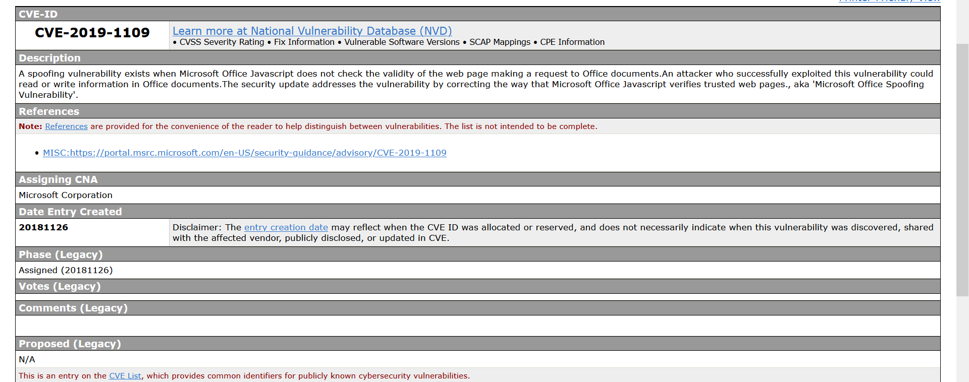
CVE example by MITRE
https://cve.mitre.org/cgi-bin/cvename.cgi?name=CVE-2019-1109

Slide 8
CVE example
by CVE Details
https://www.cvedetails.com/cve-details.php?t=1&cve_id=CVE-2019-1109

Slide 9
Vulnerability features
.
the Common Weakness Enumeration (CWE), to map security vulnerabilities with cyber-threats and have a clearer picture of the security flaw.
FIRST
MITRE

Slide 10
CVSS reference/calculator
https://www.first.org/cvss/v3.1/specification-document
https://nvd.nist.gov/vuln-metrics/cvss/v3-calculator?vector=AV:N/AC:L/PR:N/UI:N/S:U/C:L/I:N/A:N&version=3.1
https://nvd.nist.gov/vuln-metrics/cvss/v3-calculator
https://nvd.nist.gov/vuln-metrics/cvss/v3-calculator?name=CVE-2020-15840&vector=AV:N/AC:L/PR:N/UI:N/S:U/C:L/I:N/A:N&version=3.1&source=NIST

Slide 11
Common Weakness Enumeration (CWE)
Definition
A community-developed list of software and hardware weakness types. It serves as a common language, a measuring stick for security tools, and as a baseline for weakness identification, mitigation, and prevention efforts. (https://cve.mitre.org/ )
e.g.: CVE-2019-1109 is linked with CWE-20: Improper input validation

Slide 12
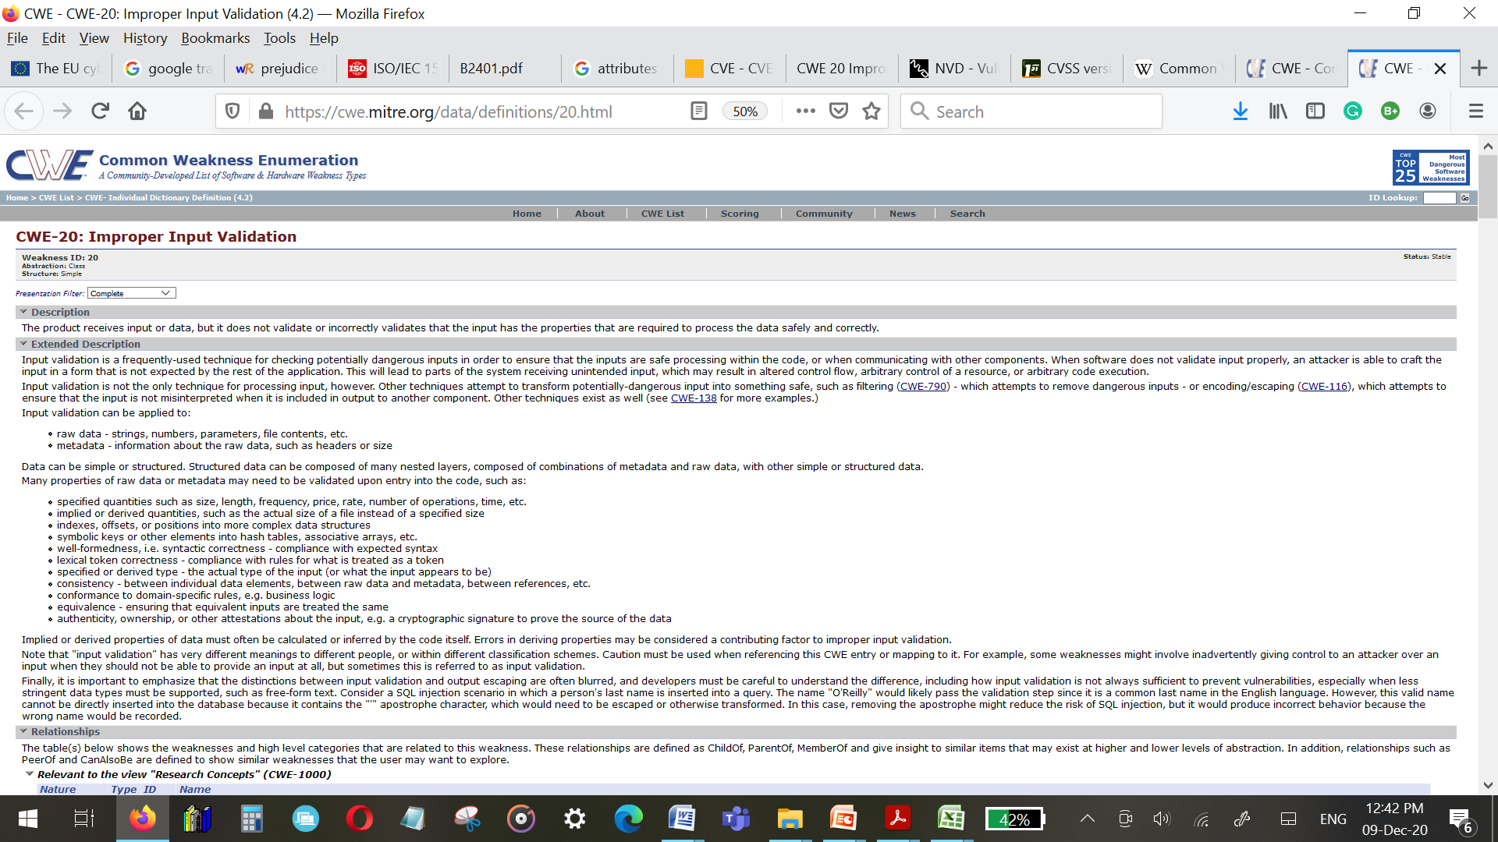
CWE example

Slide 13
Vulnerability Severity Ratings (NIST NVD based on FIRST)
NVD Vulnerability Severity Ratings (https://nvd.nist.gov/vuln-metrics/cvss )
NVD provides qualitative severity rankings of "Low", "Medium", and "High" for CVSS v2.0 base score ranges in addition to the severity ratings for CVSS v3.0 as they are defined in the CVSS v3.0 specification.

Slide 14
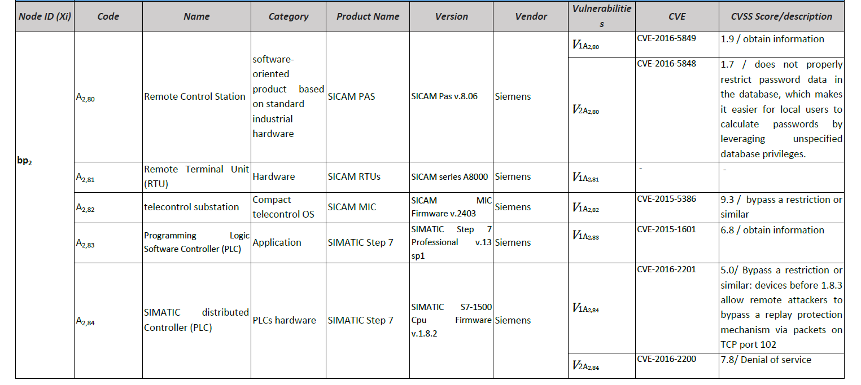
Example of assets identified vulnerabilities

Slide 15
Example of assets identified vulnerabilities

Slide 16
AVA class (Common Criteria)
The AVA: Vulnerability assessment class addresses the possibility of exploitable vulnerabilities introduced in the development or the operation of the TOE.
Assessment of development vulnerabilities is covered by the assurance family AVA_VAN.

Slide 17
AVA_VAN.1 Vulnerability analysis

Slide 18
AVA_VAN.2 Vulnerability analysis

Slide 19
AVA_VAN.3 Focused vulnerability analysis

Slide 20
AVA_VAN.4 Methodical vulnerability analysis

Slide 21
AVA_VAN.5 Advanced methodical vulnerability analysis

Slide 22
Attack potential
Definition
Measure of the effort to be expended in attacking a TOE, expressed in terms of an attacker's expertise, resources and motivation (ISO/IEC 15408-1:2009)
Perceived potential for success of an attack, should an attack be launched, expressed in terms of an attacker's expertise, resources and motivation (ISO/IEC 27032:2012)
Attack potential can be :
Basic
Enhanced-basic
Moderate
High

