Slide 1
Build an Admin Dashboard Template in PHP and Boostrap 4

Slide 2
PHP 7.1
MySQL
Bootstrap 4

Slide 3
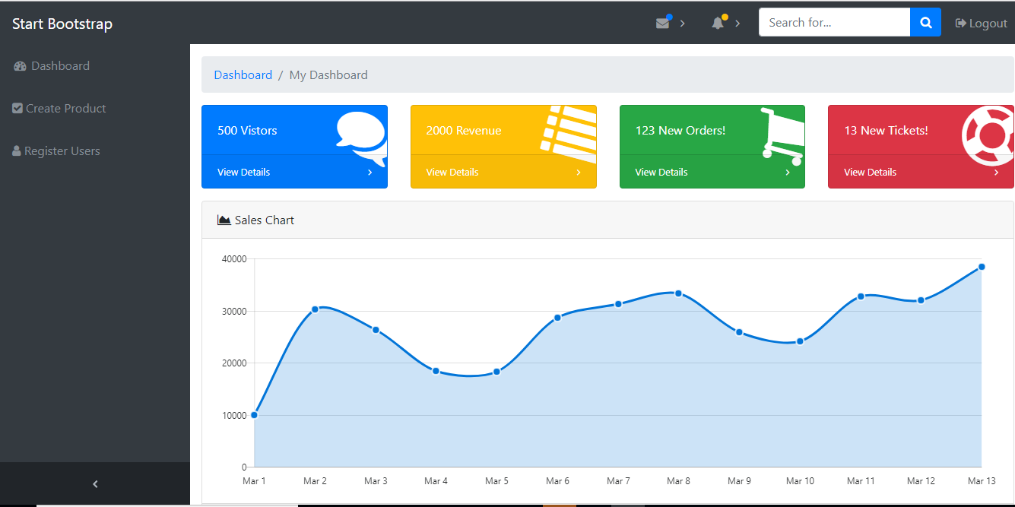

Slide 4
free Bootstrap 4 admin template available on GitHub

Slide 5
Registration Form
<?php include('server.php') ?>
<!DOCTYPE html>
<html lang="en">
<head>
<meta charset="utf-8">
<meta http-equiv="X-UA-Compatible" content="IE=edge">
<meta name="viewport" content="width=device-width, initial-scale=1, shrink-to-fit=no">
<meta name="description" content="">
<meta name="author" content="">
<title>SB Admin - Start Bootstrap Template</title>
<!-- Bootstrap core CSS-->
<link href="vendor/bootstrap/css/bootstrap.min.css" rel="stylesheet">
<!-- Custom fonts for this template-->
<link href="vendor/font-awesome/css/font-awesome.min.css" rel="stylesheet" type="text/css">
<!-- Custom styles for this template-->
<link href="css/sb-admin.css" rel="stylesheet">
</head>
<body class="bg-dark">
<div class="container">
<div class="card card-register mx-auto mt-5">
<div class="card-header">Register an Account</div>
<div class="card-body">
<form method="post" action="register.php">
<?php include('errors.php'); ?>
<div class="form-group">
<div class="form-row">
<div class="col-md-12">
<label for="exampleInputName">Username</label>
<input class="form-control" id="exampleInputName" type="text" name="username" value="<?php echo $username; ?>" >
</div>
</div>
</div>
<div class="form-group">
<label for="exampleInputEmail1">Email address</label>
<input class="form-control" id="exampleInputEmail1" type="email" aria-describedby="emailHelp" name="email" value="<?php echo $email; ?>" >
</div>
<div class="form-group">
<div class="form-row">
<div class="col-md-6">
<label for="exampleInputPassword1">Password</label>
<input class="form-control" id="exampleInputPassword1" type="password" name="password_1" >
</div>
<div class="col-md-6">
<label for="exampleInputPassword1">Confirm Password</label>
<input class="form-control" id="exampleInputPassword2" type="password" name="password_2" >
</div>
</div>
</div>
<button type="submit" class="btn btn-primary btn-block" name="reg_user">Register</button>
</form>
<div class="text-center">
<a class="d-block small mt-3" href="login.php">Login Page</a>
<!--- <a class="d-block small" href="forgot-password.html">Forgot Password?</a>-->
</div>
</div>
</div>
</div>
<!-- Bootstrap core JavaScript-->
<script src="vendor/jquery/jquery.min.js"></script>
<script src="vendor/bootstrap/js/bootstrap.bundle.min.js"></script>
<!-- Core plugin JavaScript-->
<script src="vendor/jquery-easing/jquery.easing.min.js"></script>
</body>
</html>

Slide 6
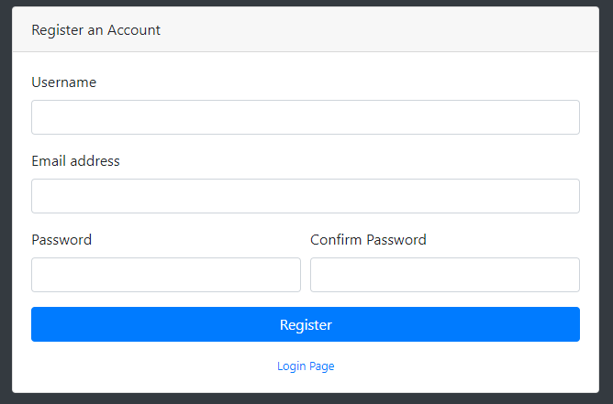

Slide 7
Login Form
<form method="post" action="login.php">
<?php include('errors.php'); ?>
<div class="form-group">
<label for="exampleInputEmail1">Username</label>
<input class="form-control" type="text" name="username">
</div>
<div class="form-group">
<label for="exampleInputPassword1">Password</label>
<input class="form-control" type="password" name="password">
</div>
<div class="form-group">
<div class="form-check">
<label class="form-check-label">
<input class="form-check-input" type="checkbox"> Remember Password</label>
</div>
</div>
<button type="submit" class="btn btn-primary btn-block" name="login_user">Login</button>
</form>
<div class="text-center">
<a class="d-block small mt-3" href="register.php">Register an Account</a>
<!-- <a class="d-block small" href="forgot-password.php">Forgot Password?</a>-->
</div>
</div>
</div>
</div>
<!-- Bootstrap core JavaScript-->
<script src="vendor/jquery/jquery.min.js"></script>
<script src="vendor/bootstrap/js/bootstrap.bundle.min.js"></script>
<!-- Core plugin JavaScript-->
<script src="vendor/jquery-easing/jquery.easing.min.js"></script>
</body>
</html>
<?php include('server.php') ?>
<!DOCTYPE html>
<html lang="en">
<head>
<meta charset="utf-8">
<meta http-equiv="X-UA-Compatible" content="IE=edge">
<meta name="viewport" content="width=device-width, initial-scale=1, shrink-to-fit=no">
<meta name="description" content="">
<meta name="author" content="">
<title>SB Admin - Start Bootstrap Template</title>
<!-- Bootstrap core CSS-->
<link href="vendor/bootstrap/css/bootstrap.min.css" rel="stylesheet">
<!-- Custom fonts for this template-->
<link href="vendor/font-awesome/css/font-awesome.min.css" rel="stylesheet" type="text/css">
<!-- Custom styles for this template-->
<link href="css/sb-admin.css" rel="stylesheet">
</head>
<body class="bg-dark">
<div class="container">
<div class="card card-login mx-auto mt-5">
<div class="card-header">Login</div>
<div class="card-body">

Slide 8
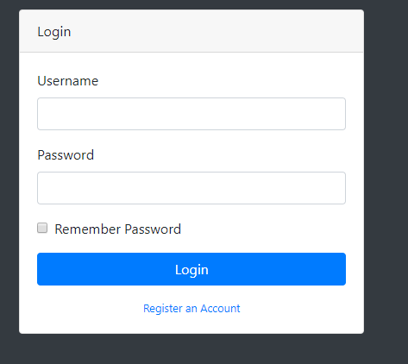

Slide 9
Bάση Δεδομένων

Slide 10
server.php
<?php
session_start();
// initializing variables
$username = "";
$email = "";
$errors = array();
// connect to the database
$db = mysqli_connect('localhost', 'root', '', 'registration');

Slide 11
Errors.php
<?php if (count($errors) > 0) : ?>
<div class="error">
<?php foreach ($errors as $error) : ?>
<p><?php echo $error ?></p>
<?php endforeach ?>
</div>
<?php endif ?>

Slide 12
Php register
Php login
Pserver insert products
Table sample

Slide 13
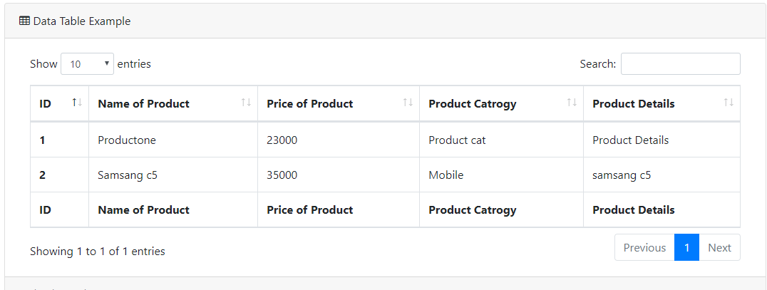

Slide 14
Dash board index page

Slide 15
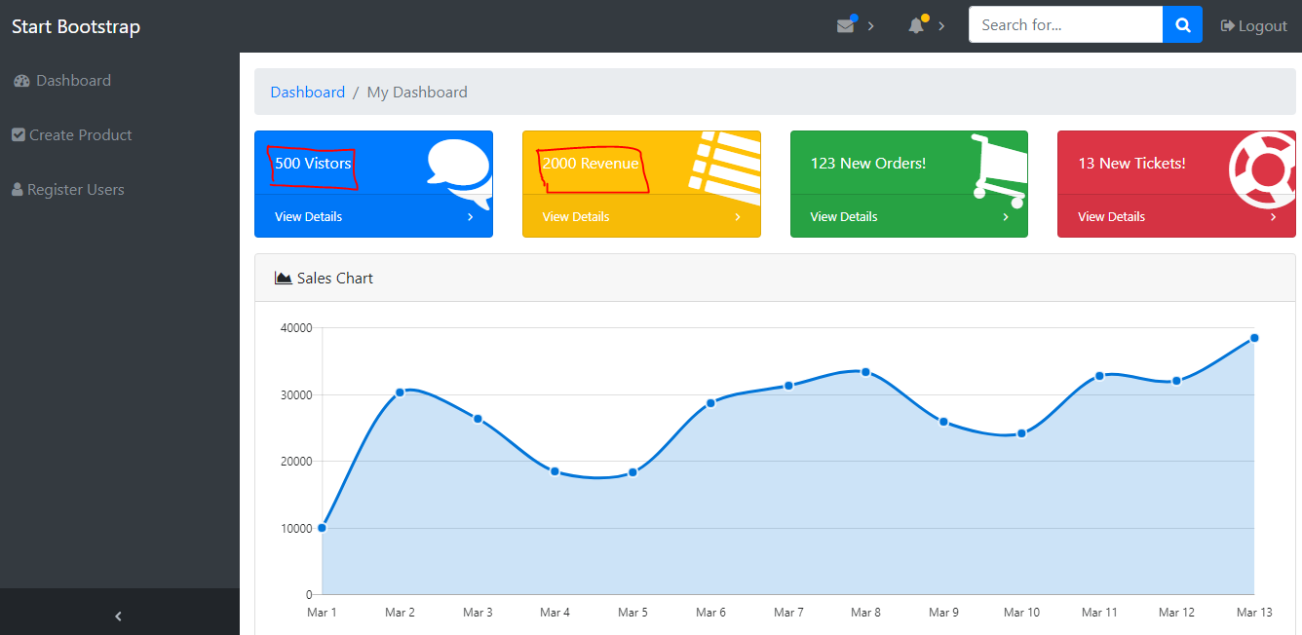

Slide 16
The data for these cards is derived from the database through a simple SELECT query.
Setup the Dashboard

