Slide 1
Track: Business & Data Analytics
1st semester
https://cybersecdatasci.cs.unipi.gr

Slide 2
Courses
CDS107: Data Analytics and Machine Learning
CDS108: Information Systems Management and Innovation
CDS109: Optimization Techniques
CDS110: Big Data Management
CDS111: Computational Tools for Business Analytics
CDS112: Algorithms and Complexity

Slide 3
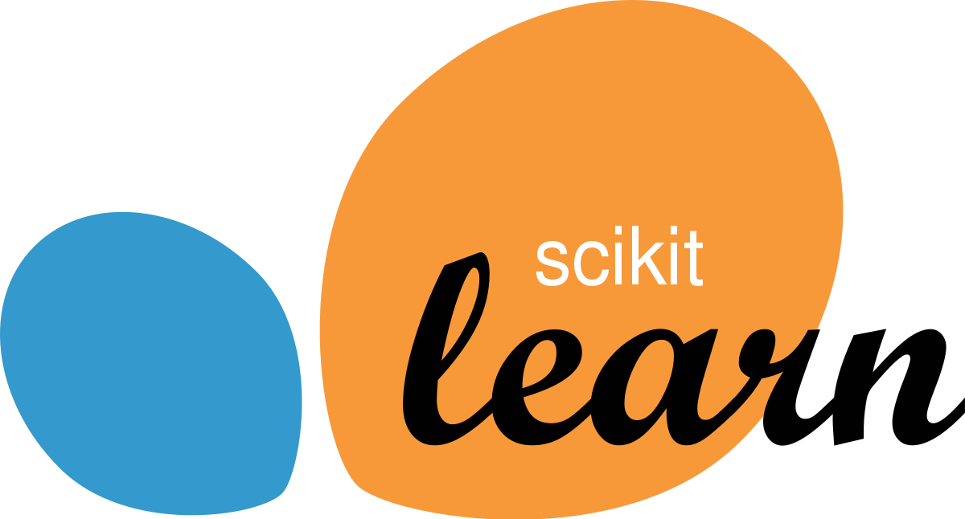
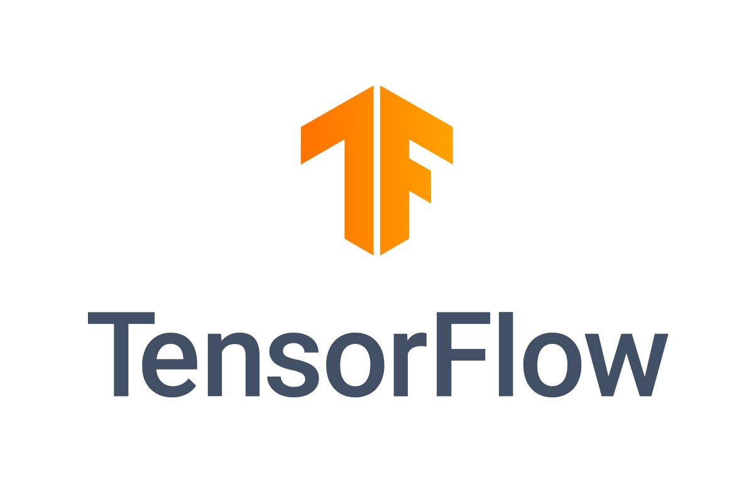
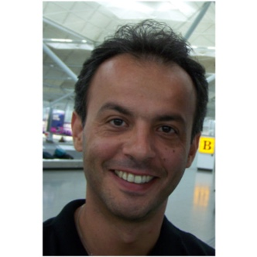
CDS107: Data Analytics and Machine Learning
Syllabus:
Introduction to data analytics: principles, pipelines and pre-processing methods
Common Machine Learning methods for classification and regression (Bayesian, Least Squares, SVM, etc.)
Neural networks and Deep Learning fundamentals
Clustering techniques (from standard to advanced)
Applications on text/audio/video analytics
Lab hours:
Scikit-learn, Matlab, TensorFlow
Instructors:
Prof. Aggelos Pikrakis, Prof. Yannis Theodoridis

Slide 4
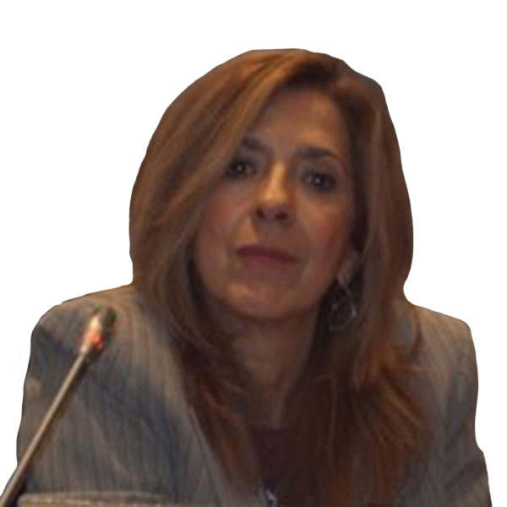
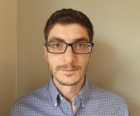
CDS108: Information Systems Management and Innovation
Syllabus:
Security mgmt of information systems, innovative e-services and supply chain services; Security governance of enterprises and smart ecosystems
Digital Transformation Mgmt
Enterprise Resource Planning (ERP); Customer Relationship Mgmt (CRM)
Software development methodologies and Enterprise Architectures
Business Process Mgmt / Process Mining
Lab hours:
Camunda BPM platform, PM4PY process mining library
Instructors:
Prof. Nineta Polemi, Dr. Alexandros Bousdekis

Slide 5
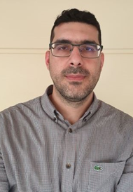
CDS109: Optimization Techniques
Syllabus:
Linear programming
Nonlinear programming
Integer programming and combinatorial optimization
Multi-objective programming
Lab hours:
Matlab
Instructor:
Dr. Gregory Koronakos

Slide 6
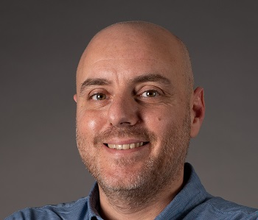
CDS110: Big Data Management
Syllabus:
Introduction – review of relational and object-relational databases; Modern trends in database design
Non-traditional data types (text, multimedia, spatial information)
Non-traditional database architecture (sensor networks, data streams, distributed, in the cloud)
The “big data” era (MapReduce architecture, etc.)
Lab hours:
MongoDB, Spark (batch vs. stream processing), SparkMLib
Instructors:
Prof. Nikos Pelekis, Dr. George Papastefanatos

Slide 7
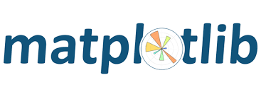
CDS111: Computational Tools for Business Analytics
Syllabus:
Business analytics with Python and Matlab
Methods, algorithms and case studies of business analytics for portfolio optimization
bi-objective problem. The portfolio return should be maximized, while portfolio risk should be minimized
solution using multi-objective evolutionary algorithms (MOEAs)
Methods, algorithms and case studies for business analytics in Industry 4.0
Lab hours:
Python libraries (numPy, Matplotlib, Pyomo, SymPy, etc.), Matlab, jmetal metaheuristic library
Instructors:
Dr. Gregory Koronakos, Dr. Alexandros Bousdekis, Dr. Kostas Liagouras

Slide 8
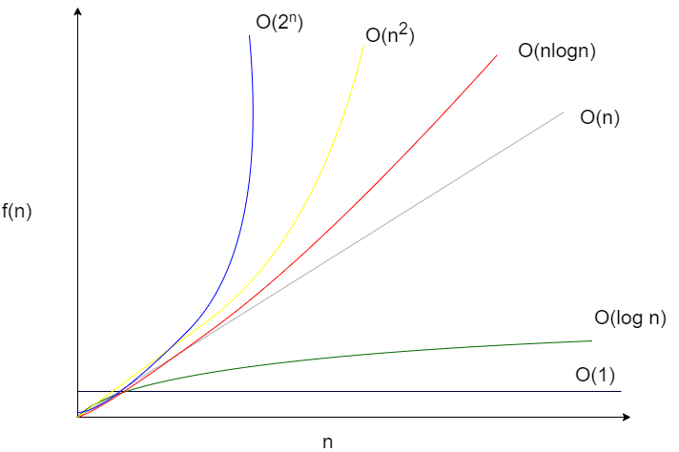
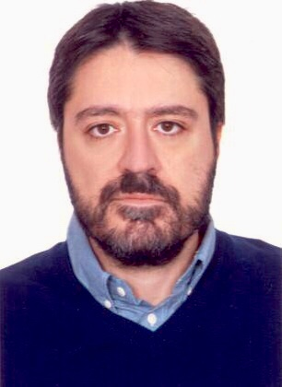
CDS112: Algorithms and Complexity
Syllabus:
Basic techniques for algorithm design and analysis
Decidability and Complexity classes
Algorithms for computationally intractable problems
Algorithmic Game Theory
Lab hours:
Exercises on the topics of the course
Instructor:
Prof. Charalampos Konstantopoulos

Slide 9
Data scientist (n.): Person who is better at statistics than any software engineer and better at software engineering than any statistician.
Josh Wills, Director of Data Engineering at Slack
Thank you for your attention !!

