Slide 1
Application Threat Modeling Example
Τμήμα Πληροφορικής

Slide 2
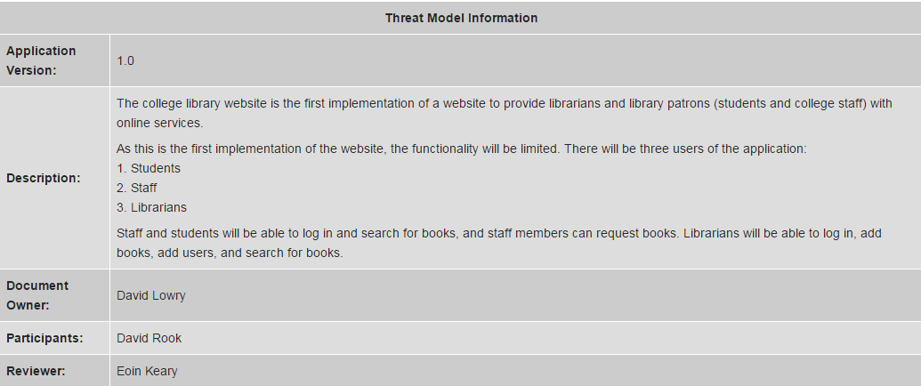
Decompose the Application

Slide 3
External Dependencies

Slide 4
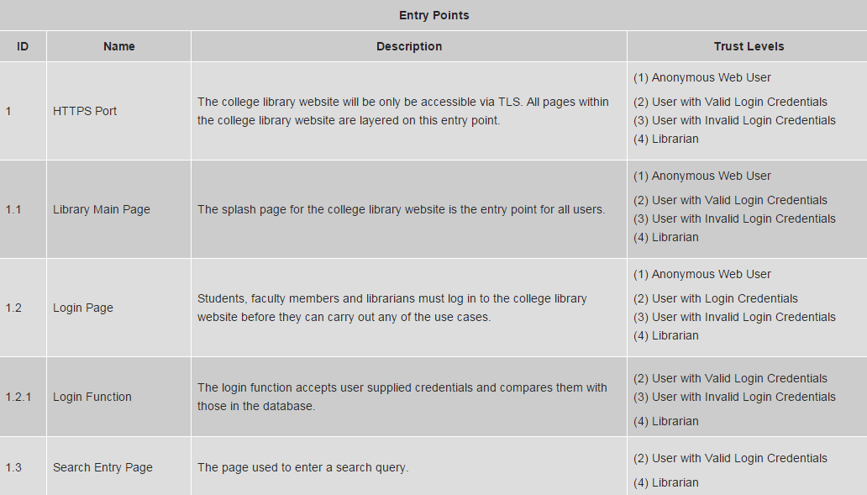
Entry Points

Slide 5
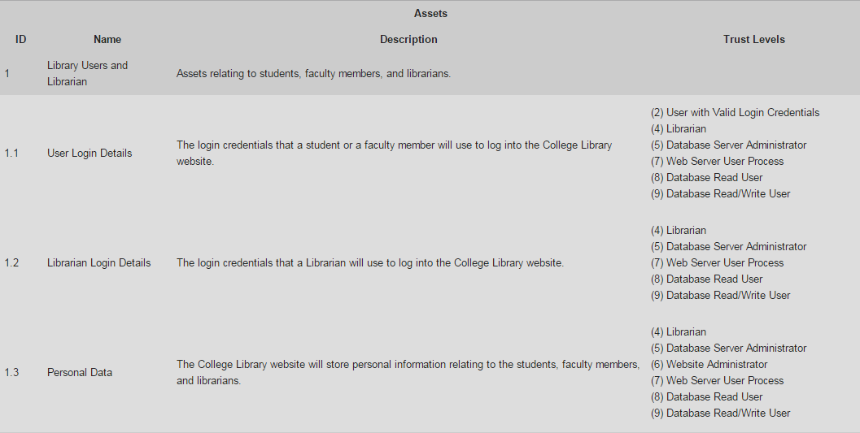
Assets

Slide 6
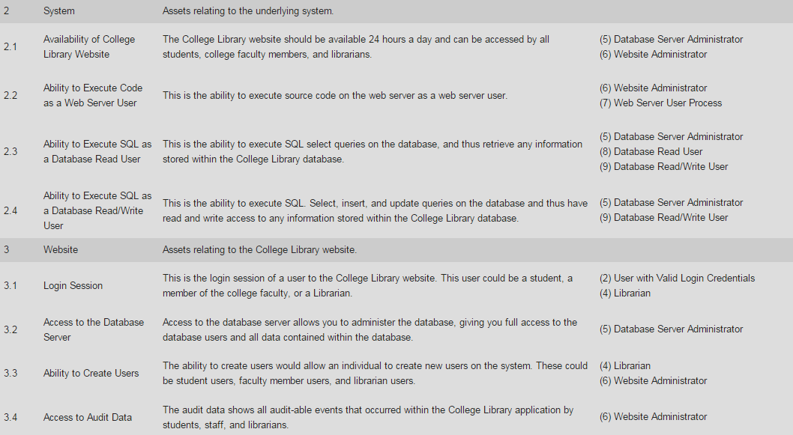

Slide 7
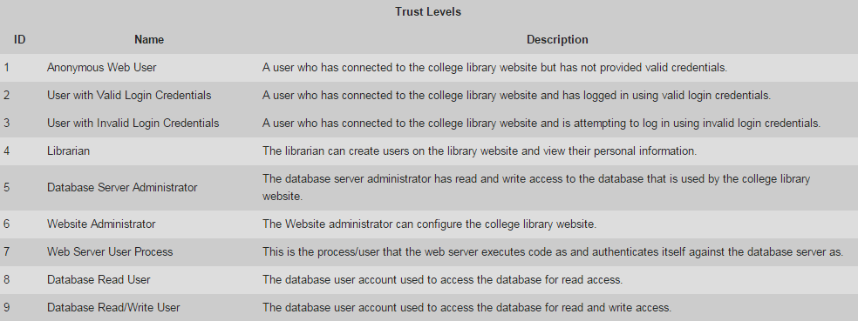
Trust Levels

Slide 8
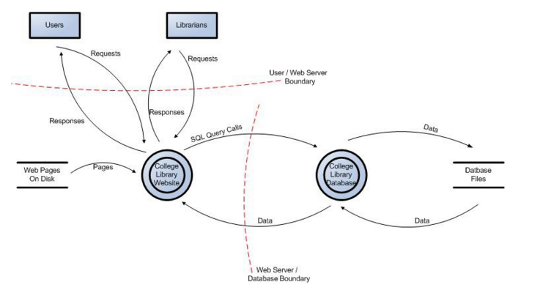
Data Flow Diagram for the College Library Website

Slide 9
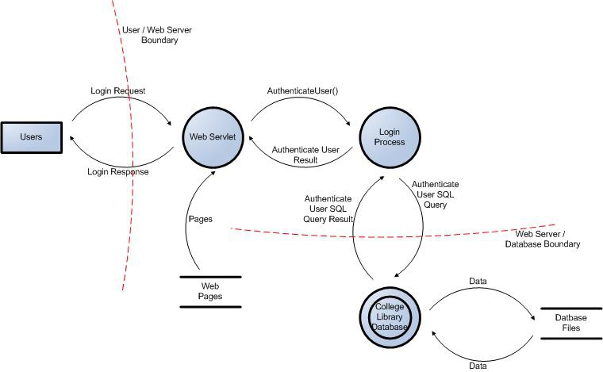
User Login Data Flow Diagram for the College Library Website

Slide 10
STRIDE Threat List

Slide 11
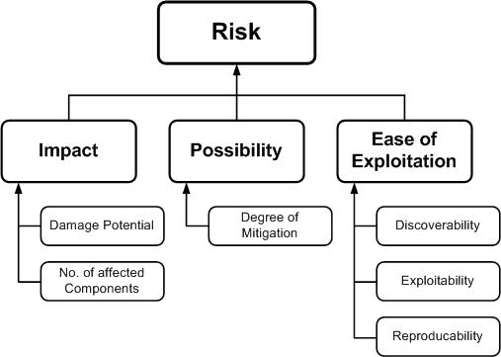
Ranking of Threats
Damage potential: Threat to reputation as well as financial and legal liability:8
Reproducibility: Fully reproducible:10
Exploitability: Require to be on the same subnet or have compromised a router:7
Affected users: Affects all users:10
Discoverability: Can be found out easily:10
Overall DREAD score: (8+10+7+10+10) / 5 = 9
In this case having 9 on a 10 point scale is certainly a high risk threat

Slide 12
Mitigation Strategies
Do nothing: for example, hoping for the best
Inform about the risk: for example, warning user population about the risk
Mitigate the risk: for example, by putting countermeasures in place
Accept the risk: for example, after evaluating the impact of the exploitation (business impact)
Transfer the risk: for example, through contractual agreements and insurance
Terminate the risk: for example, shutdown, turn-off, unplug or decommission the asset

Slide 13
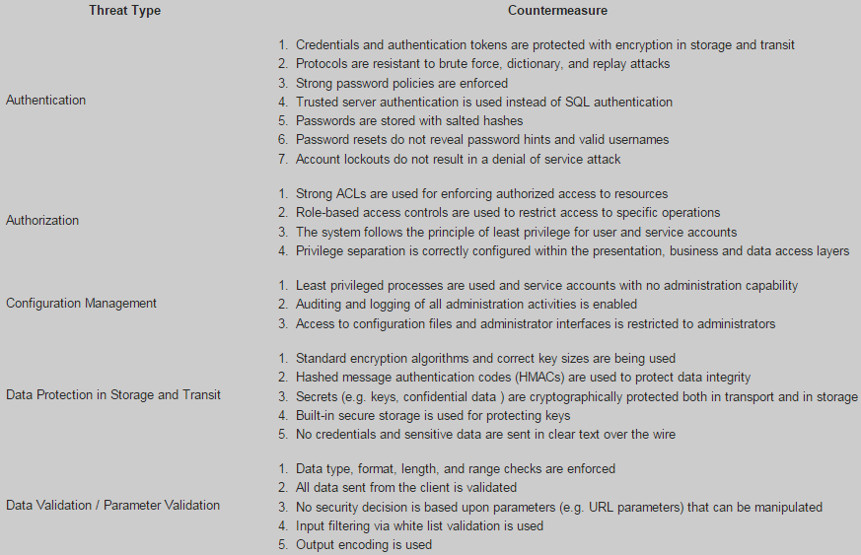
Threat & Countermeasures List

Slide 14
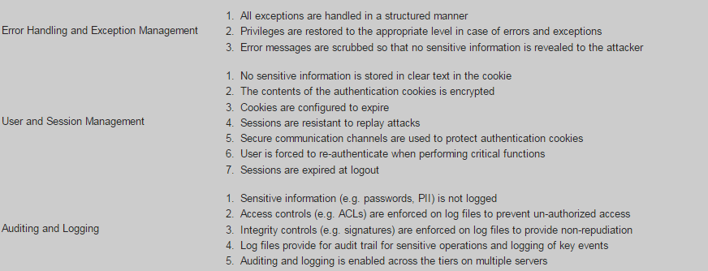

Slide 15
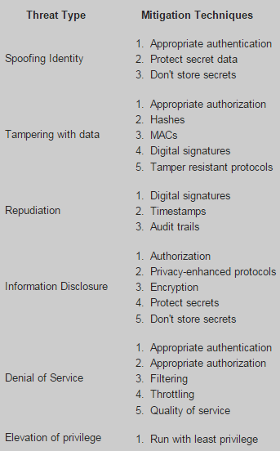
Threat & Mitigation Techniques List

Slide 16
Application Threat Modeling Example

